Slide 1

Groomer Operator Training Resource Guide
Chapter 2:
Grooming Equipment
Notes:
See pages 1-22 of manual

Slide 2
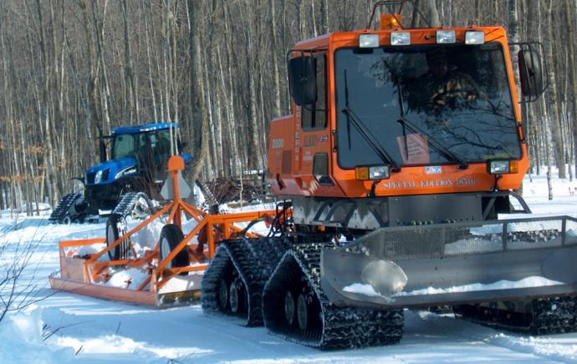
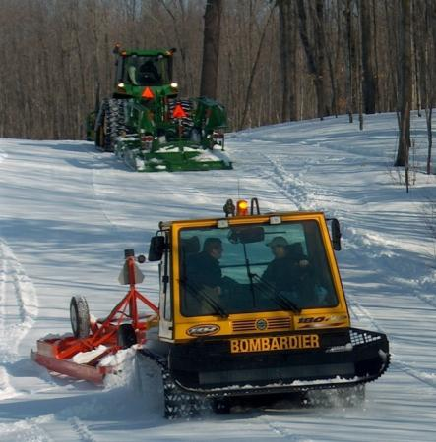
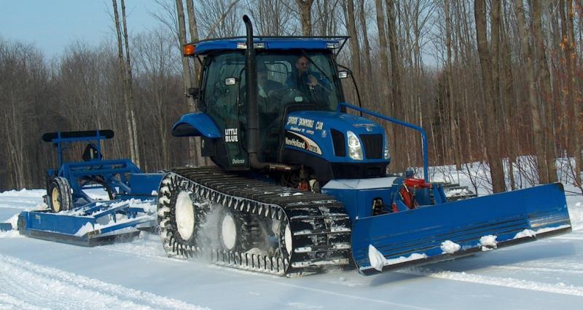
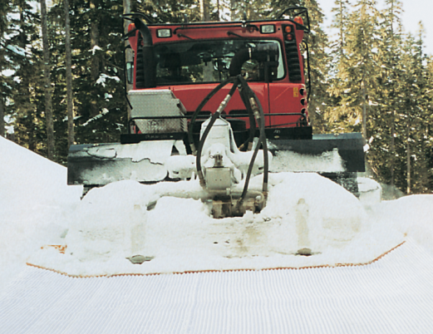
Select the Right Equipment for Your Area
Notes:
Purpose of Chapter 2 = to help you sort out what is the right equipment application for your area

Slide 3
The Right Equipment for Your Area?
The Power to pull the right size drag or to power a tiller.
Is a Front Blade needed?
Turning and Climbing ability while pulling.
Flotation in snow.
Width, Height and Weight limitations.
Equipment’s Maintenance needs and abilities of staff or volunteers.
Notes:
These are the questions one must consider to help make the right equipment choices

Slide 4
Overview of Grooming Equipment
Grooming Drags – multi-blade and single blade designs
Tillers
Compactor Bars
Grooming Tractors
Snowmobiles and ATVs

Slide 5
Grooming Drags
Play a very key role in successful trail grooming; can be the most important piece of the grooming equation.
Have a greater impact upon proper trail grooming than the tractor.
Single-blade and multi-blade designs: pros and cons.
Notes:
See page 23 of manual

Slide 6
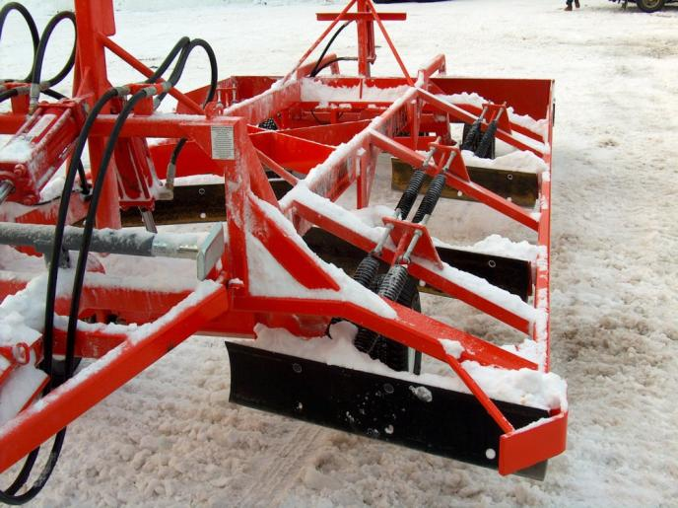
Multi-Blade Drags
2, 3, or more sets of cutting blades.
Superior performance for fully removing moguls and processing the snow.
Notes:
See page 24 of manual

Slide 7
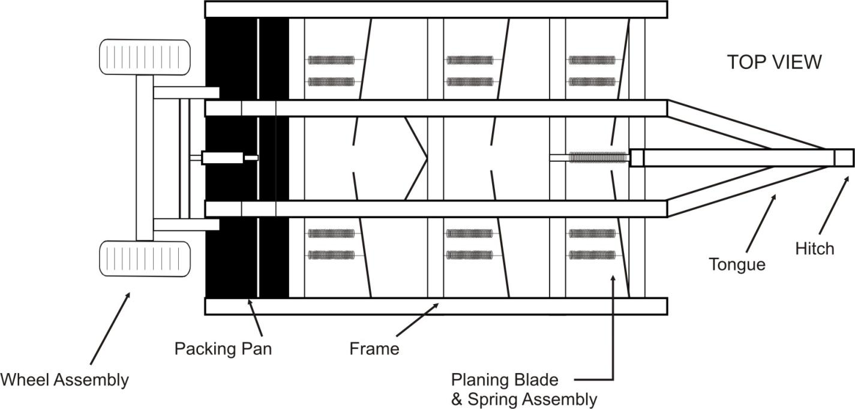
Typical Multi-Blade Drag Design: top view
Notes:
See page 24 of manual

Slide 8
Typical Multi-Blade Drag Design: cutting blades side view
Notes:
See page 25 of manual

Slide 9
Drag Width
Largely dictated by width of the trails to be groomed and by width of the tracks on the tractor pulling the drag.
Drag width should generally be at least as wide as the tractor’s track width.
Width will also be dictated by the narrowest clearing width on the overall trail system (between trees, gate, bridge, etc.).
Notes:
See pages 25-26 of manual

Slide 10
Drag Length
The longer the unit, the less tendency for it to follow the contour of the trail since it bridges from high spot to high spot, filling depressions, which leaves a smoother trail.
CONSTRAINT: too long can affect the ability to negotiate tight turns with the unit; sometimes short, fold-up drags can be beneficial for tight, twisty applications.
Notes:
See page 26 of manual

Slide 11
Drag Weight
Generally, the heavier the drag is, the better it is able to cut through moguls and compress snow after it has been processed.
BUT it should not be so heavy that it is not efficient to pull; don’t overburden the tractor with too large of a drag. Sometimes heavier drags also have more aggressive cutting blades – which also increases the burden on the tractor.
Notes:
See page 26 of manual

Slide 12
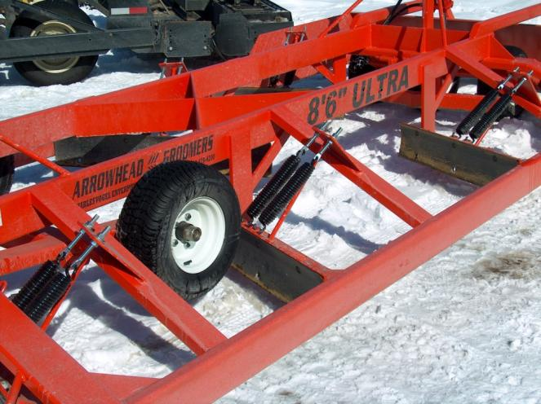
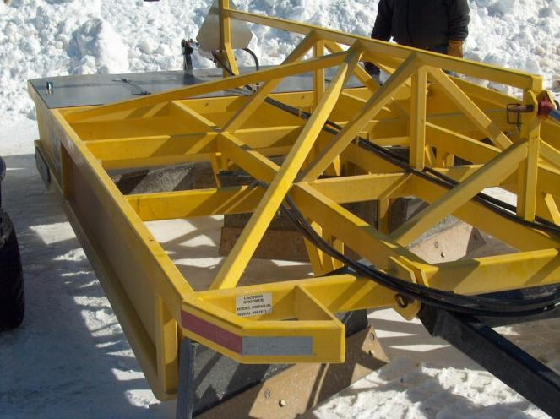
Typical Multi-Blade Drag Feature:
Frame & Blade Configurations
Notes:
See page 26 of manual

Slide 13
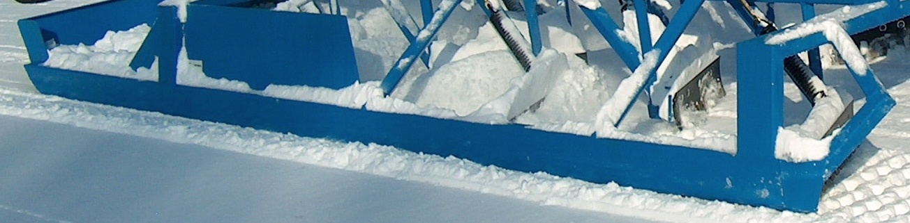
Typical Multi-Blade Drag Feature:
Side Rails
Outside edge of frame forms skid surfaces upon which the drag slides.
Also help keep snow contained within drag.
Notes:
See page 27 of manual

Slide 14
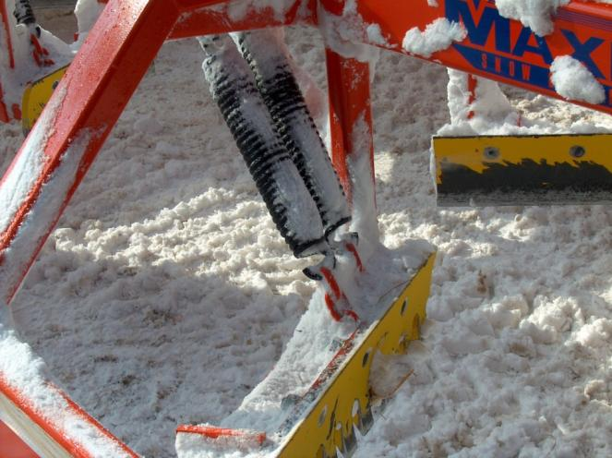
Typical Multi-Blade Drag Feature:
Spring Tripping Blades
While not all drags have blades that “trip” when the blade hits a rock or stump, it is a good feature that can help prevent equipment damage.
Notes:
See page 27 of manual

Slide 15
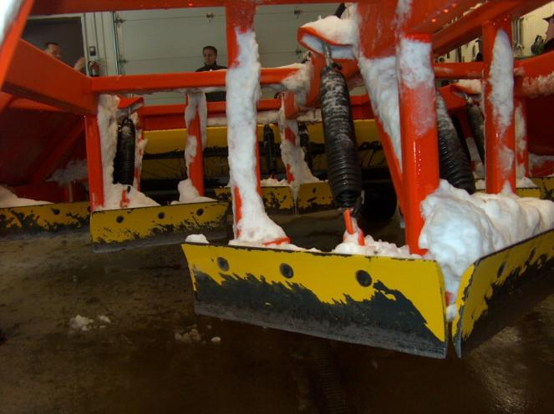
Typical Multi-Blade Drag Feature:
Cutting Blades
Should be slightly beveled so they cut into the mogul versus being straight up and down (which causes blade to skim over the top more than cut).
Notes:
See page 28 of manual

Slide 16
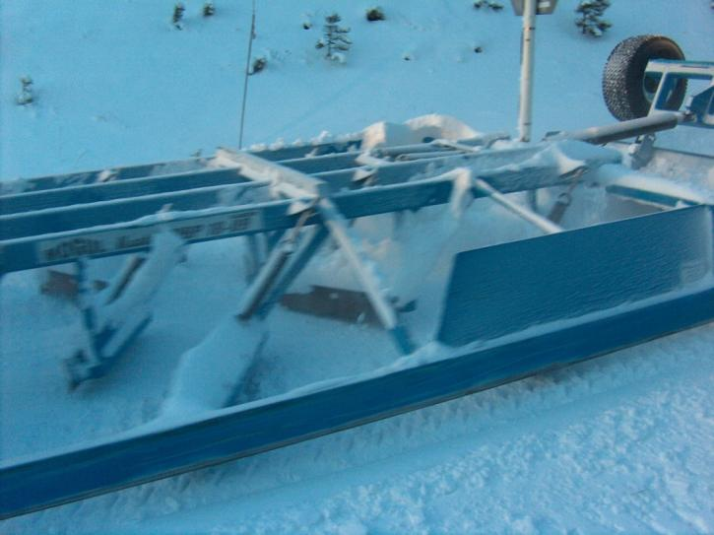
Typical Multi-Blade Drag Feature:
Cutting Blades
Typically mounted in a “stepped” manner where the front row is 5/8” below side rail and rear row is up to 3/4” below rail; this provides more cutting as frame is lowered.
Notes:
See page 28 of manual

Slide 17
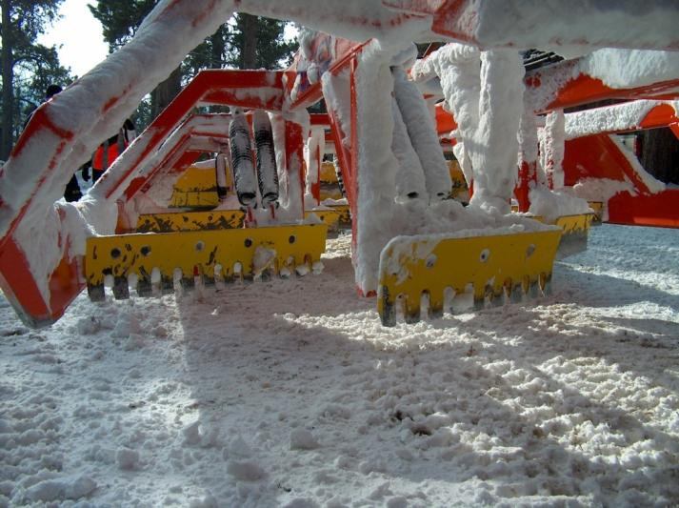
Typical Multi-Blade Drag Feature: Cutting Blades
Typically mounted in angled manner to transfer snow from outside of trail to center of trail where trail wear is often the greatest.
Serrated blades can help cut hard or icy trails.
Notes:
See page 28 of manual

Slide 18
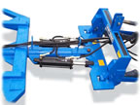
Typical Multi-Blade Drag Feature:
Tongue
Top: Pivoting Tongue hinged to move up and down, but not side to side – pintle or 5th wheel; hydraulics raise.
Bottom: Rigid Steer used behind farm tractors; steers hydraulically.
Notes:
See page 28 of manual

Slide 19
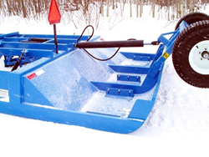
Typical Feature: Compactor Pan
Angled Front to catch and spread snow evenly across and under the pan.
Notes:
See page 29 of manual

Slide 20
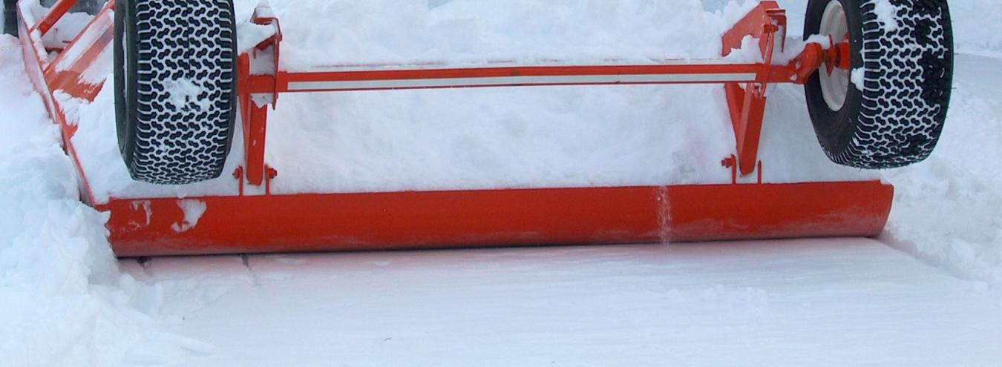
Typical Feature: Compactor Pan
Rear Radius Lip to aid “ramping up” when backing up in soft snow.
Notes:
See page 29 of manual

Slide 21
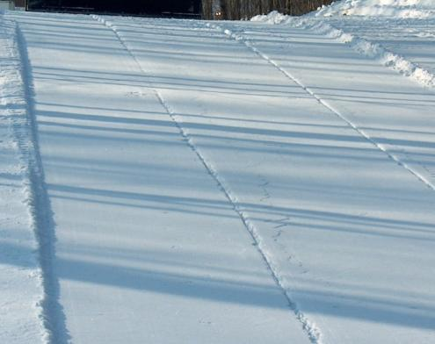
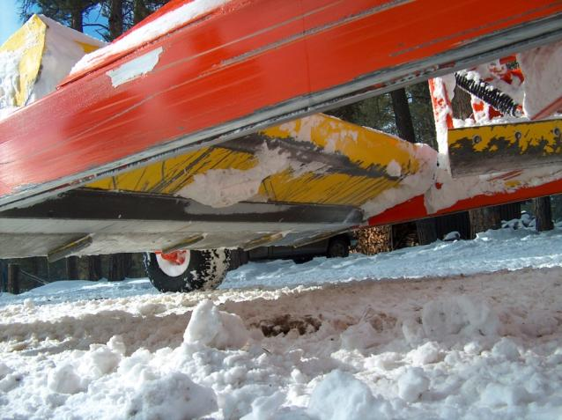
Typical Drag Feature:
Skegs
Hardened steel runners mounted on bottom of pan to reduce side hill slippage (some use a “pizza wheel” for this) and to help prevent premature wear on pan.
Skeg marks on trail
Skegs
Notes:
See page 29 of manual

Slide 22
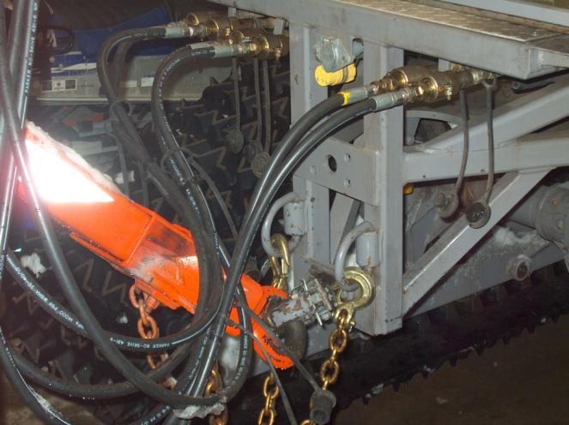
Typical Drag Feature:
Quick Release Features
Shear bolt in hitch (or a spring hitch) helps prevent major damage from hitting rocks and stumps.
Quick-release couplings help ensure hydraulic system isn’t torn out when shear bolt releases.
Notes:
See page 31 of manual

Slide 23
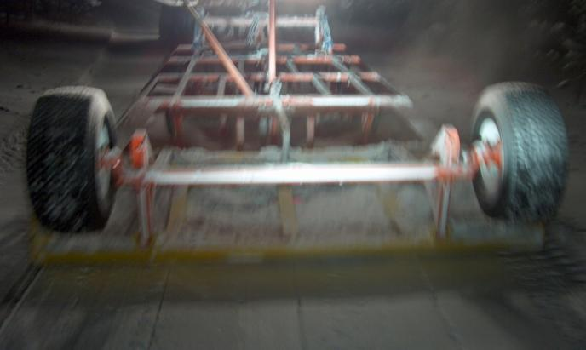
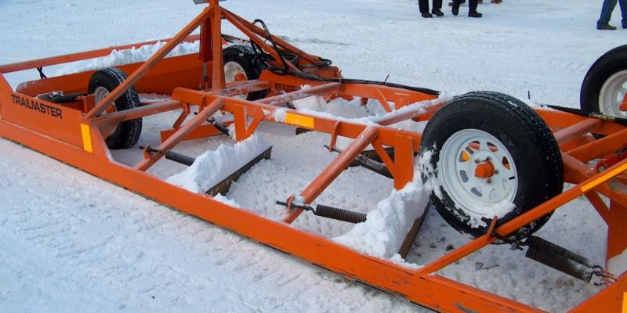
Typical Drag Feature: Wheel Assembly
Set of wheels mounted either at rear or within frame can be lowered hydraulically to raise drag frame off snow for crossing roads, backing, etc.
Notes:
See page 30 of manual

Slide 24
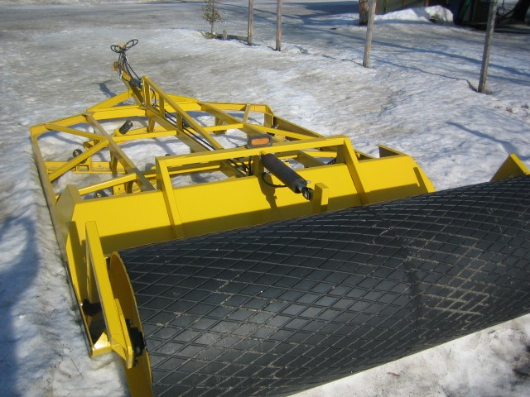
Special Drag Feature: Drum Roller
Some drags use a drum roller rather than wheels (either rear mounted or mounted within frame).
Also hydraulically raised and lowered.
Can aid compression and compaction.
Notes:
See page 31 of manual

Slide 25
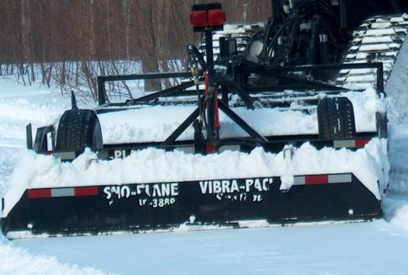
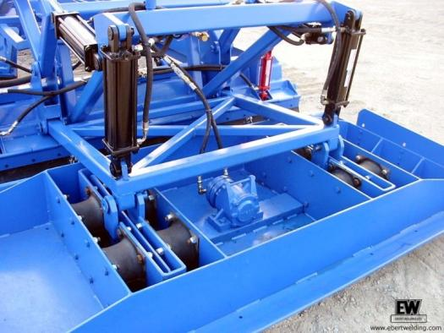
Special Drag Feature: Vibrating Pan
Some multi-blade drags hydraulically “vibrate” the rear pan in an attempt to increase compression and aid trail setup.
Requires a high-capacity hydraulic system like on a farm tractor.
Notes:
See page 30 of manual

Slide 26
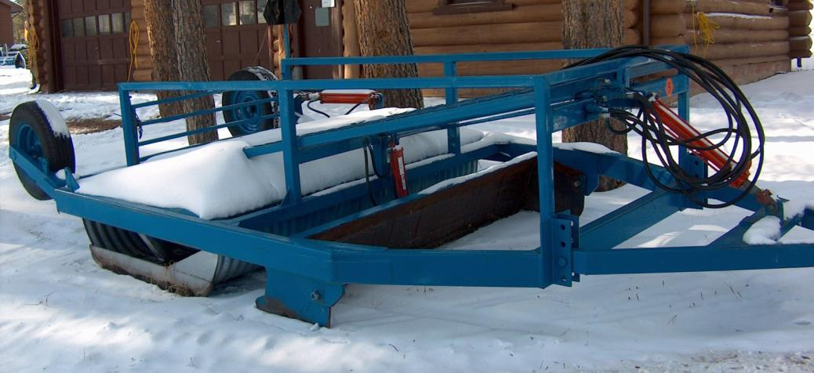
Single Blade Drags
Have one full-width cutting blade; carries snow so it can drop into depressions.
Less effective than multi-blade on heavy moguls; but can work well in deep snow areas and be easier to pull.
Notes:
See page 32 of manual

Slide 27
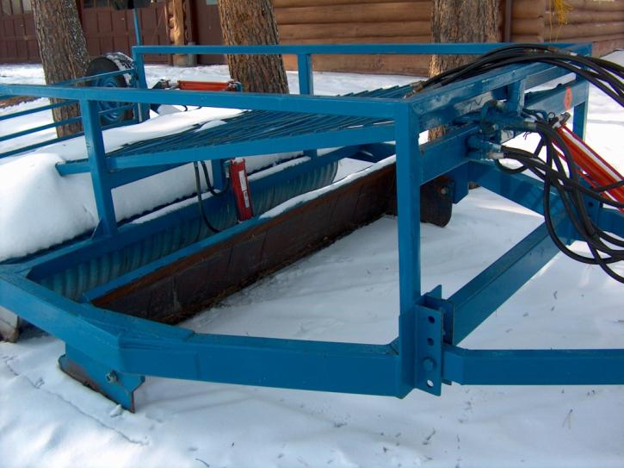
Single Blade Drags
Height of cutting blade regulated by hydraulic cylinder versus by the hitch.
Does not have side rails, so can spill snow out the side if cutting too deep; this can waste snow.
Notes:
See page 32 of manual

Slide 28
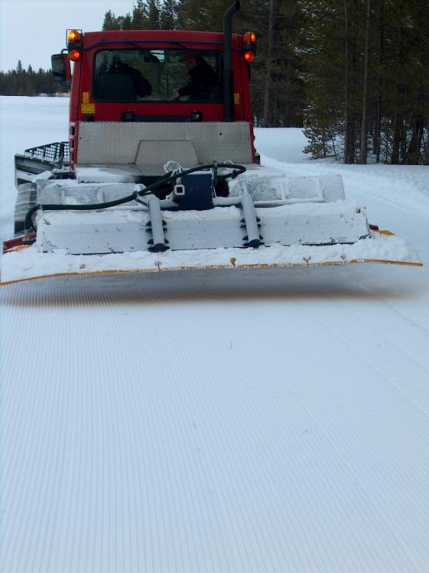
Tillers
Mounted on rear of tractor and driven hydrostatically.
Typically require deep snow.
Break up and mix old and new snow.
Notes:
See page 33 of manual

Slide 29
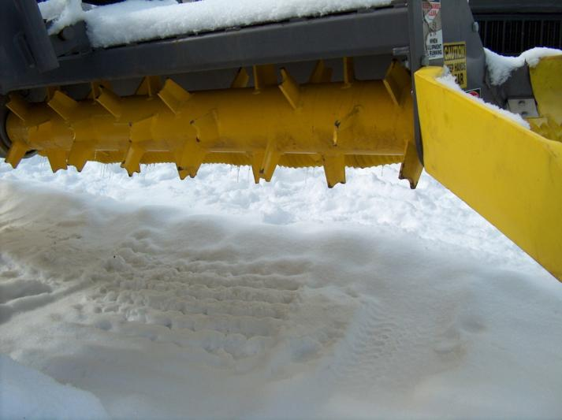
Tillers
Similar to a garden roto-tiller.
Consists of a rotating shaft (cutter bar) which has multiple tines that are typically 3 to 5 inches long and operates at a high RPM.
Notes:
See page 33 of manual

Slide 30
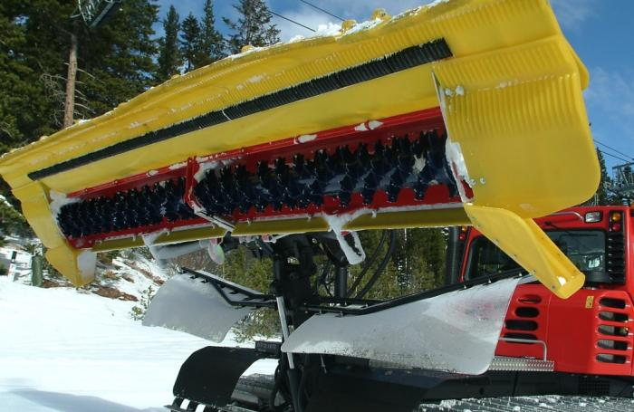
Tillers
Cutter bar operated at a high RPM conditions the snow and plastic comb “finishes” the snow surface.
Requires large tractor HP to operate.
Notes:
See page 33 of manual

Slide 31
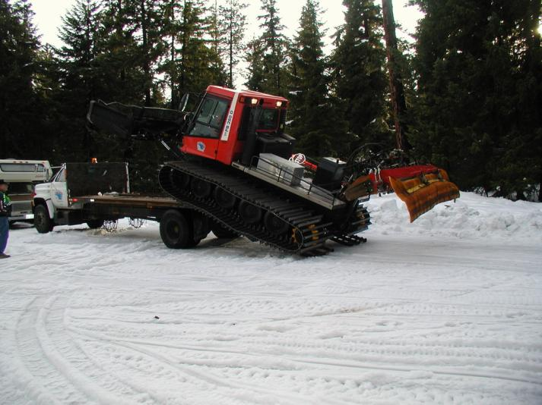
Tillers
Requires a front blade to help process snow.
BENEFITS: extreme portability, ease of backing, ease of turning around, ease of plowing drifts, easily stored, and easily hauled on a truck or trailer.
Notes:
See page 33 of manual

Slide 32
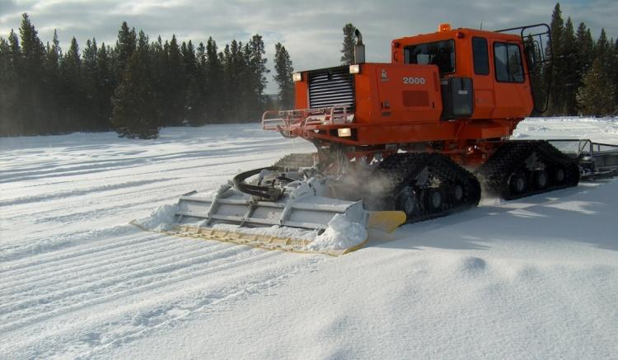
Tillers
Can work well in moist snow, but if there is dry powder snow, it may be hard to get snow trail to stay together; need good moisture for good results that will last.
Notes:
See page 33 of manual

Slide 33
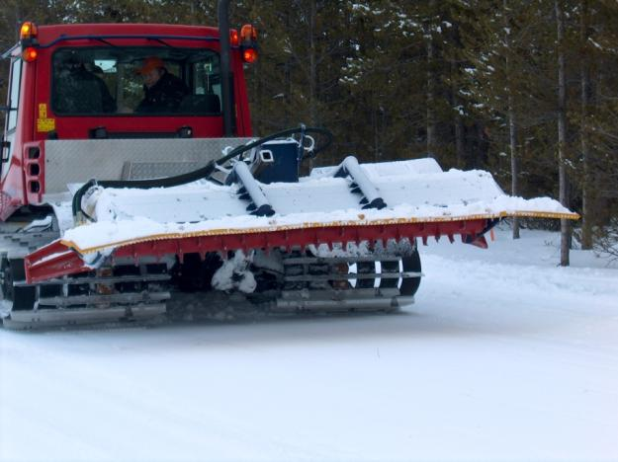
Tillers
If heavily moguled, may require multiple passes since tiller can only process to a maximum depth equal to tiller’s tine length.
Important to use front blade to cut moguls first.
Notes:
See page 34 of manual

Slide 34
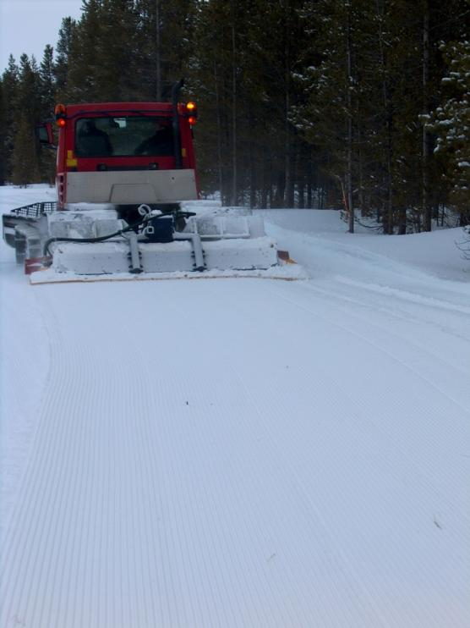
Tillers
It is easy to build a smooth trail, but not necessarily a level trail, since the unit will bob up and down, mirroring what the tracks of the tractor do; can also weave side-to-side.
Get better results on undulating trails.
Notes:
See page 34 of manual

Slide 35
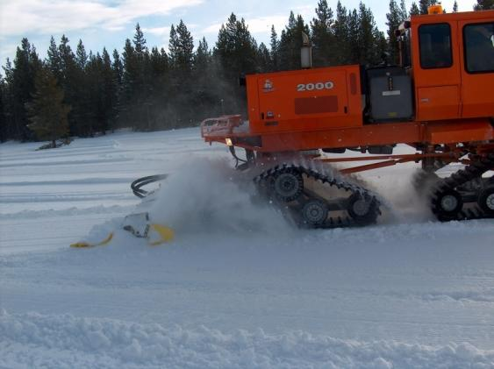
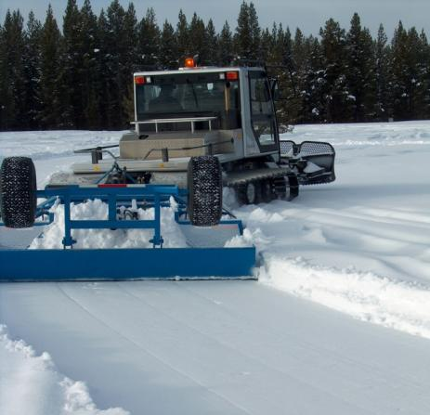
Tillers
Many areas also have a drag to supplement tiller grooming since it is rare that, season-long, conditions (weather, snowfall, moisture, and traffic) will consistently be favorable for using only a tiller.
Notes:
See page 34 of manual

Slide 36
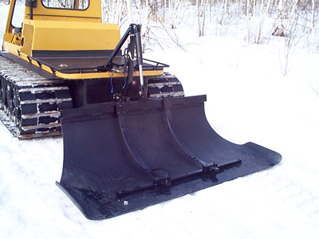
Compactor/Packer Bars
Simple, lightweight implement; short in length and attached to rear of the tractor.
Can be hydraulically lifted; some also have down pressure.
Can increase effectiveness and efficiency.
Notes:
See page 35 of manual

Slide 37
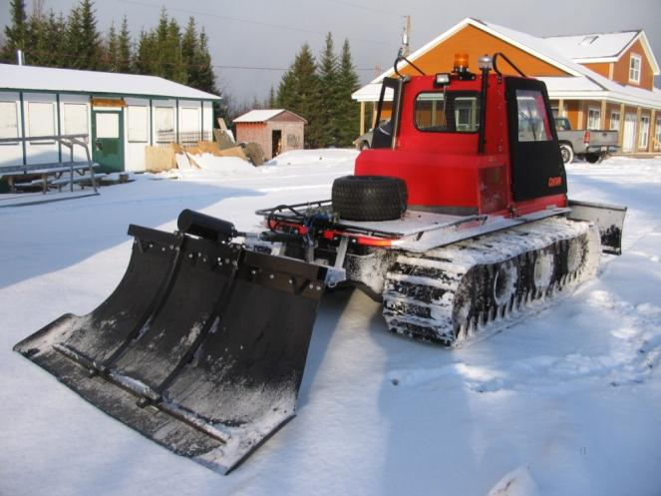
Compactor/Packer Bars
Can significantly reduce the time, effort, and cost of initial trail setup.
Saves wear and tear on tractor; provides increased tractor maneuverability.
Notes:
See page 35 of manual

Slide 38
Compactor/Packer Bars
Swampy Areas – can facilitate compaction that helps drive frost into ground and freeze swampy ground faster.
Can be used after exceptionally heavy snowfalls during the season or in areas of extreme drifting when a drag can be too much for a tractor to handle.
Is a better option than just “track packing” a trail route with just a tractor and no drag.
Notes:
See page 35 of manual

Slide 39
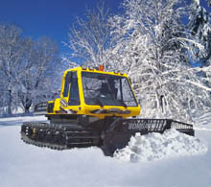
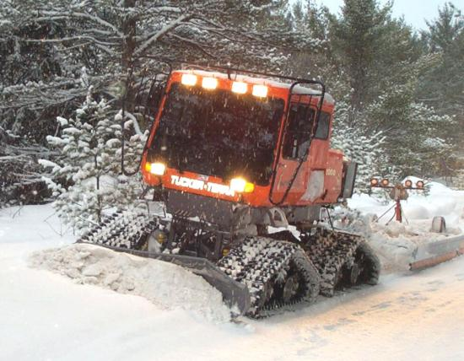
Grooming Tractors
Refers to a broad range of tracked and semi-tracked vehicles used to pull drags or carry tillers and compactor bars.
Also referred to as “prime movers.”
Notes:
See page 36 of manual

Slide 40
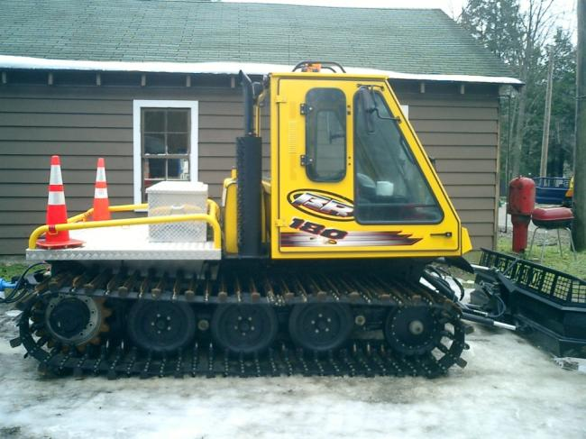
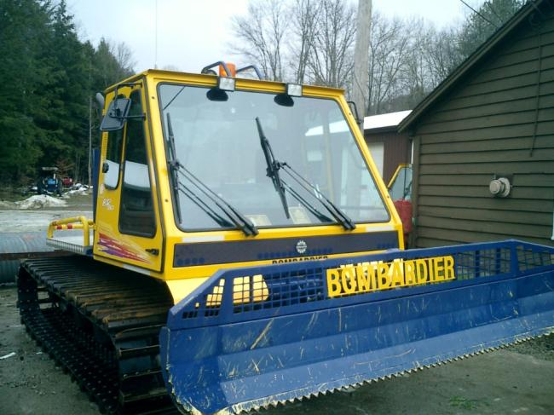
Grooming Tractor:
Typical Components
Exhaust Stack
Cab
Amber Beacon
Fuel Tank
Deck
Track Assembly
Blade

Slide 41
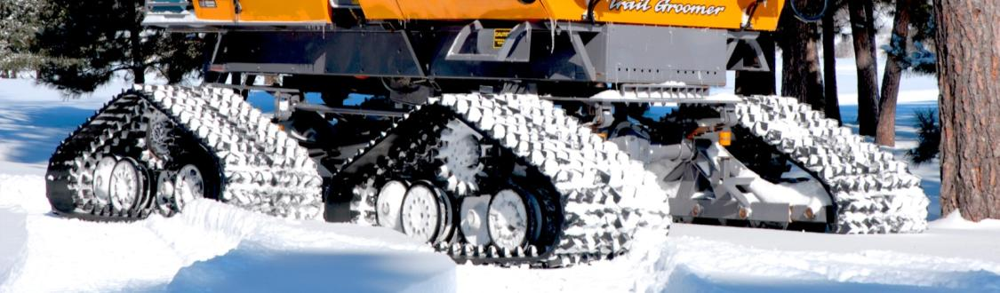
Typical Tractor Component: Tracks
Provide the “floatation” that helps the tractor stay on or near the surface of snow while providing traction to pull or carry implements.
Notes:
See pages 37-38 of manual

Slide 42
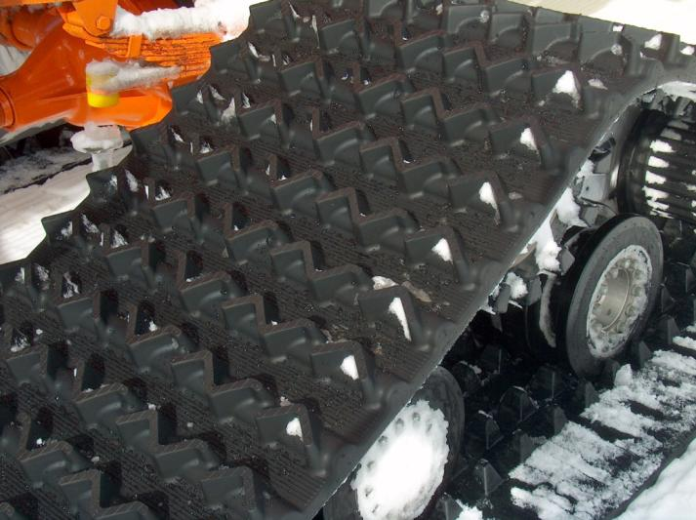
Typical Tractor Component: Tracks
Many newer tractors have all-rubber tracks which allows operation in all types of terrain without damage to tracks; can run on roads, mud, and snow; also less vibration, operator fatigue, and maintenance costs.
Notes:
See pages 37-38 of manual

Slide 43
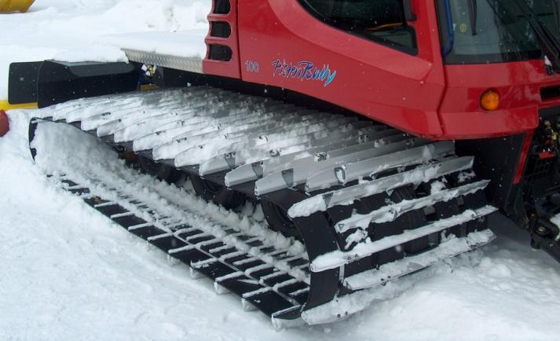
Typical Tractor Component: Tracks
Some tractors are cleated with a straight steel or aluminum bar. This requires that the vehicle be operated in deep snow to avoid damage to tracks; ice picks or grousers are often added to prevent side slippage or spinout on hills.
Notes:
See pages 37-38 of manual

Slide 44
Typical Tractor Component: Steering
2-Tracks: some by individual braking of tracks, others by individually controlling track speed using a hydrostatic drive.
4-Tracks: most articulate (front set turns right while the rear set turns left).
Farm Tractor Conversions: typically use drag as a steering rudder or braking of one wheel/track.
Notes:
See page 38 of manual

Slide 45
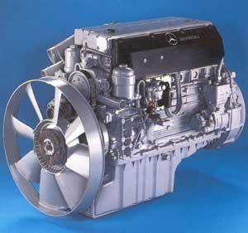
Typical Tractor Component: Engine
Motor power for the tractor is provided by a large diesel or gasoline industrial engine.
Location of the engine is important when determining the vehicle’s Center of Gravity since it is typically very heavy.
Notes:
See page 38 of manual

Slide 46
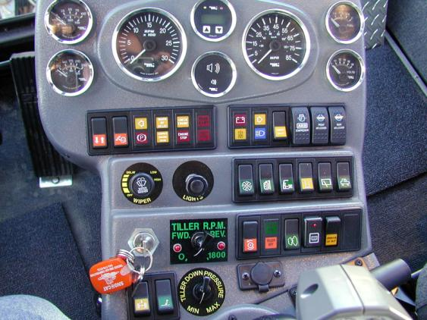
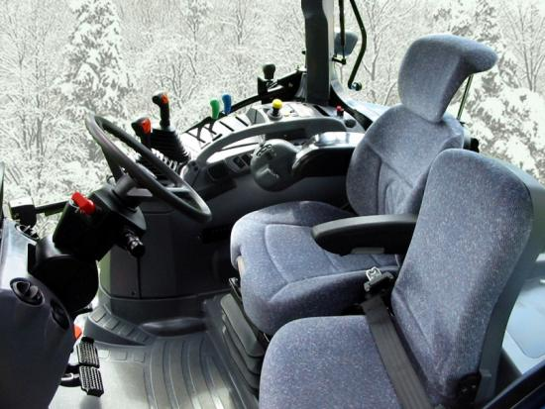
Typical Tractor Component: Cab
Most tractors have complex instruments for operating the tractor and implements.
Operators must familiarize themselves with all controls: READ THE MANUAL!
Notes:
See page 38 of manual

Slide 47
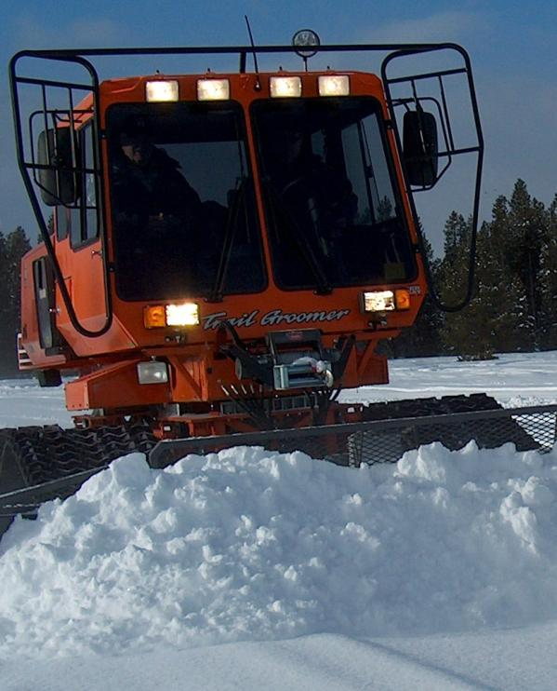
Typical Tractor Component: Front Blade
Useful to: knock down snow banks and drifts; fill in depressions and holes; keep road crossings and driveways clear; doze hillsides; pull snow into trail; process snow when tilling.
Takes lots of practice to be good at using a blade – so always be careful.
Notes:
See page 39 of manual

Slide 48
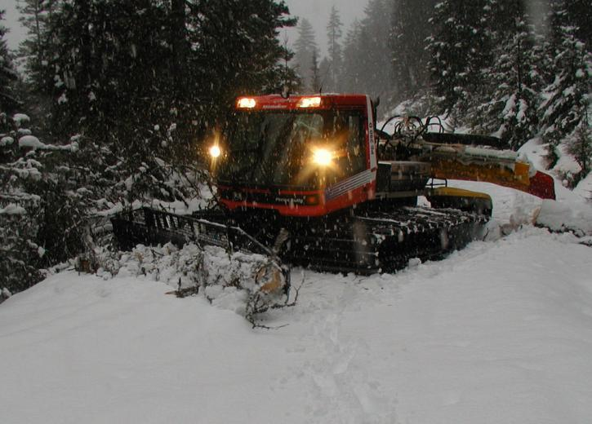
Typical Tractor Component: Front Blade
NOT A BULLDOZER!
Front blades on grooming tractors should not be used for pushing large rocks, stumps, or large uncut trees since this can severely damage the unit.
Notes:
See page 39 of manual

Slide 49
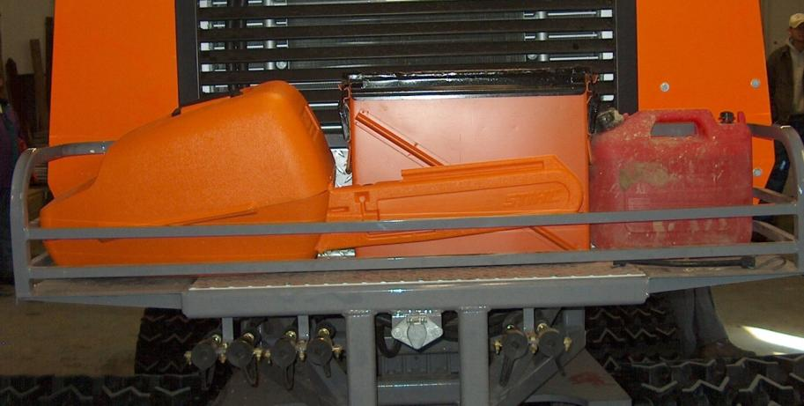
Typical Tractor Component: Cargo Deck
Can use to carry tools, shovel, chain saw, spare fuel, trail signs, and other cargo.
CAUTION: overloading cargo area can affect a vehicle’s weight, flotation, and center of gravity.
Notes:
See page 39 of manual

Slide 50
Characteristics of Grooming Tractors: GROUND PRESSURE
The technical measure of a vehicle’s ability to distribute its weight out over its tracks (or wheels on farm tractors used as groomers).
Must be able to stay on or near the surface rather than sink in and plow through snow.
Should not exceed 0.8 to 1.2 psi (divide vehicle weight by the total area of tracks {or wheels} in contact with the snow to determine psi).
Notes:
See page 40 of manual

Slide 51
Characteristics of Grooming Tractors: GROUND PRESSURE
If too high, vehicle will sink into snow rather than stay on top.
If too low, the unit may not have sufficient traction to pull a drag up hills or through deep, heavy snow.
Notes:
See page 40 of manual

Slide 52
Characteristics of Grooming Tractors: OVERALL WEIGHT
Within reasonable limits, the overall weight of the tractor can be compensated for by matching with the appropriate track area.
Weight is a limiting factor in terms of bridge load limits and crossing frozen water.
Recommendation: Never operate groomers (because they’re heavy) over ice without special planning, testing, training, and equipment.
Notes:
See page 40 of manual

Slide 53
Characteristics of Grooming Tractors:
HORSEPOWER & TORQUE
Key measurements of a tractor’s capability are its horsepower (HP) and torque.
“Gross Brake HP” is a good unit for comparing the relative power of engines.
TORQUE: ability of tractor to get a heavy load moving from a dead stop; multi-blade drags require a high degree of engine torque to get them moving.
Notes:
See page 40 of manual

Slide 54
Characteristics of Grooming Tractors: CENTER OF GRAVITY
The point around which a tractor’s weight is evenly balanced.
It is significant any time the vehicle must operate on a non-level surface: climbing and descending steep grades and side hilling.
The lower to the ground the center of gravity, the more stable the vehicle will be.
Notes:
See page 41 of manual

Slide 55

Center of Gravity for a
Typical 2-Track Grooming Tractor
Notes:
See page 41 of manual

Slide 56
Characteristics of Grooming Tractors: TRACTIVE EFFORT and COEFFICIENT OF FRICTION
Tractive Effort: amount of torque that can be applied to a track before it loses traction and spins without moving forward.
Coefficient of Friction between track and ground or snow is the limiting factor of when tracks will lose traction.
Notes:
See page 41 of manual

Slide 57
Characteristics of Grooming Tractors:
COEFFICIENT OF FRICTION
Coefficient of Friction is determined by overall vehicle weight, amount of track on ground, cross-link design of track, and weight distribution along the length of track that’s in contact with the surface.
Ideal Weight Distribution: having balance point at or near the center of the track’s length.
Notes:
See page 41 of manual

Slide 58
Characteristics of Grooming Tractors: TRACTIVE EFFORT and COEFFICIENT OF FRICTION
When a track breaks traction, it’s actually shearing the snow through force the cross-links are placing on the snow.
Fresh, unpacked snow shears much more readily than hard packed snow.
When a tractor breaks traction, spins out, and gets stuck, it is because the force required to shear snow is less than the force required to pull the combined load of the drag and tractor.
Notes:
See page 41 of manual

Slide 59

Snowmobiles and ATVs as
Grooming Tractors
Often used where width is too narrow for a large tractor or funding is too low to buy a tractor.
Key to Success: frequent repetitions to compensate for cutting and compression limitations of the small drag.
Notes:
See page 42 of manual

Slide 60

Snowmobiles and ATVs as
Grooming Tractors
Drag is typically controlled by an electric-hydraulic switch operated from seat of sled or ATV.
Notes:
See page 42 of manual

Slide 61

Snowmobiles and ATVs as
Grooming Tractors
Since operator is out in the elements, extra safety precautions are needed: extra dry clothing, tow rope, shovel, spare drive belt, and dependable communication.
Notes:
See page 42 of manual

Slide 62
Snowmobiles and ATVs as
Grooming Tractors
All other grooming and safety principles apply – just on a smaller scale.
Notes:
See page 42 of manual

Slide 63
Chapter 2 Quiz
Grooming implements include:
a) drags and planers
b) tractors
c) tillers and compactor bars
d) a and c above
e) a, b, and c above
Notes:
d) a and c above

Slide 64
Chapter 2 Quiz
Grooming implements include:
a) drags and planers
b) tractors
c) tillers and compactor bars
d) a and c above
e) a, b, and c above
Notes:
d) a and c above

Slide 65
Chapter 2 Quiz
The purpose of the front blade on a grooming tractor is to clear rocks, stumps, and downed trees from the trail to make it safe. True or False
The primary purpose of a grooming tractor is to provide the power to pull a grooming implement like a drag, power a tiller, or to carry a compactor bar across the top of the snow. True or False
Notes:
2. False, 3. True

Slide 66
Chapter 2 Quiz
The purpose of the front blade on a grooming tractor is to clear rocks, stumps, and downed trees from the trail to make it safe. False
The primary purpose of a grooming tractor is to provide the power to pull a grooming implement like a drag, power a tiller, or to carry a compactor bar across the top of the snow. True
Notes:
2. False, 3. True

Slide 67
Chapter 2 Quiz
The tractor is the most important piece of the grooming equation and has a greater impact on proper trail grooming than does a drag or tiller used behind the tractor. True or False
Notes:
4. False

Slide 68
Chapter 2 Quiz
The tractor is the most important piece of the grooming equation and has a greater impact on proper trail grooming than does a drag or tiller used behind the tractor. False
Notes:
4. False

Slide 69
Chapter 2 Quiz
If you were to use only one grooming implement to build a trail that is both smooth and level, it in most cases would be a:
a) tiller
b) multi-blade drag
c) compactor bar
d) single blade drag
e) front blade
Notes:
b) multi-blade drag

Slide 70
Chapter 2 Quiz
If you were to use only one grooming implement to build a trail that is both smooth and level, it in most cases would be a:
a) tiller
b) multi-blade drag
c) compactor bar
d) single blade drag
e) front blade
Notes:
b) multi-blade drag

Slide 71
Chapter 2 Quiz
A very simple, lightweight implement that is very maneuverable and useful for initial trail setup early in the season or for after deep snow events is a:
a) tiller
b) multi-blade drag
c) compactor bar
d) single blade drag
e) front blade
Notes:
c) compactor bar

Slide 72
Chapter 2 Quiz
A very simple, lightweight implement that is very maneuverable and useful for initial trail setup early in the season or for after deep snow events is a:
a) tiller
b) multi-blade drag
c) compactor bar
d) single blade drag
e) front blade
Notes:
c) compactor bar

Slide 73
Chapter 2 Quiz
Overloading the cargo area on a grooming tractor can impact the vehicle’s weight, flotation, and center of gravity. True or False
Too low of a ground pressure can cause a grooming tractor to sink into snow rather than stay on top of the snow.
True or False
Notes:
7. True, 8. False

Slide 74
Chapter 2 Quiz
Overloading the cargo area on a grooming tractor can impact the vehicle’s weight, flotation, and center of gravity. True
Too low of a ground pressure can cause a grooming tractor to sink into snow rather than stay on top of the snow.
False
Notes:
7. True, 8. False

Slide 75
Chapter 2 Quiz
The frame of a drag must be rigid and square to prevent it from cutting or compacting unevenly. True or False
The cutting blades on a multi-blade drag are typically mounted in a “stepped” position, downward from front to rear.
True or False
Notes:
9. True, 10. True

Slide 76
Chapter 2 Quiz
The frame of a drag must be rigid and square to prevent it from cutting or compacting unevenly. True
The cutting blades on a multi-blade drag are typically mounted in a “stepped” position, downward from front to rear.
True
Notes:
9. True, 10. True

Slide 77
Chapter 2 Quiz
The maximum width of a grooming implement like a drag or tiller is:
a) dictated by the maximum width of the trails to be groomed
b) dictated by the width and power of tractor
c) not important
d) generally narrower than the tractor
e) a and b above
f) none of the above
Notes:
e) a and b above

Slide 78
Chapter 2 Quiz
The maximum width of a grooming implement like a drag or tiller is:
a) dictated by the maximum width of the trails to be groomed
b) dictated by the width and power of tractor
c) not important
d) generally narrower than the tractor
e) a and b above
f) none of the above
Notes:
e) a and b above

Slide 79
Chapter 2 Quiz
The tracks on a grooming tractor must be large enough to keep it on or near the surface of snow. True or False
A tractor with a high center of gravity will be stable and safe to operate on steep hillsides.
True or False
Notes:
12. True, 13. False

Slide 80
Chapter 2 Quiz
The tracks on a grooming tractor must be large enough to keep it on or near the surface of snow. True
A tractor with a high center of gravity will be stable and safe to operate on steep hillsides.
False
Notes:
12. True, 13. False

Slide 81
Chapter 2 Quiz
When a tractor breaks traction, spins out, and gets stuck, it happens because the force required to shear the snow is less than the force required to pull the load. True or False
Notes:
14.True

Slide 82
Chapter 2 Quiz
When a tractor breaks traction, spins out, and gets stuck, it happens because the force required to shear the snow is less than the force required to pull the load. True
Notes:
14.True

Slide 83
Chapter 2 Quiz
The overall weight of a grooming tractor is:
a) unimportant
b) can be compensated for by track area
c) can cause problems when crossing bridges and ice
d) b and c above
e) none of the above
Notes:
d) b and c above

Slide 84
Chapter 2 Quiz
The overall weight of a grooming tractor is:
a) unimportant
b) can be compensated for by track area
c) can cause problems when crossing bridges and ice
d) b and c above
e) none of the above
Notes:
d) b and c above

Slide 85
Chapter 2 – Training Program Photo & Illustration Credits
Bombardier
Don Reed
Ebert Welding
Jerry Burr
JRJ Design
Kim Raap – Trails Work Consulting
Maine Department of Conservation
New Hampshire Bureau of Trails
New York State Office of Parks, Recreation & Historic Preservation
Pisten Bully
The Shop Industrial
Track, Inc.
Tucker Sno-Cat
Project Manager
Kim Raap – Trails Work Consulting
4015 S. Brady Court – Sioux Falls, SD 57103
(605) 371-9799 Trailswork@aol.com
Contact IASA at www.snowiasa.org

Slide 86
ACKNOWLEDGEMENT & DISCLAIMER
This series of Power Point training slides has been produced to accompany Chapters 1 – 6 of Guidelines for Snowmobile Trail Groomer Operator Training – A Resource Guide for Trail Grooming Managers and Equipment Operators which was produced by the International Association of Snowmobile Administrators (IASA) in 2005. This project has been produced by IASA, with financial assistance from the Recreational Trails Program administered by the U.S. Federal Highway Administration (FHWA), to aid local operator training.
This training program is disseminated under the sponsorship of the Department of Transportation in the interest of information exchange. The United States Government assumes no liability for the contents or use thereof. The contents of this program do not constitute a standard, specification, or regulation.
Special recognition is given to the many agencies, companies, and individuals whose photos have been used for demonstration purposes in this project. Sponsors of this project do not endorse products or manufacturers. Trade and manufacturer’s names appear in this training program only because they are considered essential to the object of these training slides.
Copyright © 2007 Owned by the International Association of Snowmobile Administrators.
All Rights Reserved.

