Slide 1

Groomer Operator Training Resource Guide
Chapter 3:
Managing Grooming
Operations, Equipment,
and Safety
Notes:
See pages 1-22 of manual

Slide 2
Grooming Operations
Understanding the “big picture” helps facilitate a better, more effective grooming operation.
Successful grooming programs require a great deal of planning and management.
Having a “Grooming Manager” is a key to success.
Notes:
See page 45 of manual

Slide 3
Establishing Grooming Priorities: Factors to Consider
Base of operations.
Snowmobile use and traffic patterns.
Locations of parking areas and services.
How many groomers available for how many miles/kilometers of trail.
Budget available for season’s length.
Cost to groom one mile/km of trail once.
Notes:
See page 46 of manual

Slide 4
Operator Selection
Good equipment is not a substitute for poor operators.
Operators should have ability to operate heavy equipment and have a fairly high degree of mechanical aptitude since on-trail repairs and adjustments are inevitable.
Must be able to work alone in remote areas and at odd hours, nights, and weekends.
Notes:
See page 47 of manual

Slide 5
Operator Training
Operators should be thoroughly instructed and tested on:
Operating features of equipment.
Grooming principles and procedures.
Maintenance schedules.
Safe operating procedures.
Notes:
See page 47 of manual

Slide 6
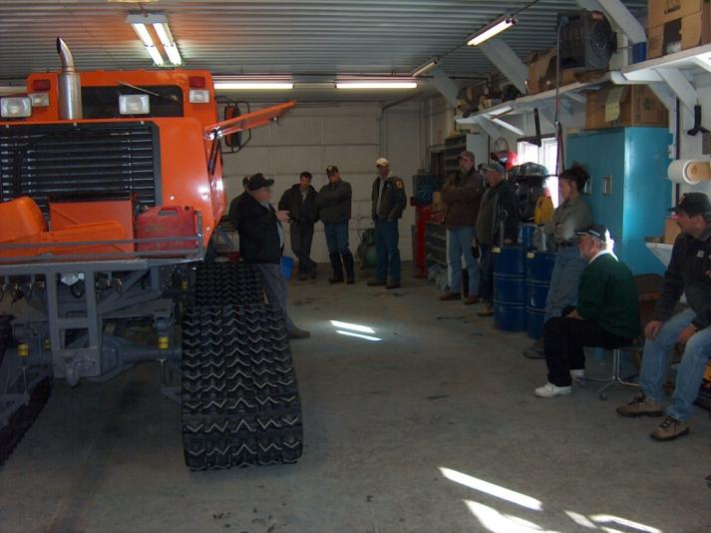
Operator Training
Checklist should be used to deliver effective and consistent operator training.
Training should include “hands-on” time.
Notes:
See page 47 and Appendix (checklist) of manual

Slide 7
Operator Safety
Always wear seat belts with shoulder straps – operators and passengers can be launched into the windshield if vehicle hits fixed objects like rocks and stumps, which can cause a very abrupt, dangerous stop.
Notes:
See page 48 of manual

Slide 8
Operator Safety
Be visible to snowmobilers – always use reflective surfaces on equipment and operate with front and rear lights and top-mounted amber beacon or strobe light “ON” at all times – day or night.
Also operate a Communicator Radio Beacon in the tractor at all times.
Notes:
See page 48 of manual

Slide 9
Operator Safety
Be prepared for trouble – grooming equipment WILL malfunction, break and get stuck, so contemplate all potential problems. Have emergency procedures in place and carry tools, spare parts, supplies, first aid kits, GPS, etc.
Notes:
See page 48 of manual

Slide 10
Essential Tools to Always Carry
Axe
Chainsaw
Jack
Snow Shovel
Chain/Tow Strap
Come-Along or Winch
Rope
Flashlight
Notes:
See page 48 of manual

Slide 11
Safety/Emergency Equipment to Also Consider Carrying in Groomer
First Aid Kit
Foil Blanket
Flares
Spare Clothing
Towels
Hand Cleaner
Oil
Sledge Hammer
Spare Batteries
Weatherproof Matches
Hydraulic Hoses/Fittings
Tools
Snow Scraper
Hi-Lift Jack
Notes:
See page 48 of manual

Slide 12
Safety/Emergency Equipment to Also Consider Carrying in Groomer
Extra Fuel
Orange Spray Paint
Fire Extinguisher
Chains
Pry Bar
Paper
Plate for Jack
Tree Strap
Stakes
Butane Torch/Heater
At least 4 – 14” High-Visibility Traffic Cones
High Energy Food
Drinking Water
Notes:
See pages 48-49 of manual

Slide 13
Operator Safety
Avoid grooming across ice – many jurisdictions prohibit ice crossings.
If necessary, establish procedures to test and monitor ice thickness and quality. Also consider installing an escape hatch (sun roof) for emergency operator exit in the event tractor falls through the ice.
Notes:
See page 49 of manual

Slide 14
Operator Safety
Stay in communication – always carry a 2-way radio, cell phone, or satellite phone that works in the area.
Work the plan – file a Trip Plan with route and scheduled check-in times; if an emergency occurs or contact is lost – all should stick to the plan and work it.
Notes:
See page 49 of manual

Slide 15
Operator Safety
Carry extra signs for replacement – replacing missing signs (particularly safety and regulatory signs) helps ensure route will be safe for riders, as well as the groomer the next time it must pass through that area.
Groomer operator is often the most familiar with the trail’s signs, so carry extra signs, stakes, and fasteners for timely replacement of anything that is missing.
Notes:
See page 49 of manual

Slide 16
Operator Safety
Routine preventative maintenance – the importance of effective Preventative Maintenance to safety should not be underestimated.
Well maintained equipment is far less likely to injure an operator or strand an operator in a dangerous situation.
Notes:
See page 49 of manual

Slide 17
Operator Safety
Check equipment PRIOR to departure – Check: fuel and fluid levels; the tracks; hydraulic lines; for cracked or broken parts; the flashlight, tool, and emergency kits; and for adequate spare clothing in case the heater or tractor quit.
DO NOT LEAVE unless everything checks out OK and is in place.
Notes:
See page 49 of manual

Slide 18
Stopping on the Trail:
PLANNED STOPS
Operator has full control over where and when the stop is made; the groomer is parked well off the main trail.
Typically done off-trail where you know terrain is safe and snow is compacted well enough to support tractor: along open straight-aways, intersections, parking lots, etc.
Notes:
See page 50 of manual

Slide 19
Stopping on the Trail:
UNPLANNED FULL STOPS
Use best judgment and extreme caution
Sleds approaching groomer from front,
Informational stop by snowmobiler,
Repairs to trail or removing blow-down,
Mechanical failure of groomer or stuck on trail,
Assistance to disabled snowmobiler,
Crash related stop.
Notes:
See pages 50-52 of manual

Slide 20
Snowmobiles Approaching Groomer from Front
When on a narrow trail – move groomer to far right side of trail as quickly as possible and stop.
After checking to see that no traffic is coming from opposite direction – signal to riders to proceed past the groomer.
Notes:
See page 50 of manual

Slide 21
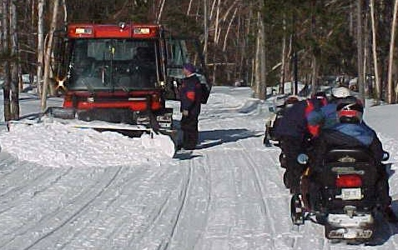
Informational Stop by Snowmobiler in Unsafe Area
Tell snowmobiler it is not a safe location to stop.
Request them to follow you down the trail to a safer location where you’ll answer their questions.
Notes:
See page 51 of manual

Slide 22
Stops for Repairs to Trail or Removing Blow-Downs
If you anticipate the time needed to make repair or remove obstacle will be relatively short – make sure all warning lights are turned on, quickly make the corrections, and get back underway as soon as possible.
Notes:
See page 51 of manual

Slide 23

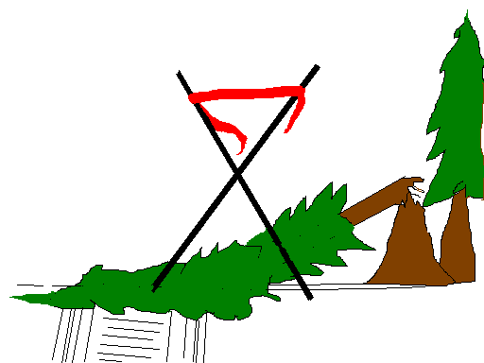
Stops for Repairs to Trail or Removing Blow-Downs
If the stop is anticipated to take a longer period of time, place warning devices on trail to warn riders of the groomer’s presence.
Notes:
See page 51 of manual

Slide 24
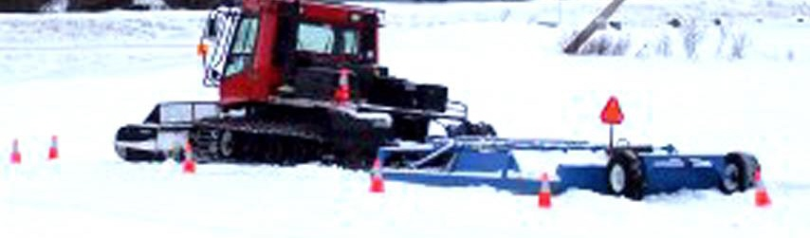
Mechanical Failure of Groomer or Stuck on the Trail
If the groomer becomes disabled or stuck on the trail and cannot be moved – take action quickly by placing warning devices in the front and rear of the groomer.
Notes:
See page 51 of manual

Slide 25
Assistance to Disabled Snowmobile
If you anticipate there will be a need to be in the location for an extended time – park the groomer as far right on trail as possible and also place warning devices.
If communications are available – call for assistance for snowmobiler and get back underway again ASAP.
Notes:
See page 51 of manual

Slide 26
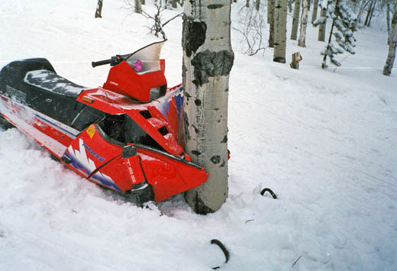
Crash Related Stop
If you come upon the site of any crash – presume it is most likely an “unsafe site.”
DO NOT proceed until the site is made safe!
Notes:
See page 52 of manual

Slide 27
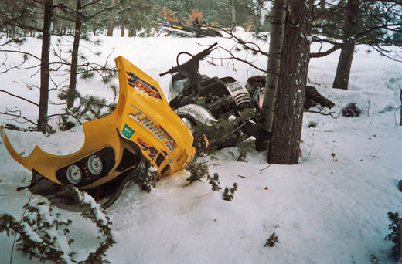
Crash Related Stop
First, park groomer as far to right as possible and place warning devices.
Secure the site and assess situation for any injuries.
Notes:
See page 52 of manual

Slide 28
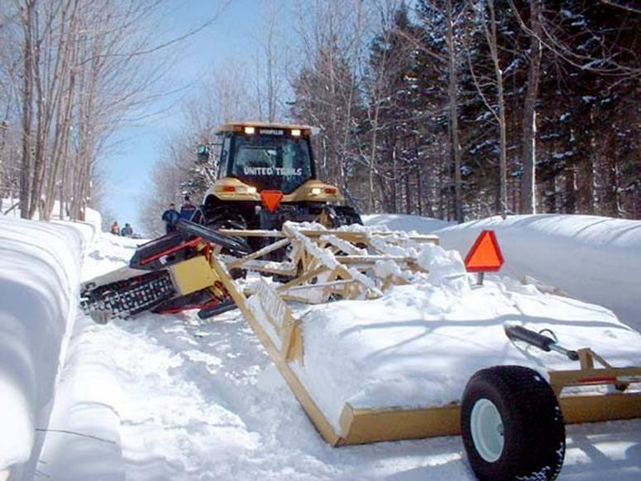
Crash Related Stop
If the accident is because a snowmobile collided with the groomer – do not move the equipment, just secure the scene.
Notes:
See page 52 of manual

Slide 29
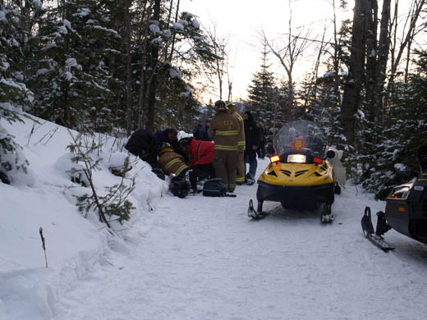
Crash Related Stop
Assess the situation to determine if current resources at the scene are sufficient to handle the emergency.
If “yes” – offer any
assistance you can give
and stay at site until the
trail has been cleared.
Notes:
See page 52 of manual

Slide 30
Crash Related Stop – If situation is not being handled, take control and:
Call dispatch, 911, or send someone for help;
State problem or situation;
Give the number of injured, if any;
Give the location, trail number, or trail name;
If known, state best way for rescue to arrive;
Stay calm and do not talk too much;
Don’t move injured, but protect all victims at scene and keep them warm;
Notes:
See page 52 of manual

Slide 31
Crash Related Stop – If situation is not being handled, take control and:
If there are bystanders, ask them to either close trail or direct traffic until other help arrives;
Update emergency personnel upon their arrival;
DOCUMENT, DOCUMENT, DOCUMENT After the scene has been turned over to emergency personnel, write down everything that you observed and that transpired while you were at the accident scene. And don’t talk to others about the incident.
Notes:
See page 52 of manual

Slide 32
Operator Guidelines and Policies
No alcohol or drugs – impaired operators present a severe safety risk and increased liability.
No smoking – absolutely prohibited around refueling, shop, and maintenance areas; may also be banned in tractor cab.
No firearms – present a safety and liability issue and should not be carried in tractor.
Notes:
See page 53 of manual

Slide 33
Operator Guidelines and Policies
Passengers in groomer – while some areas routinely operate with a driver and an assistant, others prohibit passengers not associated with the grooming operation.
Safety is the key issue: 1) is the operator competent enough to not be distracted by a passenger, and 2) the Grooming Manager needs to know how many to rescue in the event of an emergency.
Notes:
See page 53 of manual

Slide 34
Operator Guidelines and Policies
Communications are key to the success of any grooming program – always have a formal communications plan and follow it.
Communicate: weather conditions, large groups, trail conditions, hazards, leave times, planned grooming routes, safe return at end of shift, etc.
Notes:
See page 54 of manual

Slide 35
Preparing the Trail
Remove bumps, holes and debris PRIOR to snowfall: preparation and smoothing of the trail’s sub-base (dirt, gravel, grass, road, etc.) prior to freeze-up and snowfall can be the single most important item to help provide a smooth, stable winter trail.
Notes:
See page 54 of manual

Slide 36
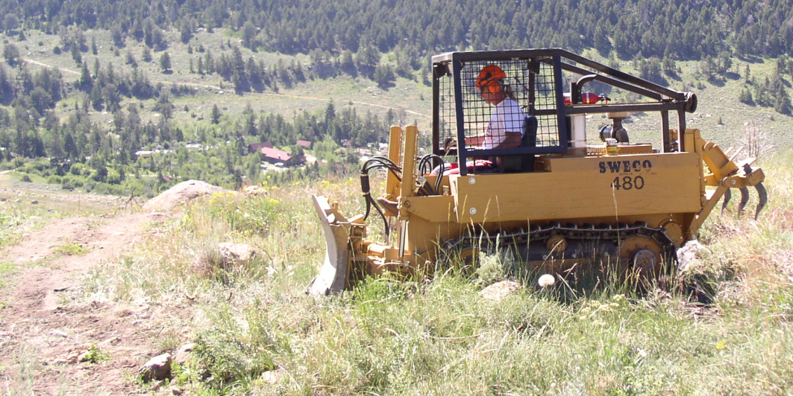
Preparing the Trail
Trail maintenance prior to snowfall can help make trails smoother in the winter. It is a good investment of time and money.
Notes:
See page 54 of manual

Slide 37
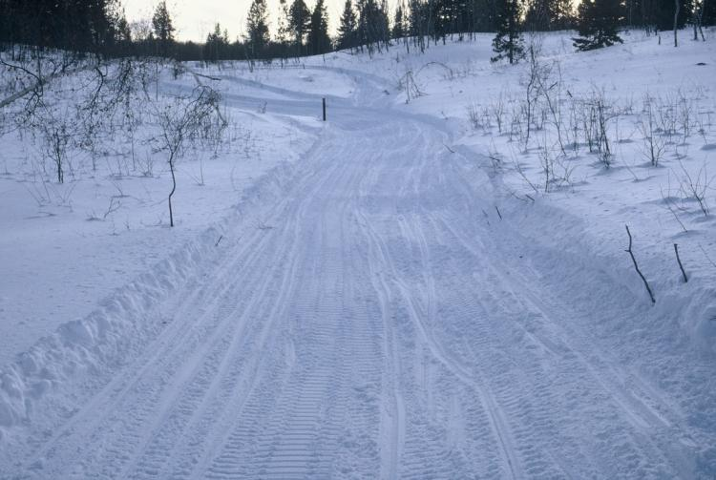
Preparing the Trail
Bumps and holes in the ground will also produce bumps in the trail after snowfall; they can reappear as moguls on heavily traveled trails almost immediately after grooming.
Notes:
See page 54 of manual

Slide 38
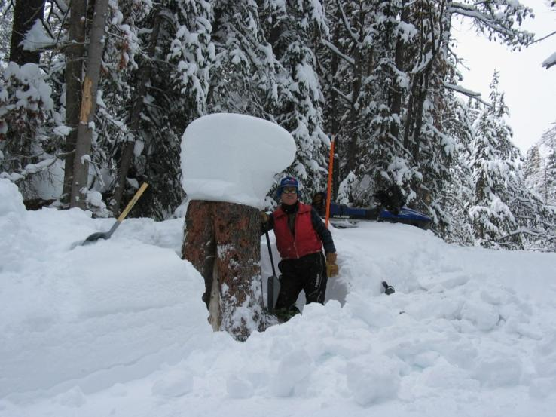
Preparing the Trail
Brush, stumps, and debris should be removed from trail where they could be a hazard or block visibility.
Keep debris off the trail to help prevent premature thaws.
Notes:
See page 55 of manual

Slide 39
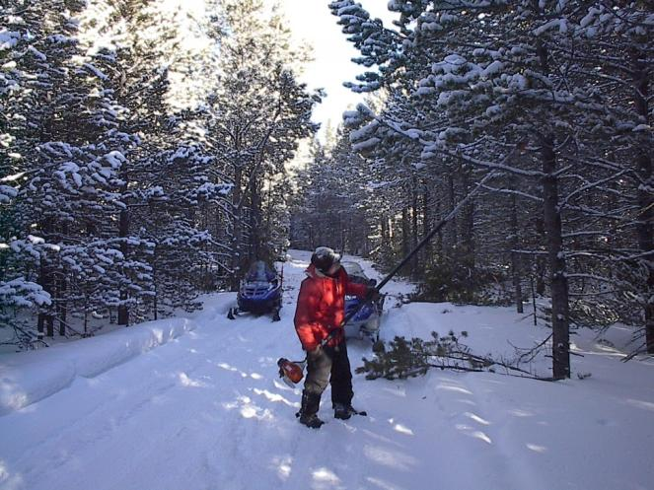
Preparing the Trail
Limb trees to improve trail visibility and safety, protect equipment from damage, and to open up the canopy so snow can reach the trail’s surface.
Notes:
See page 55 of manual

Slide 40
Early Season Trail Preparation
First snowfalls processed on the trail often create the base for remainder of the winter; an early solid, smooth base will help keep the trail smoother throughout the season.
Early snowfalls often contain more free water and can compact well, so vigorous smoothing and heavy compacting is important.
Notes:
See page 55 of manual

Slide 41
Early Season Trail Preparation
Newly fallen snow layers should ideally be cut to 6 inches (15 cm) or less before compacting to ensure full compaction throughout the layer.
Thick layers of newly fallen snow typically do not compact well; this often can result in a less dense base layer that is more prone to mogul formation.
Notes:
See page 55 of manual

Slide 42
Early Season Trail Preparation
Areas prone to wetness (like low or swampy crossings): advantageous to keep snow thickness to a minimum in early part of season. This allows underlying soil to freeze and become stable; frozen layer of earth will also help keep trail solid later into spring.
Since snow is an excellent insulator, keep thin but covered so ground remains frozen.
Notes:
See page 55 of manual

Slide 43
Early Season Trail Preparation
Some wet areas (like springs, seeps) never freeze to any degree. They should be a concern throughout season, particularly if they produce ice flows. Sometimes these areas can be covered with materials like wood chips to minimize carryover of mud and dirt onto the adjacent trail surface.
If possible, avoid such areas with the trail.
Notes:
See page 55 of manual

Slide 44
Chapter 3 Quiz
Ensuring the safety of groomer operators includes:
a) making sure they are prepared for trouble by carrying safety and emergency equipment
b) providing them with communications equipment and requiring them to file a trip plan
c) a good preventative maintenance program
d) requiring that they wear seat belts
e) a and b above
f) a, b, c, and d above
Notes:
f) a, b, c and d above

Slide 45
Chapter 3 Quiz
Ensuring the safety of groomer operators includes:
a) making sure they are prepared for trouble by carrying safety and emergency equipment
b) providing them with communications equipment and requiring them to file a trip plan
c) a good preventative maintenance program
d) requiring that they wear seat belts
e) a and b above
f) a, b, c, and d above
Notes:
f) a, b, c and d above

Slide 46
Chapter 3 Quiz
New equipment helps compensate for poor equipment operators. True or False
Budget, weather, and traffic patterns should be considered when developing and managing weekly grooming schedules. True or False
Notes:
2. False, 3. True

Slide 47
Chapter 3 Quiz
New equipment helps compensate for poor equipment operators. False
Budget, weather, and traffic patterns should be considered when developing and managing weekly grooming schedules. True
Notes:
2. False, 3. True

Slide 48
Chapter 3 Quiz
Groomer operators should never operate equipment while under the influence of drugs or alcohol because their abilities and judgment will be impaired. True or False
When parked on the trail, always shut the groomer’s lights off to avoid blinding or distracting oncoming snowmobile traffic. True or False
Notes:
4. True, 5. False

Slide 49
Chapter 3 Quiz
Groomer operators should never operate equipment while under the influence of drugs or alcohol because their abilities and judgment will be impaired. True
When parked on the trail, always shut the groomer’s lights off to avoid blinding or distracting oncoming snowmobile traffic. False
Notes:
4. True, 5. False

Slide 50
Chapter 3 Quiz
A Grooming Manager:
a) someone who directs all aspects of a grooming program and establishes priorities and schedules
b) important for a successful grooming program
c) anyone who wants to be in charge
d) should understand heavy equipment operation, maintenance, snow mechanics, and be able to work with people
e) a, b, and d above
f) a, b, c, and d above
Notes:
f) a, b, c and d above

Slide 51
Chapter 3 Quiz
A Grooming Manager:
a) someone who directs all aspects of a grooming program and establishes priorities and schedules
b) important for a successful grooming program
c) anyone who wants to be in charge
d) should understand heavy equipment operation, maintenance, snow mechanics, and be able to work with people
e) a, b, and d above
f) a, b, c, and d above
Notes:
f) a, b, c and d above

Slide 52
Chapter 3 Quiz
A mid-day grooming in high traffic areas may be useful to keep moguls from getting too deep, but a second grooming should be scheduled that same night to provide better conditions and proper time for effective trail setup. True or False
Notes:
7. True

Slide 53
Chapter 3 Quiz
A mid-day grooming in high traffic areas may be useful to keep moguls from getting too deep, but a second grooming should be scheduled that same night to provide better conditions and proper time for effective trail setup. True
Notes:
7. True

Slide 54
Chapter 3 Quiz
The following factors should be considered when establishing grooming priorities:
a) available labor and operating budget
b) number of groomers available
c) total miles/kilometers of trail to be groomed
d) snowmobile traffic patterns
e) locations of businesses, parking areas & attractions
f) length of season, snow conditions, weather patterns
g) all of the above
Notes:
g) all of the above

Slide 55
Chapter 3 Quiz
The following factors should be considered when establishing grooming priorities:
a) available labor and operating budget
b) number of groomers available
c) total miles/kilometers of trail to be groomed
d) snowmobile traffic patterns
e) locations of businesses, parking areas & attractions
f) length of season, snow conditions, weather patterns
g) all of the above
Notes:
g) all of the above

Slide 56
Chapter 3 – Training Program Photo Credits
Kim Raap – Trails Work Consulting
New Hampshire Bureau of Trails
New Hampshire Fish & Game Department
South Dakota Department of Game, Fish & Parks
Wyoming State Trails Program
Project Manager
Kim Raap – Trails Work Consulting
4015 S. Brady Court – Sioux Falls, SD 57103
(605) 371-9799 Trailswork@aol.com
Contact IASA at www.snowiasa.org

Slide 57
ACKNOWLEDGEMENT & DISCLAIMER
This series of Power Point training slides has been produced to accompany Chapters 1 – 6 of Guidelines for Snowmobile Trail Groomer Operator Training – A Resource Guide for Trail Grooming Managers and Equipment Operators which was produced by the International Association of Snowmobile Administrators (IASA) in 2005. This project has been produced by IASA, with financial assistance from the Recreational Trails Program administered by the U.S. Federal Highway Administration (FHWA), to aid local operator training.
This training program is disseminated under the sponsorship of the Department of Transportation in the interest of information exchange. The United States Government assumes no liability for the contents or use thereof. The contents of this program do not constitute a standard, specification, or regulation.
Special recognition is given to the many agencies, companies, and individuals whose photos have been used for demonstration purposes in this project. Sponsors of this project do not endorse products or manufacturers. Trade and manufacturer’s names appear in this training program only because they are considered essential to the object of these training slides.
Copyright © 2007 Owned by the International Association of Snowmobile Administrators.
All Rights Reserved.

