Slide 1

Groomer Operator Training Resource Guide
Chapter 4:
Operating Grooming Equipment
Notes:
See pages 1-22 of manual

Slide 2
General Operating Guidelines:
How much snow is required to start grooming operations?
It requires a lot more snow to safely and effectively operate a groomer than it does to operate a snowmobile.
It can be good to let sleds run on the snow first. This starts the de-aeration and compaction process, which then makes grooming more effective – so don’t rush it.
Notes:
See page 57 of manual

Slide 3
How much snow is required to start grooming operations?
It varies by area and is affected by terrain and type of snow:
Generally, at least 8 to 12 inches (20 to 30 cm) of wet snow on smooth terrain like a road is enough to start grooming operations.
Notes:
See page 57 of manual

Slide 4
How much snow is required to start grooming operations?
It varies by area and is affected by terrain and type of snow:
If snow is drier, or if terrain is rough or uneven, at least 12 to 18 inches (30 to 45 cm) of snow (or more) may be required to safely begin effective grooming operations.
Notes:
See page 57 of manual

Slide 5
Best Grooming Temperatures
Generally, when using a drag, grooming should be suspended when the air temperature is below -25 F (-32 C) or above +40 F (+5 C) since extreme temps can cause snow to stick in the blades or build up on the packing pan enough of the time to make grooming a smooth trail impossible.
Notes:
See page 57 of manual

Slide 6
General Operating Guidelines:
Wind And Shade Can Be
Beneficial For Grooming
Wind and the location or aspect of the trail can influence grooming effectiveness.
Wind blowing new snow into trail, overcast sky, and shaded trail locations with cooler temperatures can have beneficial effects.
Notes:
See page 57 of manual

Slide 7
General Operating Guidelines:
Keep Blades Clean
Blades must scour (self-clean) in order to groom effectively with a drag.
It may be necessary to stop and scrape frost or snow buildup off the front tractor blade or from the drag’s blades.
Notes:
See page 57 of manual

Slide 8
General Operating Guidelines:
Keep Blades Clean
If this is a continuous problem, consider using a plastic covering on the drag’s blades.
Night grooming can be the best way to help minimize these types of effects from weather.
Notes:
See page 57 of manual

Slide 9
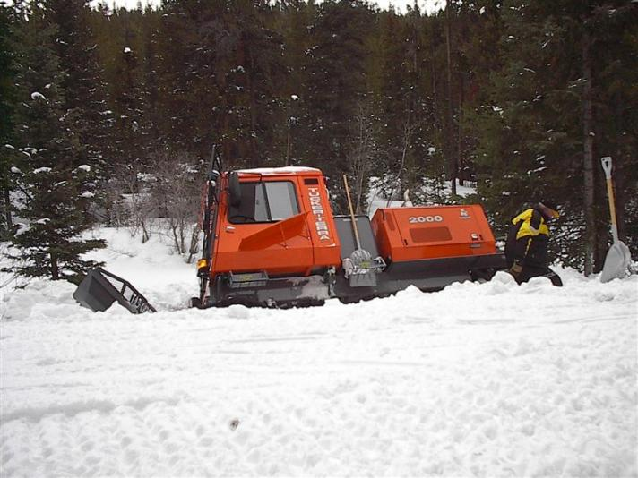
General Operating Guidelines:
Stay on the Trail!
It is essential to stay on the compacted trail base with the grooming equipment at all times. If you get into deep loose snow, you risk becoming severely stuck.
Notes:
See page 58 of manual

Slide 10
General Operating Guidelines:
Stay on the Trail!
Turn around only where you know the snow base will support the equipment. Get out and walk to check depth and firmness of snowpack if you’re not certain.
If possible, use areas where turnarounds have been made before.
Notes:
See page 58 of manual

Slide 11
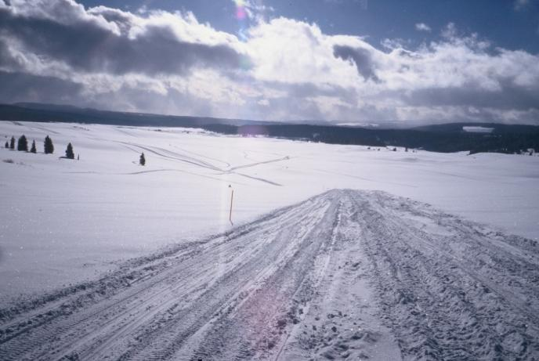
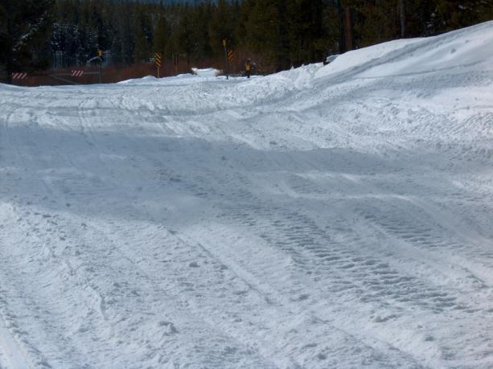
General Operating Guidelines:
Know the Trail and Stay on It
Yes
No
Yes
No
Don’t follow snowmobile tracks unless you’re positive
they’re on the trail!
Notes:
See page 58 of manual

Slide 12
General Operating Guidelines:
Shut Down in Poor Visibility
It may become necessary to shut down on the trail because of poor visibility caused by high winds, heavy snowfall, or fog.
Stop the groomer right where it is and leave all lights on with engine idling; also advise the grooming manager of your situation.
Notes:
See page 58 of manual

Slide 13
General Operating Guidelines:
Shut Down in Poor Visibility
Wait the situation out since it would be easy to get off the trail and get in trouble.
ALWAYS stay with equipment and wait for conditions to improve. NEVER get out and try to walk to shelter.
Notes:
See page 58 of manual

Slide 14
General Operating Guidelines:
Always Watch for Snowmobiles
When the trail is narrow or winding, keep to the right and slow down. If necessary, stop when a large group is approaching.
ALWAYS ANTICIPATE
Plan for approaching snowmobiles at sharp or blind curves and on hills.
Notes:
See page 58 of manual

Slide 15
General Operating Guidelines:
Always Watch for Snowmobiles
Watch for sleds that may overtake you from behind. Stay to the right and allow them to pass.
If the trail is narrow or winding, look for a place to pull off and stop where it is safe. Then signal for them to pass.
Notes:
See page 58 of manual

Slide 16
Grooming Basics:
Building Trail Base versus
Maintaining Trail Base
Any time there is new snow to work with (either from new snowfall, blown in snow, or snow pulled in from trail edges), grooming will build (increase) the trail’s base / depth.
Notes:
See page 58 of manual

Slide 17
Grooming Basics:
Building Trail Base versus
Maintaining Trail Base
If “new” snow is not available, grooming will simply maintain the trail base, which is less desirable because it does not increase trail depth and just reprocesses the existing snow.
Notes:
See page 58 of manual

Slide 18
Grooming Basics:
Building Trail Base versus
Maintaining Trail Base
Remember that a drag’s blades must always have snow in them to accomplish either trail building or trail maintenance.
Notes:
See page 58 of manual

Slide 19
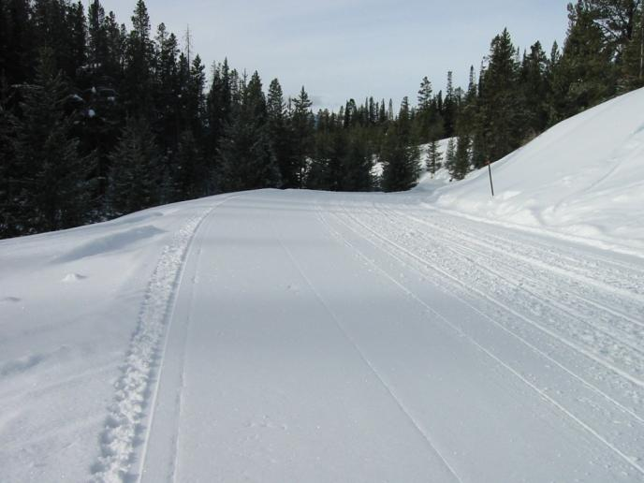
Grooming Basics:
Ideal Groomed Trail Width
Maximum of 1½ to 2 times the width of the drag or tiller.
Trail ‘clearing width’ may only allow a single implement width in some areas.
Notes:
See pages 58-59 of manual

Slide 20
Ideal Groomed Trail Width
Control your trail width – on wide roads or in open areas, don’t try to groom too wide. Pick a route and stick to it to ensure the trail base is built from the ground up. Grooming wider than 2 times the drag/tiller width will result in soft pockets and a rough trail from inconsistent processing and compaction.
Notes:
See pages 58-59 of manual

Slide 21
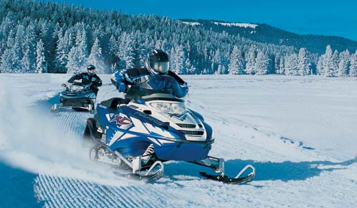
Ideal Groomed Trail Width
Maintaining a trail width of 1½ times the drag/tiller width consistently grooms the middle of the trail, which is where many riders favor.
Notes:
See pages 58-59 of manual

Slide 22
Ideal Groomed Trail Width
Maintaining a “1½ times the equipment” width can help to build a crown in the middle of the trail since one track of the tractor is always in the center of trail (and churning by the tracks helps to process the snow).
Notes:
See pages 58-59 of manual

Slide 23
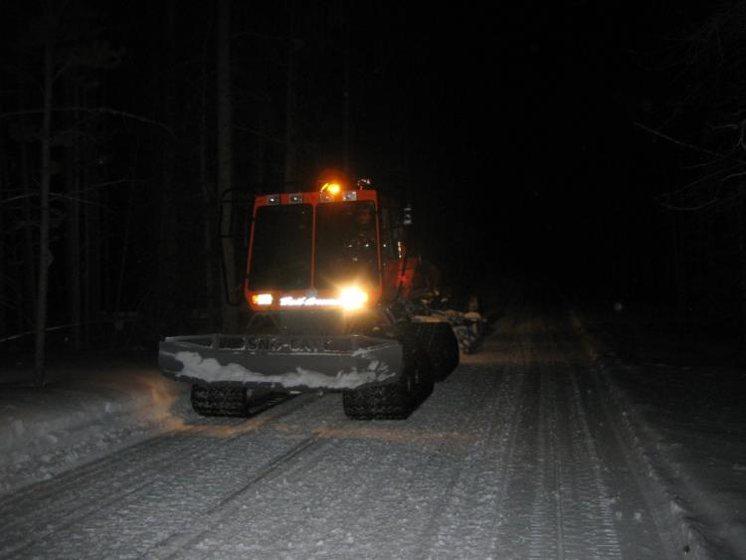
Grooming Basics:
Stay to the Right
ALWAYS groom on the right side of the trail.
Reverse grooming direction the next pass to widen the trail.
Notes:
See page 59 of manual

Slide 24
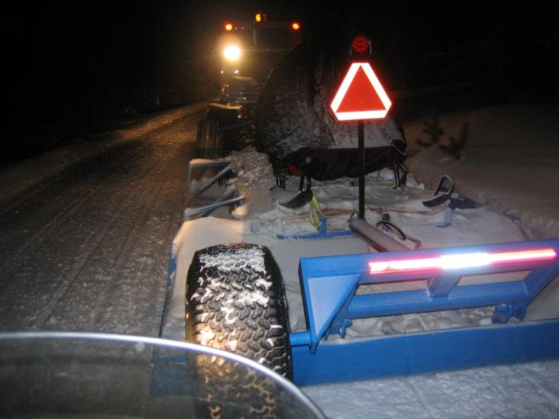
Grooming Basics:
Stay to the Right
NEVER groom against traffic on the left side of the trail.
NEVER groom against traffic on a one-way trail.
Notes:
See page 59 of manual

Slide 25
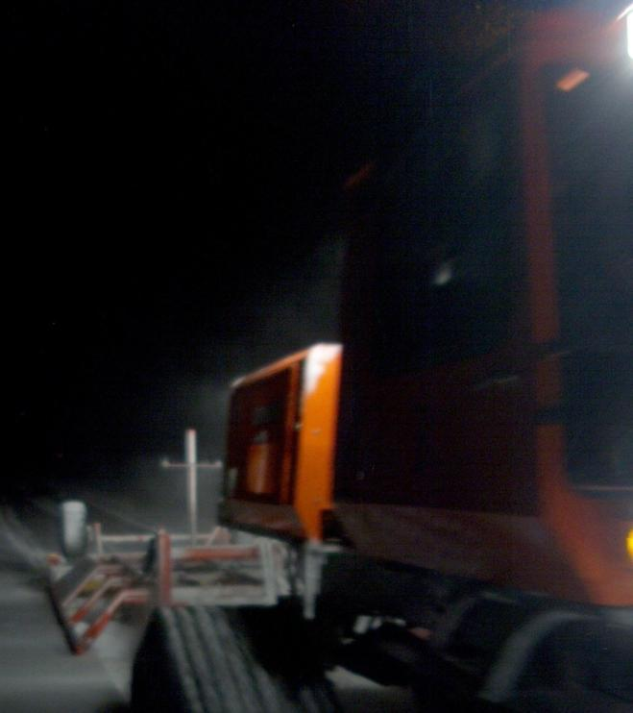
Grooming Basics:
Constantly Watch Behind
Pay attention to what’s in the rearview mirrors even though it may be difficult to see in the dark or through snow dust; this may mean spending up to 75% of your time monitoring the product behind.
Notes:
See page 59 of manual

Slide 26
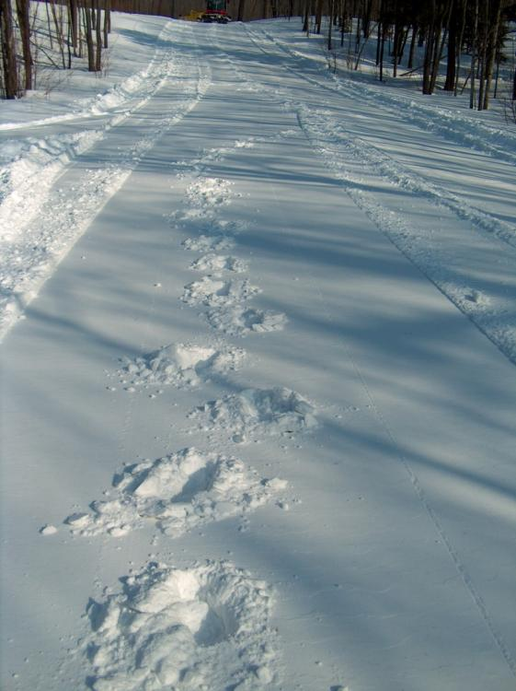
Grooming Basics:
Constantly Watch Behind
Periodically get out and walk back to check the finished trail behind.
Use “boot test” to evaluate the finished product.
Soft trail with poor compaction
Notes:
See page 59 of manual

Slide 27
“Boot Test”
When boots make a deep imprint: snow is SOFT and compaction is poor. Check implement settings and make adjustments. If this doesn’t help, perhaps you should not be grooming until conditions improve.
A light imprint indicates MEDIUM strength snow and medium compaction.
If it is difficult to imprint snow: snow is HARD and grooming is working well.
Notes:
See page 13 of manual

Slide 28
“Ski Test”
Another simple way for the operator to get a general indication of snow strength on the trail, from inside the cab, is to watch ski imprints from the last snowmobile traveling on the trail:
If body of ski is sinking in: SOFT snow. Check implement settings and conditions.
If skag is riding on the surface: HARD snow.
Notes:
See page 13 of manual

Slide 29
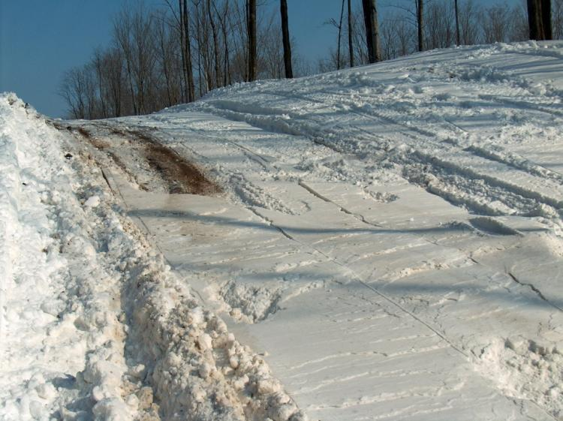
Grooming Basics:
Know the Trail and Anticipate Needs
You often need snow for: crown of hills, approaches, creek crossings, bottom of curves, and bare/ sunny/ windswept areas. If you don’t carry it with, you won’t have it to use.
Notes:
See page 59 of manual

Slide 30
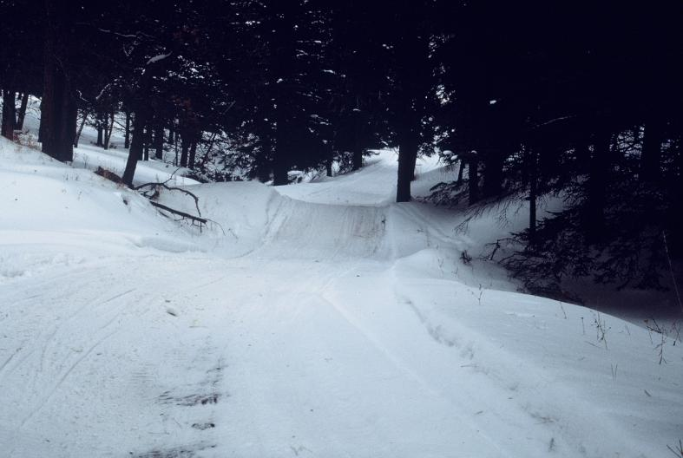
Know the Trail and Anticipate Needs
When going thru a dip, swale, or ditch that the drag spans – anticipate a need to lower the drag’s blades before you get there to gather snow.
Notes:
See page 59 of manual

Slide 31
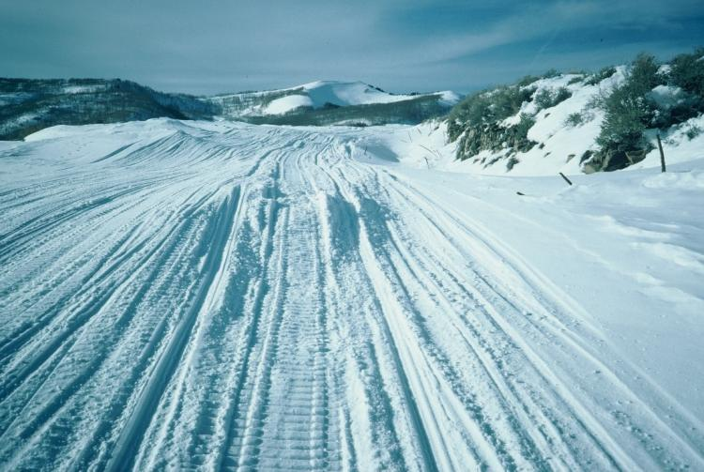
Know the Trail and Anticipate Needs
When approaching a heavily drifted or deep snow area, a steep hill, a road crossing, or a switchback – anticipate a need to raise blades in advance to avoid spinout or stuck.
Notes:
See pages 59-60 of manual

Slide 32
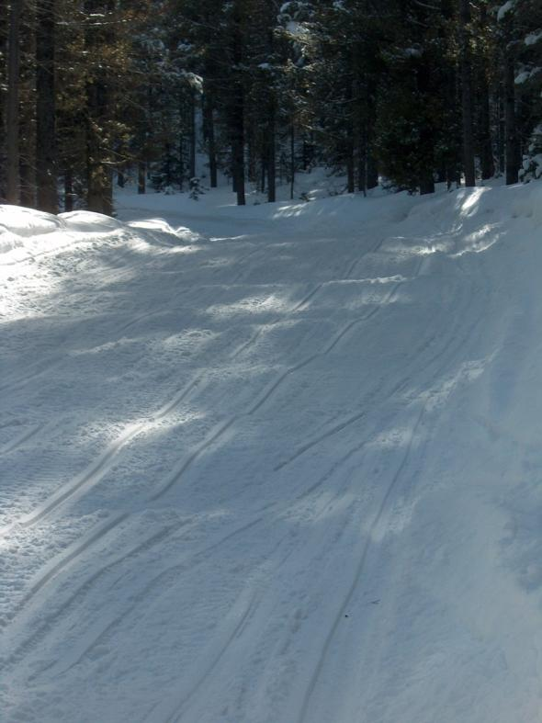
Grooming Basics:
Pay Attention on Curves
Work down the high outside edges on curves.
Pull top snow down with front blade and work into bottom with drag or tiller.
Notes:
See page 60 of manual

Slide 33
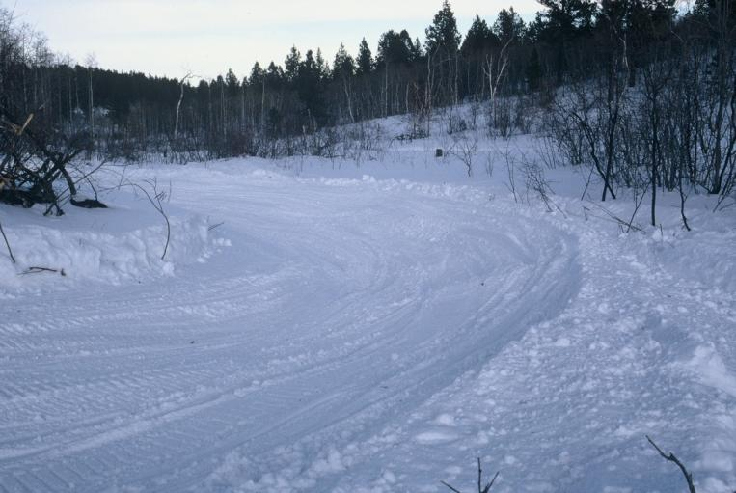
Pay Attention on Curves
Be careful not to straddle top of the berm; you may get high-centered.
Always anticipate on-coming traffic when working a curve.
Notes:
See page 60 of manual

Slide 34
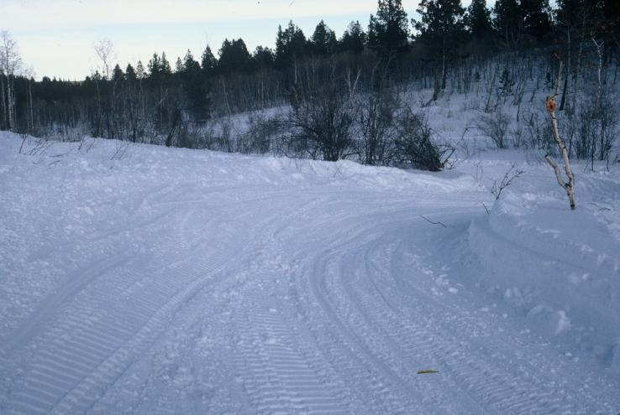
Pay Attention on Curves
A drag often will not stay on the side of a sharp curve, so you need to be either at the top or down in the bottom of the curve.
Notes:
See page 60 of manual

Slide 35
Grooming Basics:
Take the Time to Do It Right
Regulate the speed of the tractor and cutting depth of implement according to trail conditions and grooming needs.
If there is a particularly rough area and a place to turn around, groom the trail a second time (or it will likely be even rougher the next time you return).
Notes:
See page 60 of manual

Slide 36
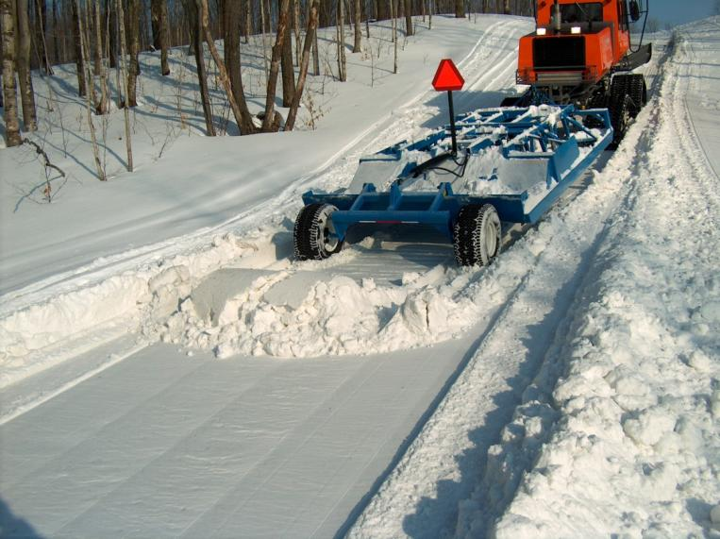
Grooming Basics:
Remove Backup Piles
If you need to back-up on the trail, never leave a back-up pile in the trail since it can be an extreme safety hazard.
Always regroom the trail immediately or shovel it off.
Notes:
See page 60 of manual

Slide 37
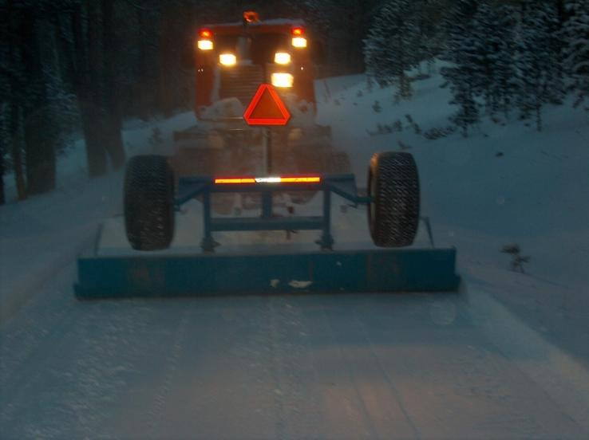
Grooming Basics:
Think Visibility
Always operate grooming tractors with their warning beacon/strobe and lights “ON” at all times – day or night.
Always display a SMV sign at rear of unit.
Notes:
See page 60 of manual

Slide 38
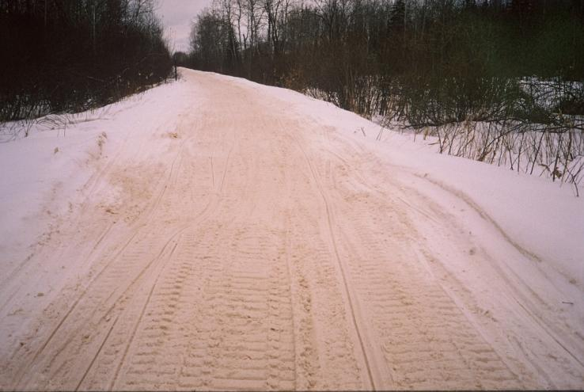
Grooming Basics:
Beware of Dirty Snow
“Dirty” snow can deteriorate the trail base quickly since any amount of sunlight (solar radiation) can affect the firmness and quality of the trail.
Notes:
See page 60 of manual

Slide 39
Grooming Basics:
Beware of Dirty Snow
Try to pull new snow in from trail’s edge with front blade to mix old and new snow.
Sometimes running the track 4” over on the right outside berm will help spill new snow onto the trail.
Notes:
See page 60 of manual

Slide 40
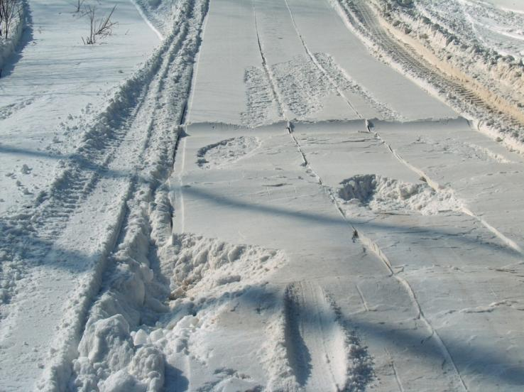
Grooming Basics:
Don’t Leave Holes in the Trail
Holes in the trail caused by being stuck, drag malfunction, or operator error can be a hazard. Always remove them (shovel or regroom).
Notes:
See page 61 of manual

Slide 41
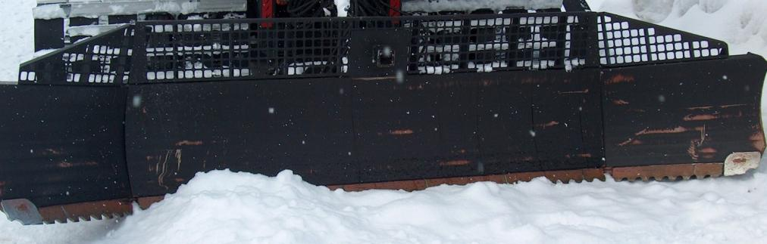
Grooming Basics:
Cover Ice
If possible, try to cover icy spots on the trail with snow to improve safety.
Sometimes ice can be scored with a scarifier blade to aid traction and steering.
Also try to process ice back into the snowpack.
Notes:
See page 61 of manual

Slide 42
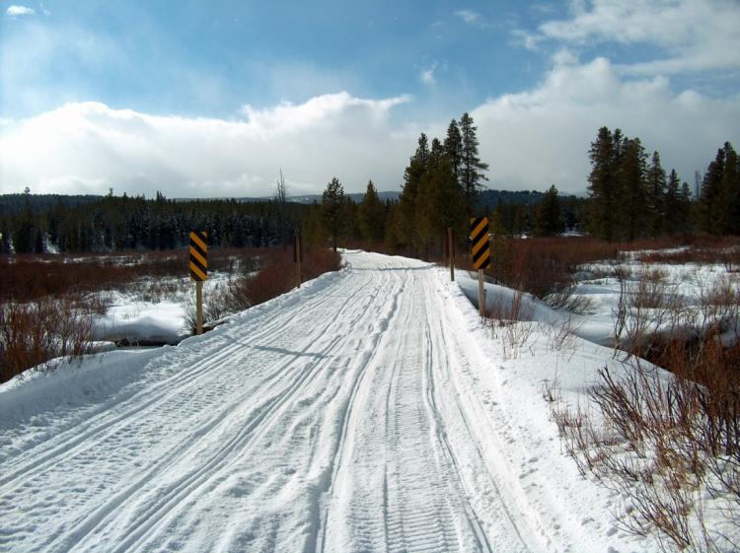
Grooming Basics:
Groom Bridges
All too often operators fail to groom across bridges, which can lead to rough and unsafe conditions before, across, and after bridges.
Notes:
See page 61 of manual

Slide 43
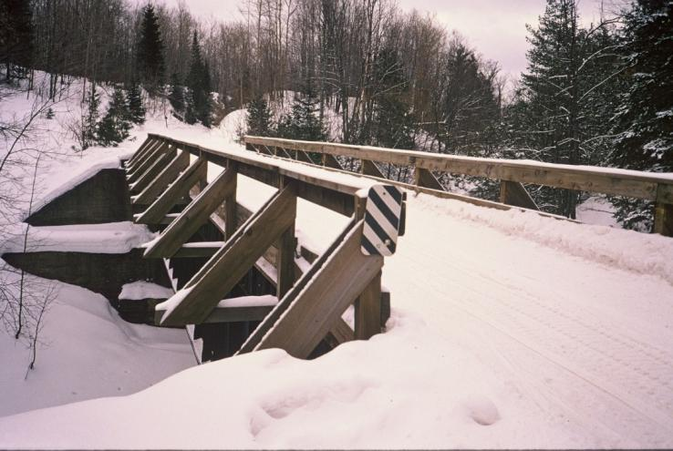
Grooming Basics:
Groom Bridges
Start by panning across to avoid damage. Use the groomer to bring snow onto bridge; eventually you will build enough base to groom across every pass.
Notes:
See page 61 of manual

Slide 44
Tips for Effective Grooming with a Drag
Remove Air from Hydraulics and Compensate for Leaks
After hooking drag to tractor – raise and lower a few times to remove air from hoses and cylinders.
Inspect all connections for leaks and promptly fix even slight leaks.
Notes:
See page 61 of manual

Slide 45
Tips for Effective Grooming with a Drag
Remove Air from Hydraulics and Compensate for Leaks
Remember that the loss of pressure from leaks will cause components to settle. This requires compensation by continually adjusting (raising) the component controlled by that leaking hydraulic.
Notes:
See page 61 of manual

Slide 46
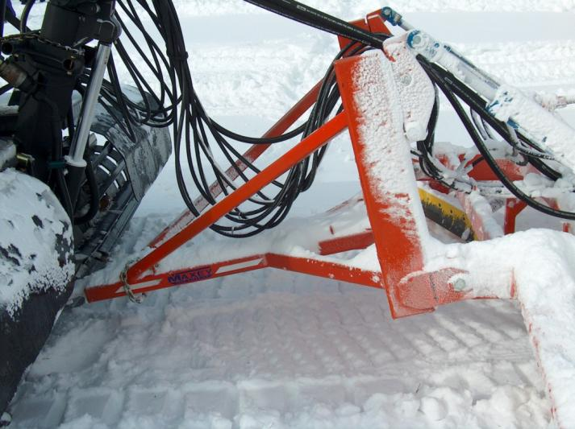
Tips for Effective Grooming with a Drag
Check for Clearance and
Binding When Turning
Inspect hydraulic hoses for binding and interference as tractor is turned.
Check for clearance between outside of tracks and outside front of drag when tractor is fully turned.
Notes:
See page 61 of manual

Slide 47
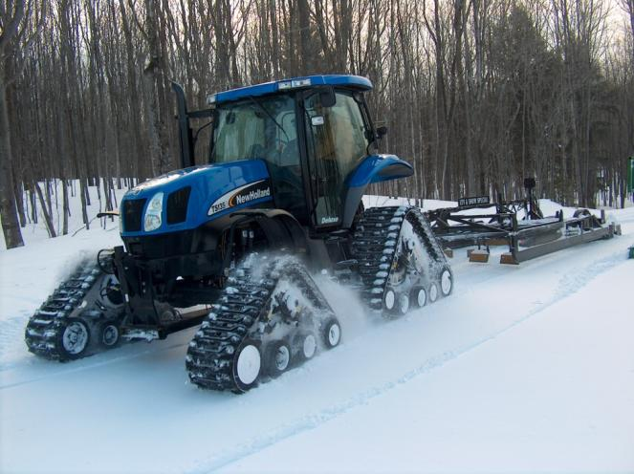
Tips for Effective Grooming with a Drag
Pay Attention!
Grooming equipment can be complex and operating it is a demanding job that requires the operator’s undivided attention at all times.
Notes:
See page 61 of manual

Slide 48
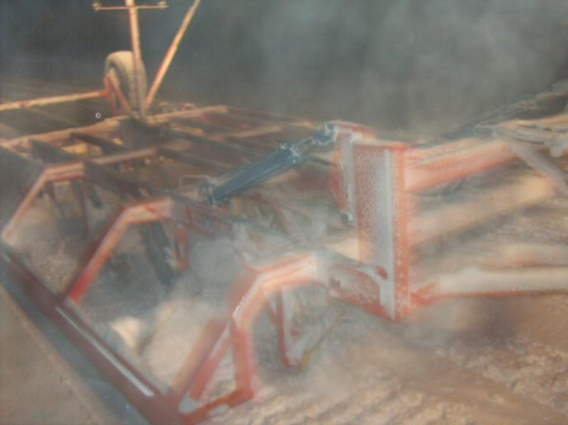
Tips for Effective Grooming with a Drag
Pay Attention!
While it’s important to be watching the trail ahead to observe changing conditions, it’s almost more important to watch what the grooming drag behind is doing – even though snow dust may impair rear visibility.
Notes:
See page 61 of manual

Slide 49
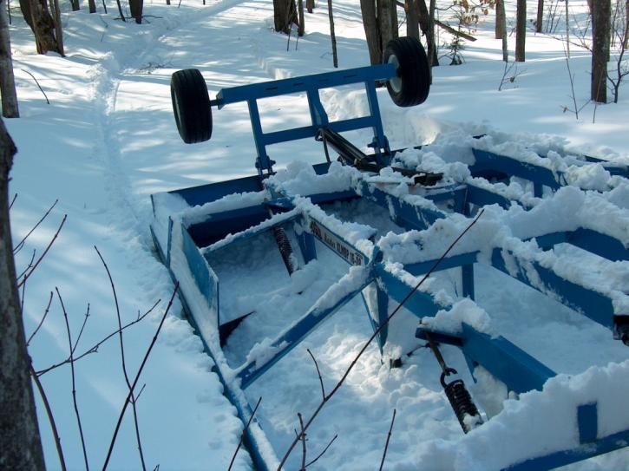
Tips for Effective Grooming with a Drag
Pay Attention!
Don’t simply drop the drag and forget it.
Operator must constantly respond and adjust to ever-changing trail and snow conditions.
Notes:
See page 61 of manual

Slide 50
Tips for Effective Grooming with a Drag
Keep the Mirrors Clean and
Use Them
The rearview mirrors on the tractor are critically important and should be used to constantly monitor how the snow is processing in the drag blades, as well as the finished trail surface behind the unit.
Notes:
See page 62 of manual

Slide 51
Tips for Effective Grooming with a Drag
Get Out and Check the Trail
While monitoring work with mirrors is important, it’s also important to occasionally get out of the tractor and walk across the groomed surface to check it.
If you sink in, recheck the drag’s settings for good processing and compression.
Notes:
See page 62 of manual

Slide 52
Tips for Effective Grooming with a Drag
Remove the Entire Mogul
Remember that moguls and drifts should be completely cut away since only partial removal results in uneven trail density and moguls quickly reforming.
Typically, the greatest cutting depth is needed on curves and in high traffic areas.
Notes:
See page 62 of manual

Slide 53
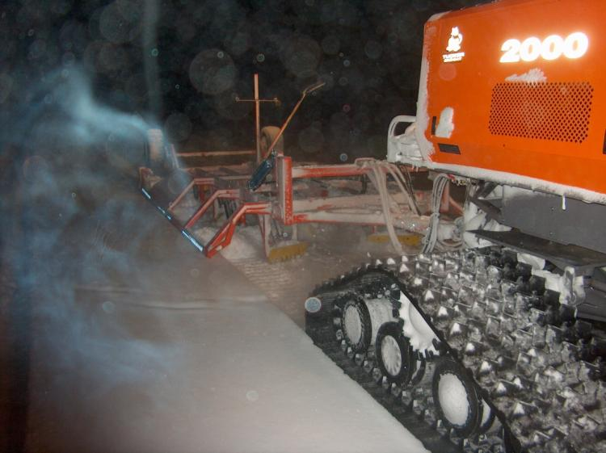
Tips for Effective Grooming with a Drag
Watch the Speed
The most effective grooming speed is typically 5 to 7 mph (8-11 kph) and is governed by the way the snow is being processed.
Notes:
See page 62 of manual

Slide 54
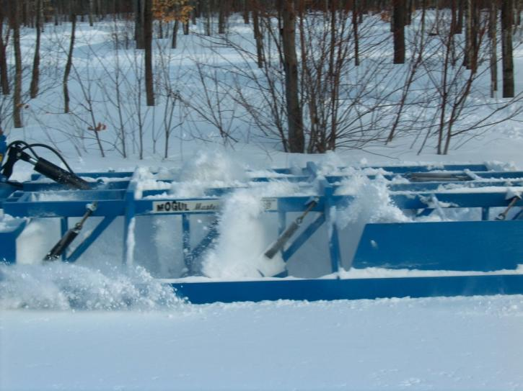
Tips for Effective Grooming with a Drag
Watch the Speed
Too slow: rolling action in front of blades will not be adequate.
Too fast: will get drag bounce, a poor trail, and spray snow out (wasting it).
Notes:
See page 62 of manual

Slide 55
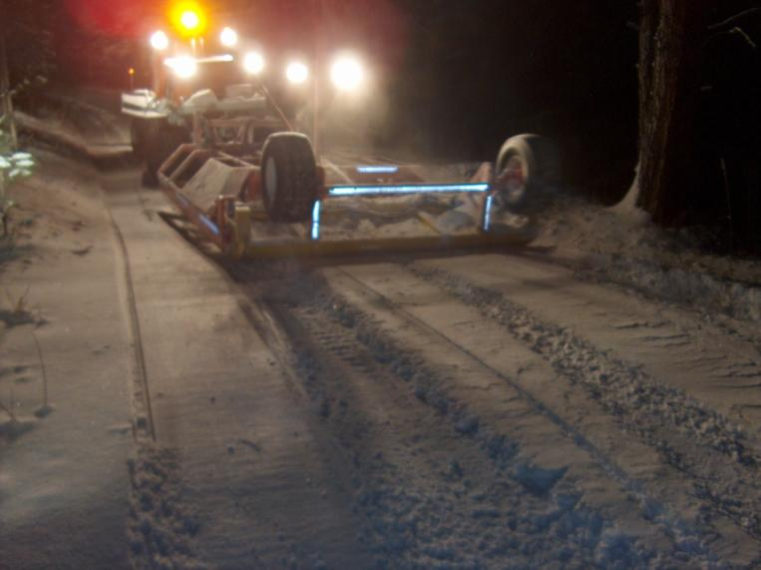
Tips for Effective Grooming with a Drag
Watch the Speed
Excess speed can prevent blades from properly cutting off moguls and not give snow time to fall into dips or holes.
Notes:
See page 62 of manual

Slide 56
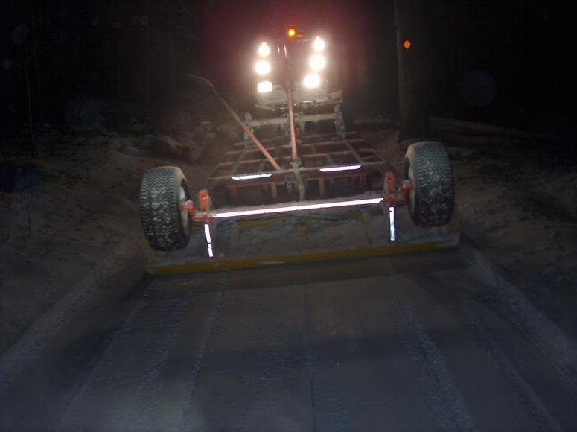
Tips for Effective Grooming with a Drag
Watch the Speed
Slow down and take the time needed to get a good finished product; the trail will stand up better to traffic.
Notes:
See page 62 of manual

Slide 57
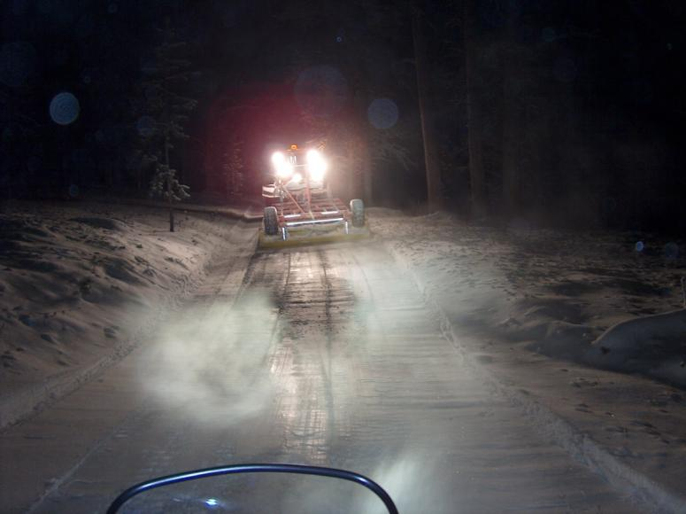
Tips for Effective Grooming with a Drag
Watch the Speed
Grooming too fast is a much more detrimental factor than most operators realize and is a huge waste of grooming resources. Note washboard effect from drag bounce.
Notes:
See page 62 of manual

Slide 58
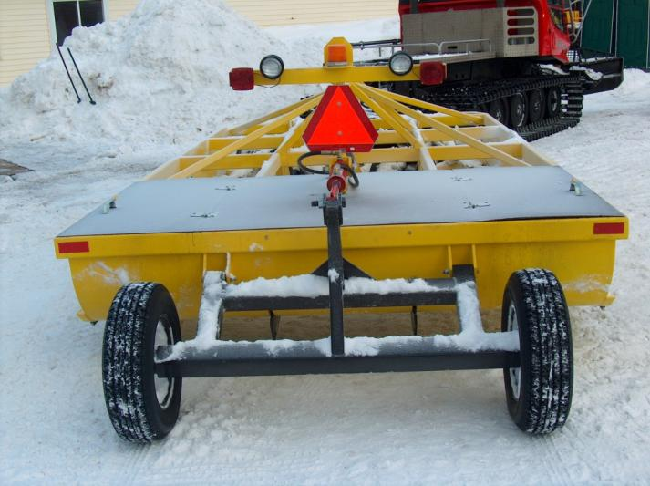
Tips for Effective Grooming with a Drag
Slow Down When Using Wheel Kits
Going too fast with wheels down can cause stress fractures, hitch damage, and frame twisting (and if the frame isn’t square, the drag won’t groom right).
Notes:
See page 62 of manual

Slide 59
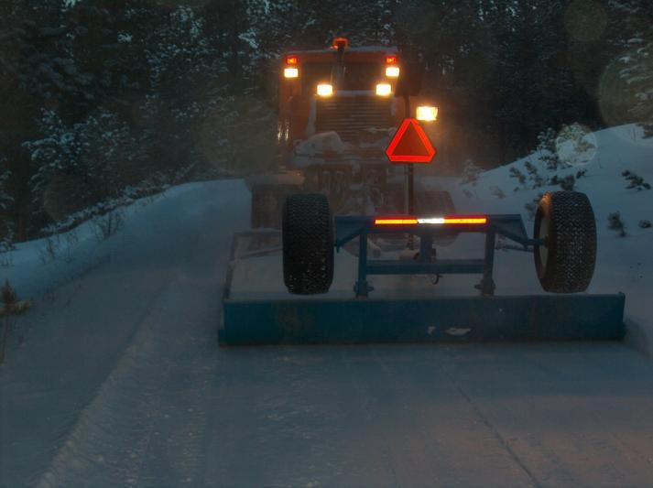
Tips for Effective Grooming with a Drag
Groom at Night or
When Traffic is Low
Greatest single key to effective grooming is low traffic/cold temp.
Always groom when traffic volumes are at their lowest, which is typically at night.
Allows setup time and enhances safety.
Notes:
See pages 62-63 of manual

Slide 60
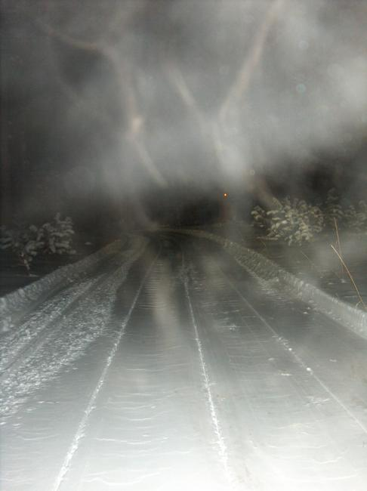
Tips for Effective Grooming with a Drag
Groom at Night or
When Traffic is Low
Grooming at night generally produces the best quality trail since temperatures are typically colder. This can help snow flow better, as well as setup harder and more quickly.
Notes:
See pages 62-63 of manual

Slide 61
Tips for Effective Grooming with a Drag
Early Season Cautions
If a grooming program has more than one drag – use an older one for early season setup to avoid damage to your better equipment.
Go slower because of potential hidden hazards.
Notes:
See pages 62-63 of manual

Slide 62
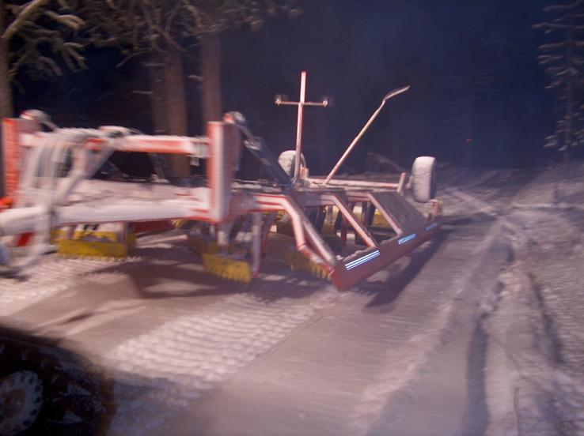
Tips for Effective Grooming with a Drag
Early Season Cautions
It may be better to “ride the pan” versus trying to cut much with drag blades on initial passes in early or low snow conditions.
Notes:
See page 63 of manual

Slide 63
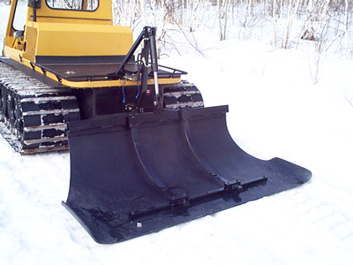
Tips for Effective Grooming with a Drag
Early Season Cautions
Consider using a Compactor Bar for better early season effectiveness and to save wear and tear on drag or tiller.
Notes:
See page 63 of manual

Slide 64
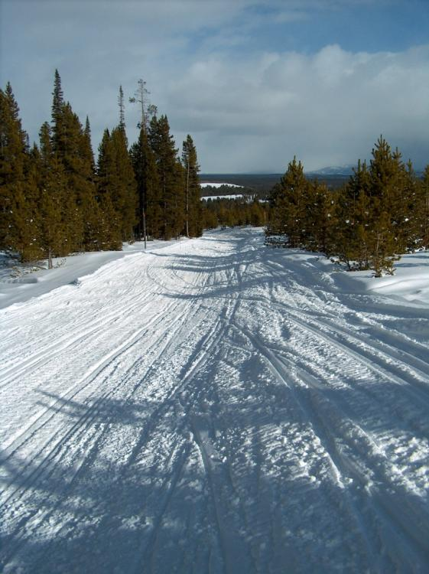
Tips for Effective Grooming with a Drag
Pull Snow to Middle of Trail
There is often a lack of snow in middle of trail (where most sled traffic is at).
Use front blade to pull snow in from trail’s outer edge.
Operate drag on outer edge of trail.
Notes:
See page 63 of manual

Slide 65
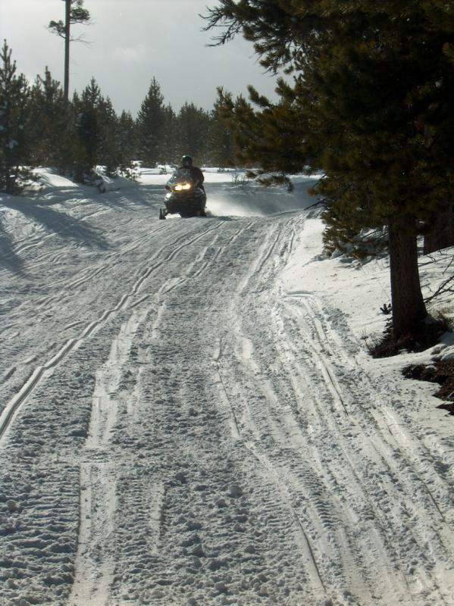
Tips for Effective Grooming with a Drag
Pull Snow to Middle of Trail
The outside 2 or 3 feet (.6 to .9 meter) of a trail will often be softer than the middle of trail due to the compaction sled traffic contributes in middle. This enables a drag to redistribute softer outside snow to the middle of trail.
Notes:
See page 63 of manual

Slide 66
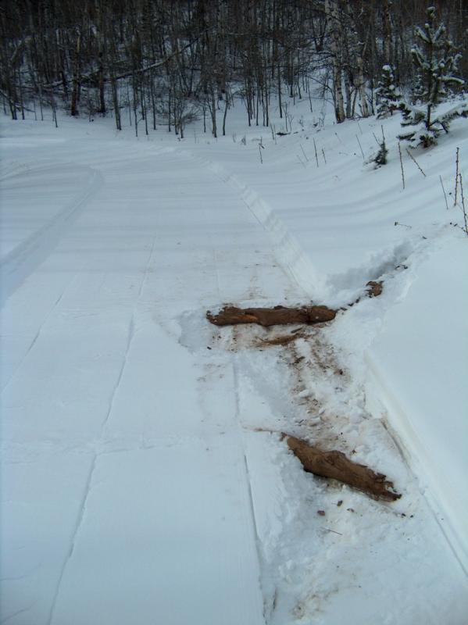
Tips for Effective Grooming with a Drag
Remove Debris from Trail
Debris can not only be a hazard, but also can attract heat which can have a thawing effect on the trail.
Notes:
See page 62 of manual

Slide 67
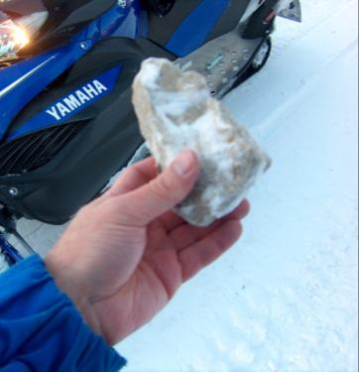
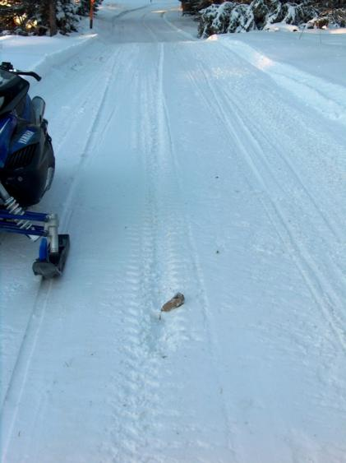
Tips for Effective Grooming with a Drag
Remove Rocks from Trail
Rocks caught under cutting blades (even small ones like in the top photo) can create ruts in the trail which can be a hazard, as well as contribute to areas in the trail where compaction is less dense.
Notes:
See page 62 of manual

Slide 68
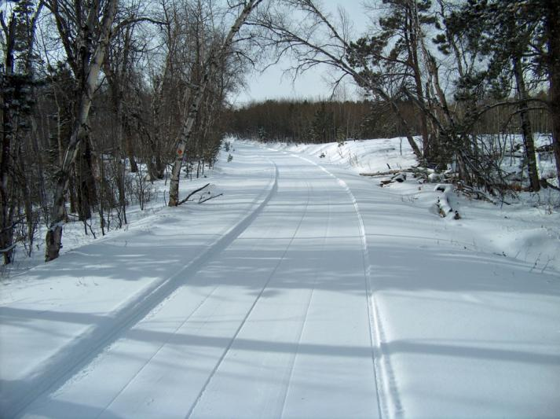
Tips for Effective Grooming with a Drag
Watch the Temperature
The best temperature for grooming with a drag is generally in the +5 to +25 F (-15 to -4 C) range, but drags can also work well in some areas in the -20 to +20 F range (-6 to -29 C).
Notes:
See page 63 of manual

Slide 69
Tips for Effective Grooming with a Drag
Watch the Temperature
Generally, wet snow grooms best at night and dry snow grooms best during the day (if the daytime traffic level is low).
Often early evening has the best temperatures for the most effective grooming.
Notes:
See page 63 of manual

Slide 70
Tips for Effective Grooming with a Drag
Watch the Temperature
If it is either so warm or so cold that snow continually sticks to the blades so they will not scour – grooming operations should be suspended until temperatures are more favorable.
Notes:
See page 63 of manual

Slide 71
Tips for Effective Grooming with a Drag
Use Wax or Silicone Spray to
Help Blades Scour
Air that is significantly colder than the snow can cause frost to form on blades and prevent them from scouring. This is a greater problem on single-blade drags since they must scour to work properly since there is only one blade for processing.
Notes:
See page 63 of manual

Slide 72
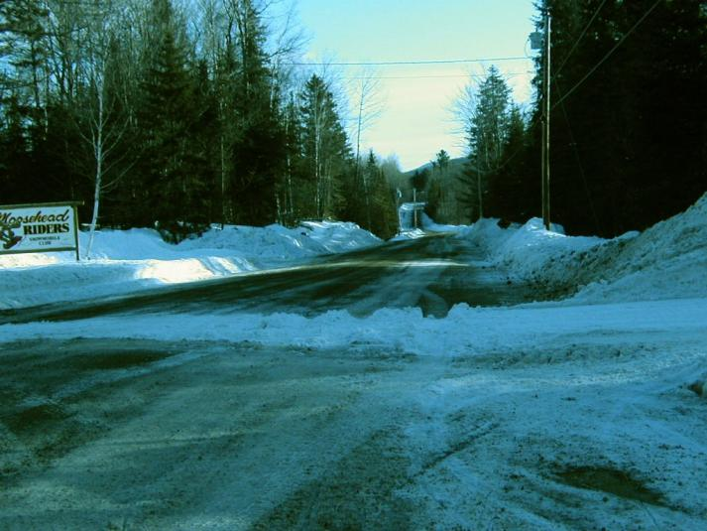
Tips for Effective Grooming with a Drag
Don’t Dump Snow on
Road Crossings
Frozen piles of snow dumped on roads can be hazardous for motorists and can also create ill-will toward snowmobiling.
Notes:
See page 64 of manual

Slide 73
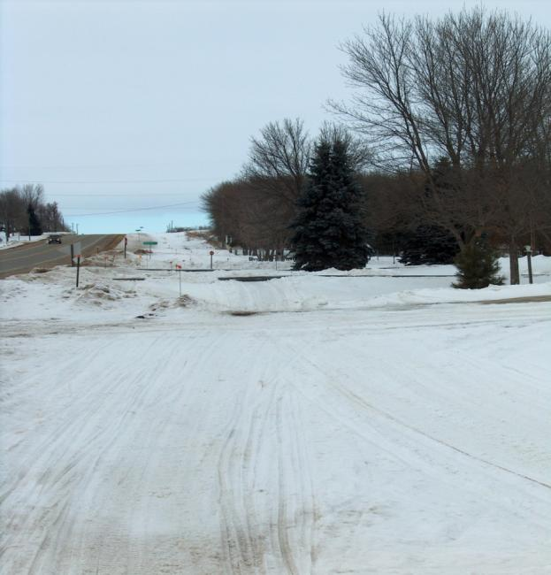
Tips for Effective Grooming with a Drag
Don’t Dump Snow on Driveways
Snow deposited on driveways can strain relationships with adjacent landowners.
Notes:
See page 64 of manual

Slide 74
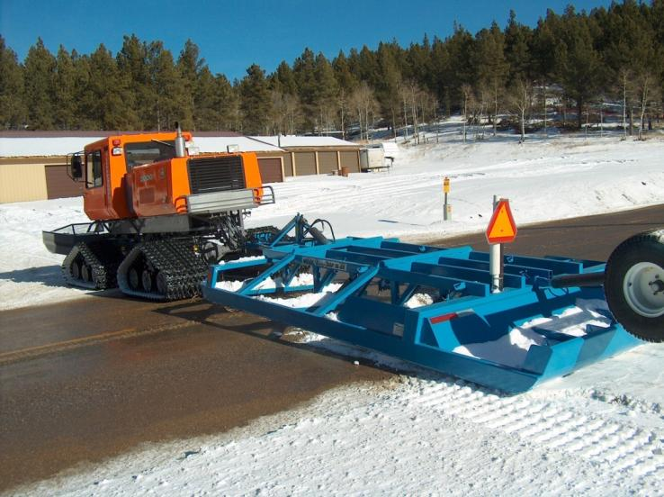
Tips for Effective Grooming with a Drag
Don’t Dump Snow on Road Crossings or Driveways
Always cross roads and driveways with care and raise the drag.
If you leave snow – shovel it off.
Wheels should be down!
Notes:
See page 64 of manual

Slide 75
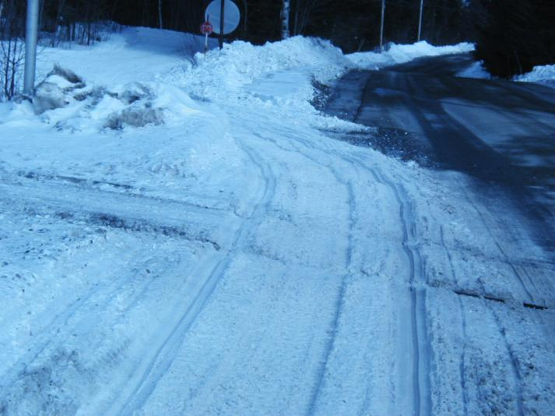
Tips for Effective Grooming with a Drag
Don’t Dump Snow on Railroad Crossings or Railroad Tracks
Avoid dragging or dumping snow on RR tracks since frozen piles of snow can derail a train. You may need to shovel.
Only cross RR tracks at legal crossings.
Notes:
See page 64 of manual

Slide 76
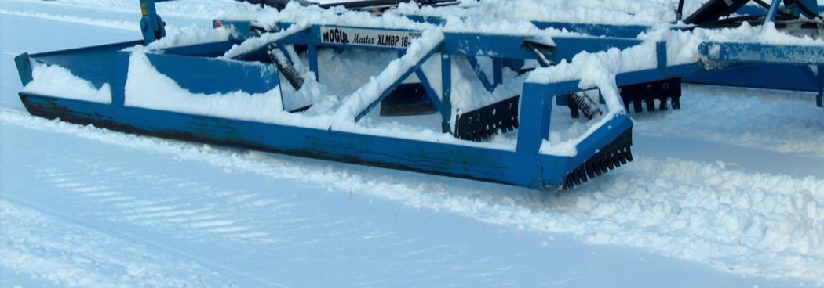
Tips for Effective Grooming with a Drag
Don’t Set Drag Blades Too Low on Smooth Trails
Use only the rear set of blades to “skim” minimally moguled trails; this helps increase the trail’s base.
Cut only as deep as the bottom of a mogul’s “dip.”
Notes:
See page 65 of manual

Slide 77
Tips for Effective Grooming with a Drag
Deep New Snowfall Can Mean Starting Over
Moguls under deep new snow usually can’t be removed.
Process new snow and compact new base. Two passes may be required to obtain sufficient compaction. A longer setup time will also be required.
Notes:
See page 65 of manual

Slide 78
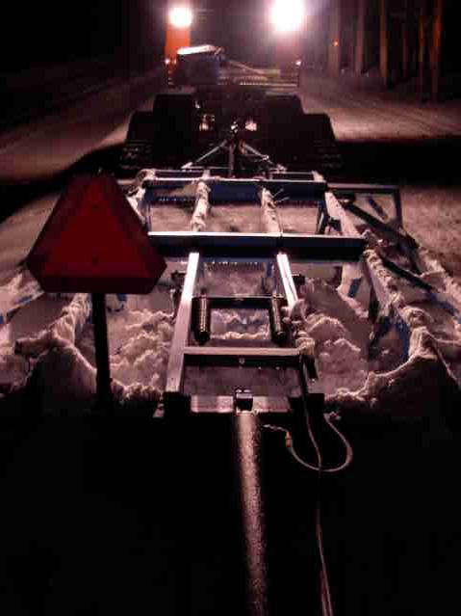
Tips for Effective Grooming with a Drag
Grooming Wet Snow
Requires more operator finesse since snow has more surface tension and won’t flow well.
Adjust drag somewhat higher and pick up speed; monitor snow to ensure it flows freely.
Notes:
See page 65 of manual

Slide 79
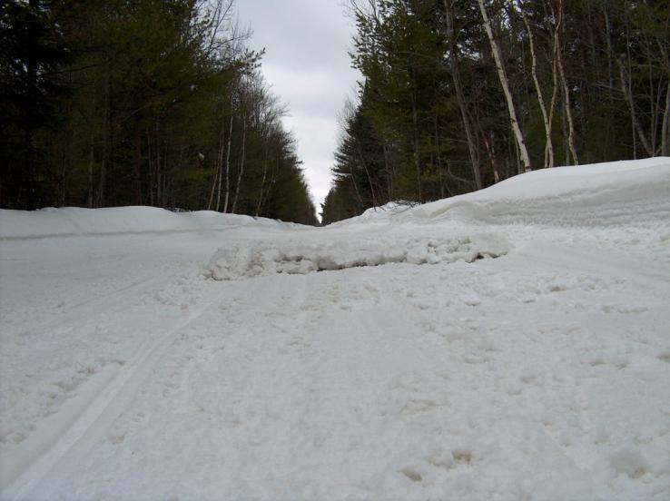
Tips for Effective Grooming with a Drag
Grooming Wet Snow
If snow begins to collect in drag – raise it enough to clear the snow and lower again. But don’t deposit piles in the trail!
Notes:
See page 65 of manual

Slide 80
Tips for Effective Grooming with a Drag
Continually Monitor Drag Blades
Particularly when trails are smooth, operators must continually adjust the cutting height. The need is different with multi and single blades:
Multi-Blade: weight of drag causes natural settling which forces cutting blades deeper as frames settles. This requires operator to monitor and readjust upward as needed.
Notes:
See page 66 of manual

Slide 81
Tips for Effective Grooming with a Drag
Continually Monitor Drag Blades
Single Blade: blade must exert constant down pressure. When the trail is relatively smooth, this can result in the lone cutting blade being forced upward. As a result, the operator must continually monitor and readjust downward as needed.
Notes:
See page 66 of manual

Slide 82
Tips for Effective Grooming with a Drag
Continually Monitor Drag Blades
Single Blade: operator must understand that the blade is typically concave like this: ( This shape lends itself to drafting and being sucked downward when you cross a soft pocket of snow in trail. Beware that this can cause springs to trip and create humps in the trail.
Notes:
See page 66 of manual

Slide 83
Tips for Effective Grooming with a Drag
Adjusting Blade Height
Multi-Blade: it takes less than a “quick short bump” to adjust blades. Barely crack the hydraulic spool open to when it just barely “squeals” and you’ll likely have all the adjustment you need.
Notes:
See page 66 of manual

Slide 84
Tips for Effective Grooming with a Drag
Adjusting Blade Height
Multi-Blade: since the cutting depth of the blades are often preset and stepped down from front to back, it requires lowering or raising the side rails only a fraction of an inch/centimeter to substantially change the cutting depth.
Notes:
See page 66 of manual

Slide 85
Tips for Effective Grooming with a Drag
Adjusting Blade Height
Multi-Blade: it is good to cut enough to keep a significant supply of snow in front of the rear spreader pan since it helps to continually build/increase the trail’s base.
Notes:
See page 66 of manual

Slide 86
Tips for Effective Grooming with a Drag
Adjusting Blade Height
Single Blade: cut enough to keep the area in front of the pan full of snow, but not so much that snow is spilling out the sides and being wasted.
Snow in front of the blade should be kept rolling or moving constantly.
Notes:
See page 66 of manual

Slide 87
Tips for Effective Grooming with a Drag
Adjusting Blade Height
Single Blade: blade depth will typically vary from ¼ inch (0.6 cm) to a maximum of about 2 inches (5 cm).
A quick, short bump of the hydraulic control lever is all that’s needed to raise or lower the blade ¼ to ½ inch (0.6 to 1.3 cm), which will often be sufficient.
Notes:
See page 66 of manual

Slide 88
Tips for Effective Grooming with a Drag
Adjusting Blade Height
Single Blade: raising the blade too much, too quickly can leave a bump in the trail; so be cautious to not inadvertently create a hazard.
Remember that the pan will ride up and over whatever goes under the blade; so again be cautious of creating humps.
Notes:
See page 66 of manual

Slide 89
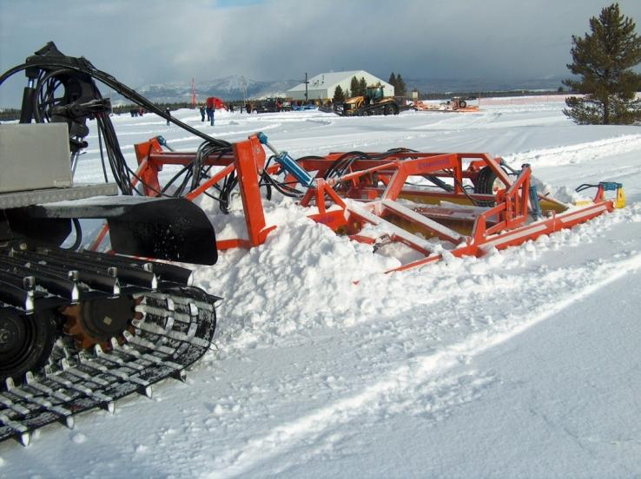
Tips for Effective Grooming with a Drag
Spilling Snow = Carrying Too Much
When snow in front of the blade isn’t churning or is spilling out the sides, the drag is carrying too much snow and isn’t working effectively.
Often a slight tap of the control lever to raise the blades will correct this situation.
Notes:
See pages 66-67 of manual

Slide 90

Tips for Effective Grooming with a Drag
Grooming Hills
Can be a special challenge.
Likely to be a lack of snow at the top and an abundance at the bottom.
Hillside between top and bottom may also be icy or bare.
Notes:
See page 67 of manual

Slide 91

Tips for Effective Grooming with a Drag
Grooming Hills
As much as anywhere, operator must anticipate and plan ahead.
Must also keep to the right so groomer isn’t a hazard.
Notes:
See page 67 of manual

Slide 92

Tips for Effective Grooming with a Drag
Grooming Hills
In approach from the top when grooming downhill – anticipate a need to carry snow for the crest/top area.
Notes:
See page 67 of manual

Slide 93

Tips for Effective Grooming with a Drag
Grooming Hills
In approach from bottom – drag may need to be raised as groomer begins climbing hill to lighten the load.
Notes:
See page 67 of manual

Slide 94
Tips for Effective Grooming with a Drag
Grooming Hills
Note in photo that tracks have spun and dug trenches which drag can fall into, unless it is wider than the tractor. In this case, the tractor can quickly become stuck unless the drag is raised.
Notes:
See page 67 of manual

Slide 95

Tips for Effective Grooming with a Drag
Grooming Curves
Another special challenge.
Likely to be low or no snow in the bottom of a sharp curve.
At the same time, there may be high berms on outside the edge.
Notes:
See pages 67-68 of manual

Slide 96

Tips for Effective Grooming with a Drag
Grooming Curves
Beware that dropping too far down into the center of a sharp or blind curve can be dangerous; so never deviate over the mythical centerline more than 2 feet.
Notes:
See pages 67-68 of manual

Slide 97

Tips for Effective Grooming with a Drag
Grooming Curves
If groomer gets too high on outside edge, it risks getting high centered and stuck.
Use front blade to pull snow from outside into bottom of curve.
Notes:
See pages 67-68 of manual

Slide 98

Tips for Effective Grooming with a Drag
Grooming Curves
Understand that it is difficult to “carry” much snow into a curve with a multi-blade since it tends to “build depth” versus “carry and dump” like single blade drags.
Notes:
See pages 67-68 of manual

Slide 99
Tips for Effective Grooming with a Drag
Grooming Curves
The only location in a curve where there is ever “extra” snow that may be available is at the outside end of the curve; so try to use it.
Notes:
See procedure narrative in second paragraph on page 68 of manual

Slide 100
Tips for Effective Grooming with a Drag
Making a Double Pass
Can be desirable on rough moguled areas (if there is a safe, firm place to turn around).
Means section will receive 3 grooming reps.
Pass 1: (normal rep through section) go a little faster than normal – drop into bottom of curves and don’t spend extra time grooming.
Notes:
See page 68 of manual

Slide 101
Tips for Effective Grooming with a Drag
Making a Double Pass
Pass 2: (return route after turnaround) again make it quick without a lot of extra grooming effort.
Pass 3: (return/2nd on original rough area) really slow down, work trail carefully, and vary position of groomer as needed to take advantage of windrows created by pass numbers 1 and 2.
Notes:
See page 68 of manual

Slide 102

Proper Use of the Front Blade
Don’t Overuse the Front Blade
When using a drag – best used only to level drifts or to pull new snow into the trail. Snow is then best processed, compressed, and leveled by the drag.
Keep snow on the trail!
Notes:
See page 69 of manual

Slide 103

Proper Use of the Front Blade
Don’t Overuse the Front Blade
Don’t “over groom” by continually raising and lowering the front blade since this can lead to accentuating dips in the trail, as well as create rolling trail surfaces.
Notes:
See page 69 of manual

Slide 104

Proper Use of the Front Blade
Don’t Overuse the Front Blade
Trail leveling is best accomplished by the planer effect of a drag.
Don’t “groom” with the front blade. Rather, let the drag blades do the real leveling work.
A smooth trail doesn't require use of the front blade!
Notes:
See page 69 of manual

Slide 105

Proper Use of the Front Blade
Don’t Overuse the Front Blade
It is particularly important to not continually raise and lower the front blade; it will lead to an uneven trail surface since there is no “planer effect” to help level the trail.
Use the TILT adjustment instead of UP/DOWN.
Notes:
See page 69 of manual

Slide 106

Proper Use of the Front Blade
Front Blade Use with Tiller
When using a tiller, the front blade must perform the important process of removing moguls. The front blade needs to be in use nearly fulltime.
Notes:
See page 69 of manual

Slide 107

Proper Use of the Front Blade
Front Blade Use with Tiller
When using a front blade to help remove moguls while tilling, snow should be rolling and churning in front of the blade – just as is desired for processing in a drag.
Notes:
See page 69 of manual

Slide 108
Proper Use of the Front Blade
Beware of Hazards
Watch for rocks and stumps since hitting these hazards can put a great deal of stress on the tractor.
If the blade or tracks hit something, let go of the steering wheel momentarily; this can reduce stress on critical parts by allowing some give in the steering system.
Notes:
See page 69 of manual

Slide 109

Proper Use of the Front Blade
Cutting Tracks Across a Side Hill
Approach the upper steeply inclined slope transversely and use the laterally swiveled blade to push snow – thereby creating a flat track in front of the tractor.
Notes:
See page 69 of manual

Slide 110

Proper Use of the Front Blade
Cutting Tracks Across a Side Hill
Start using a small amount of snow and use more and more snow as the tractor progresses.
Snow pushed downhill will broaden the path and provide greater safety.
Notes:
See page 69 of manual

Slide 111

Proper Use of the Front Blade
Blade Use at Grooming Speed
When using a drag: run with bottom of front blade set about 4 inches (10 cm) above bottom of tracks – not at ground level and not up high.
This allows for day-lighting drifts and keeps blade safe from hitting a buried hazard.
Notes:
See page 69 of manual

Slide 112

Proper Use of the Front Blade
Blade Use at Grooming Speed
Watch behind the front blade to monitor the blade height in relation to bottom of the tracks.
Notes:
See page 69 of manual

Slide 113

Proper Use of the Front Blade
Blade Use at Grooming Speed
If there is a need to use the blade for heavy dozing or for building trail across a drifted side slope – slow down and operate with caution.
Notes:
See pages 69-70 of manual

Slide 114

Proper Use of the Front Blade
Blade Use at Grooming Speed
When using a tiller: blade should always have snow in it since it needs to cut away moguls and feed snow to the tiller for processing. It is very important to know the trail route and the snow depth.
Notes:
See page 70 of manual

Slide 115

Proper Use of the Front Blade
Blade Use at Grooming Speed
If snowfall is low or you are uncertain about trail location or potential hazards – slow down and operate with caution.
Notes:
See page 70 of manual

Slide 116

Proper Use of the Front Blade
Blade Use at Grooming Speed
To flatten low moguls or ripples – drive with blade in “float” position (blade is open with its own weight on ground and no hydraulic down pressure).
Approach larger moguls at about ½ the mogul height (not in float) so snow falls forward into dip behind the mogul.
Notes:
See page 70 of manual

Slide 117

Proper Use of the Front Blade
Blade Use at Grooming Speed
Use “tilt” cylinder to set cutting height rather than “up” and “down” since “up/down” can contribute to a rough or undulating finished surface.
Notes:
See page 70 of manual

Slide 118
Proper Use of the Front Blade
Using Front Blade to
Assist with Climbing
When working fresh deep snowfall, blade can be important to obtaining good weight distribution – particularly if using a tiller.
Also important to obtaining good contact pressure on the snow with groomer.
Notes:
See page 70 of manual

Slide 119
Proper Use of the Front Blade
Using Front Blade to
Assist with Climbing
When climbing steep slopes and operator stops just before unit digs itself in:
Drive backwards with blade lowered to help smooth out the step.
Start again with blade raised and you can typically get a little further; stop before the unit digs itself in and then repeat.
Notes:
See page 70 of manual

Slide 120
Proper Use of the Front Blade
Using Front Blade to
Assist with Descending
When descending steep slopes, the front blade may also be lowered and used as a braking device.
Notes:
See page 70 of manual

Slide 121

Tips for Grooming with a Tiller
Preparing Fresh Snow
Fresh snow should be worked as gently as possible. Snow crystals are destroyed if a tiller is used too aggressively, causing snow crystals to no longer bond and become slush.
Notes:
See page 70 of manual

Slide 122
Tips for Grooming with a Tiller
Processing Moguls
A durable snow surface is only produced by mixing processed snow with fresh snow or by mixing snow on top of the trail with old snow lying at lower levels.
The tiller’s teeth smash chunks of snow into slush, which fills the gaps on the surface of trail.
Processed snow is then shaped by comb.
Notes:
See pages 70-71 of manual

Slide 123

Tips for Grooming with a Tiller
Processing Icy Surfaces
Icy trail surfaces should only be broken open if the snow coating is strong enough or if fresh snow has fallen.
Notes:
See page 71 of manual

Slide 124
Tips for Grooming with a Tiller
Processing Wet Snow
A relatively hard surface may be formed as the result of high humidity which can cause a film of water to develop on comb; sometimes the tilt option on the tiller can be used to help break up this glazing effect.
Notes:
See page 71 of manual

Slide 125
Tips for Grooming with a Tiller
Processing Extreme Sugar Snow
When there is very fine, dry (sugar) snow – it may be desirable to use only a smoothing board.
Tilling in these conditions can create “side walls” (banks of snow spilled out sides).
Can be difficult to create a durable surface.
Good idea to leave snow alone for 2 – 3 hours until temperature changes crystals.
Notes:
See page 71 of manual

Slide 126

Tips for Grooming with a Tiller
Control the Ground Speed
Too fast: tracks will throw snow out the side and over top of tiller onto surface that has already been prepared.
Too fast can also cause tiller to bounce and sway, which results in an uneven surface.
Notes:
See page 71 of manual

Slide 127
Tips for Grooming with a Tiller
Need Sufficient Snow Cover
Never operate tiller until snow is deep enough to prevent damage to underlying turf and to the grooming unit.
When possible – create snow reserves in critical areas where snow may melt back and expose bare ground.
Notes:
See page 71 of manual

Slide 128
Tips for Grooming with a Tiller
Proper Tiller Depth
Indications that tiller depth is set CORRECTLY:
Perfectly clean snow surface behind tiller.
Snow surface retains a firm base.
Economical operation of the unit.
Favorable loading for the tractor and tiller.
Notes:
See page 72 of manual

Slide 129
Tips for Grooming with a Tiller
Proper Tiller Depth
Indications that tiller depth is set INCORRECTLY:
Rotary shaft is set too high so there is no output visible behind tiller.
No markings at hard points on snow surface.
Snow crystal bonding and the base quality deteriorates.
Notes:
See page 72 of manual

Slide 130
Tips for Grooming with a Tiller
Proper Tiller Depth
Indications that tiller depth is set INCORRECTLY:
Rotary shaft is set too deep so there is too little snow through-flow; snow flows out the side and forms a side wall.
Large amounts of power are required, which is not economical.
Notes:
See page 72 of manual

Slide 131
Tips for Grooming with a Tiller
Side Walls Being Formed by Tiller
Side walls being formed to left and right of tiller indicate:
Excessive ground speed.
Excessive engine speed.
Tiller depth set too deep.
Rotary shaft is at a standstill.
Cylinder equipment carrier has been adjusted.
Notes:
See page 72 of manual

Slide 132
Tips for Grooming with a Tiller
Side Walls Being Formed by Tiller
Side walls being formed to left and right of tiller indicate:
Contact pressure position switched “ON” rather than in “FLOAT” position.
The lateral finisher/comb must overlap the prepared track to ensure the transition between tracks occurs in a clean manner.
Notes:
See page 72 of manual

Slide 133
Tips for Grooming with a Tiller
Don’t Leave Holes or Piles
Any holes in the trail surface and/or piles of snow created when driving or turning around should be flattened out again as quickly as possible.
Notes:
See page 72 of manual

Slide 134
Tips for Grooming with a Tiller
Trail Surface Doesn’t Look Good
When parts of the trail look like they weren’t processed and finished okay, it may indicate:
Tiller is set too high; check shaft depth adjustment.
Engine speed is too slow.
Lever not in engaged (float) position.
Notes:
See page 72 of manual

Slide 135
Tips for Grooming with a Tiller
Trail Surface Doesn’t Look Good
When parts of the trail look like they weren’t processed and finished okay, it may indicate:
Excessive ground speed.
Failure to use front tractor blade to create an even surface area on trail – so tiller is lying “open” on moguls.
Notes:
See page 72 of manual

Slide 136
Tips for Grooming with a Tiller
Remove Snow from the Unit
Regularly remove snow that can build up on the loading/cargo area of the tractor; increased weight will cause increased fuel consumption and also affect the unit’s center of gravity.
Notes:
See page 73 of manual

Slide 137
Tips for Grooming with a Tiller
Groomer is Almost at a Standstill
If vehicle is almost at a standstill,
it may indicate:
Tiller is set too deep; check shaft depth adjustment.
Excessive engine speed.
Cylinder equipment carrier adjusted by mistake.
Direction of tiller rotation set to contra-rotation.
Notes:
See page 73 of manual

Slide 138
Tips for Grooming with a Tiller
Groomer is Almost at a Standstill
If vehicle is almost at a standstill,
it may indicate:
Rotary shaft at a standstill (jammed, crushed, or frozen).
The shaft is unbalanced.
A gear is missing as a result of improper maintenance.
Snow is frozen on the shaft.
Notes:
See page 73 of manual

Slide 139
Tips for Grooming with a Tiller
Violent Vibration When Tiller ON
If there are violent vibrations in the vehicle when tiller is ON, it may indicate:
The shaft is unbalanced.
A gear is missing as a result of improper maintenance.
Snow is frozen on the shaft.
Notes:
See page 73 of manual

Slide 140
Tips for Grooming with a Tiller
Violent Vibration When Tiller ON
If there are violent vibrations in the vehicle when tiller is ON, it may indicate:
Vibration means Unbalanced – screws unfasten themselves and bearings can be destroyed.
Always rectify imbalance immediately; it is UNSAFE.
Notes:
See page 73 of manual

Slide 141
Tips for Grooming with a Tiller
Operation on Hills and Steep Slopes
When operating uphill – only drive with amount of power needed and watch for track engagement/traction.
If excessive power is used, tracks will spin and machine will dig itself in.
If tracks begin to dig themselves in, stop and look for a new route.
Notes:
See page 73 of manual

Slide 142
Tips for Grooming with a Tiller
Operation on Hills and Steep Slopes
When operating downhill – drive at moderate speed to ensure: 1) engine doesn’t over-rev, 2) unit doesn’t drift sideways in an uncontrolled manner, and 3) unit doesn’t pull snow down the slope behind it.
Notes:
See page 73 of manual

Slide 143
Tips for Grooming with a Tiller
Operation on Hills and Steep Slopes
When operating downhill – drive with as few steering movements as possible while ensuring that both tracks are turning.
Reduce speed when driving over hilltops to ensure machine tilts forward in a controlled manner.
Notes:
See page 73 of manual

Slide 144
Tips for Grooming with a Tiller
Operation on Hills and Steep Slopes
If when driving downhill the tractor should start to slip or drift sideways, immediately counter-steer up to a point where the tracks contra-rotate to ensure vehicle’s longitudinal axle is again pointing in the direction of the fall line – briefly increase speed to do this.
Notes:
See page 73 of manual

Slide 145
Tips for Grooming with a Tiller
Operation on Hills and Steep Slopes
When vehicle is slipping in the fall line – reduce the slipping movement by: 1) changing over (reversing) tiller’s rotary shaft direction, and 2) carefully using the front blade as an anchor point. Continue to do so until the vehicle is stabilized.
Notes:
See page 73 of manual

Slide 146
Tips for Operating Tracked Vehicles
Keep Vehicle on Top of the Snow
Snow can have a top crust that is harder than the underlying base due to various melt-freeze or wind-packing conditions.
Try not to spin the tracks through the crust if at all possible.
Notes:
See page 74 of manual

Slide 147

Tips for Operating Tracked Vehicles
If Stuck – Don’t Spin
If the groomer gets stuck DO NOT SPIN THE TRACKS!
Remember that a tractor is rarely stuck in a level position unless it spun out while climbing a hard packed icy hill; in this case, raise the implement and back down the hill.
Proceed with caution!
Notes:
See page 74 of manual

Slide 148

Tips for Operating Tracked Vehicles
If Stuck – Don’t Spin
More often than not the tractor will be tilted to the right / outside edge of the trail because it fell off the compacted base.
First thing to do: get the tractor level (particularly gear-drive tractors).
It is likely high-centered, so get the shovel out.
Notes:
See page 74 of manual

Slide 149

Tips for Operating Tracked Vehicles
If Stuck – Don’t Spin
Once the tractor is level, gently rock the vehicle back and forth to help pack snow.
Better to unhook drag sooner versus later; this can save time, effort, and equipment damage.
If this doesn’t work – winch, shovel some more, or call for a tow.
Notes:
See page 74 of manual

Slide 150
Tips for Operating Tracked Vehicles
Use Contour of Hill
If uphill travel is too steep – try to travel at an angle around the hill that uses ground contour to your advantage.
Look ahead and plan your route.
Tilt front blade to uphill side to move snow to downhill side, forming a bench to travel upon.
Notes:
See page 74 of manual

Slide 151
Tips for Operating Tracked Vehicles
Descend in Low Gear
When descending steep grades – use a sufficiently low gear and always keep the tracks revolving to permit steering.
A good rule of thumb is to use the same gear as what is required for climbing the hill.
Notes:
See page 74 of manual

Slide 152
Tips for Operating Tracked Vehicles
Raise Drag in Deep Snow
In deep snow or in drifts such as can occur along fence lines or in a road ditch – raise the drag to prevent too much snow buildup. Also remove accumulated snow from the pan.
If track slippage occurs – try to “wriggle” the unit through the area.
Notes:
See page 74 of manual

Slide 153
Tips for Operating Tracked Vehicles
Steer Clear of Tree Wells
Beware that the snow next to tree wells can be soft due to thawing and lack of stability on the sidewalls – so stay as far away as possible to avoid becoming stuck.
A “walk around” the edge is always advisable to test stability.
Notes:
See page 75 of manual

Slide 154
Tips for Avoiding Equipment Damage
Always Follow the Manufacturer’s Recommendations
Always check and follow guidelines for equipment operation and maintenance.
It’s easier to preserve what you have than it is to restore what you’ve lost.
Notes:
See page 75 of manual

Slide 155
Tips for Avoiding Equipment Damage
Proper Track Tension
There is always potential to have a track come off any tracked vehicle. This most commonly occurs during aggressive side hill operations or from hitting the edge of a stump, rock, or ditch with the track.
Proper tension is the best prevention.
Notes:
See page 75 of manual

Slide 156
Tips for Avoiding Equipment Damage
Warm Up and Cool Down the Engine
Never go from cold start to high power immediately. Always allow engine to warm up for at least 10 minutes at just above idle.
Also allow engine to idle without lights and electrical load prior to shut down to recharge the batteries and to cool down properly.
Notes:
See page 75 of manual

Slide 157
Tips for Avoiding Equipment Damage
Respect the Torque
Tracked vehicle produce a large amount of torque in able to pull heavy loads; be careful not to overstress the unit which could create hairline fractures or misalignments.
Notes:
See page 75 of manual

Slide 158
Tips for Avoiding Equipment Damage
Don’t Run Hydraulics Over the Relief Pressure
If the hydraulics squeal, back off the control.
Running hydraulics past the limit (exceeding relief pressure) causes excess heat and can lead to various mechanical problems.
Notes:
See page 75 of manual

Slide 159
Tips for Avoiding Equipment Damage
Come to a Full Stop
Before Shifting to Reverse
This can cause failure of the transmission, driveline, U-joints, tracks, or differentials.
Always allow engine RPM to return to idle before shifting from forward to reverse.
Notes:
See page 75 of manual

Slide 160
Tips for Avoiding Equipment Damage
Manually Shift
Automatic Transmissions
An engine performs best when operated at the peak of the horsepower and torque power curves – so don’t lug it!
One way to ensure this is to manually shift so that an RPM of at least 2000 to 2200 is consistently maintained.
Notes:
See page 76 of manual

Slide 161
Use It – Don’t Abuse It!
10 Common Operator Abuses
Failure to perform proper warm up: can impair control responses and cut down on the life of engine and transmission. Use a 10 minute warm up period to check the vehicle.
Notes:
See page 76 of manual

Slide 162
Use It – Don’t Abuse It!
10 Common Operator Abuses
Failure to perform walk-around inspection: there is no replacement for an operator’s daily start-up inspection. They need to be familiar with their machine, which can help prevent major problems. Follow a checklist; also stop once per hour during operation to walk around the vehicle.
Notes:
See page 76 of manual

Slide 163
Use It – Don’t Abuse It!
10 Common Operator Abuses
Operating when repairs are needed: if a vehicle is operated with known problems – even little ones – it unnecessarily risks the vehicle’s integrity and the operator’s safety.
Notes:
See page 76 of manual

Slide 164
Use It – Don’t Abuse It!
10 Common Operator Abuses
Operation without proper training: can lead to overloading, stressing, and damaging equipment. Always read all manuals as part of training. Operators must always be attentive to odd sounds and the vehicle’s response to controls.
Notes:
See page 76 of manual

Slide 165
Use It – Don’t Abuse It!
10 Common Operator Abuses
Misapplication of equipment to job: all too often tracked vehicles are used for purposes they were not designed for (bulldozer). Know and respect limits of the vehicle’s capabilities to help protect the tractor’s life and usefulness, as well as to improve the operator’s safety.
Notes:
See page 76 of manual

Slide 166
Use It – Don’t Abuse It!
10 Common Operator Abuses
Going too fast: tracked vehicles are designed to pull heavy loads at relatively slow speeds. High speed operation over rough terrain can damage the tracks and drive train, as well as cause vibration that can harm the frame and components. Also, working in too high of a gear overworks and overheats the transmission and produces a poorly groomed trail that does not stand up well to traffic.
Notes:
See page 77 of manual

Slide 167
Use It – Don’t Abuse It!
10 Common Operator Abuses
Unauthorized modifications: typically stress vehicles beyond their limits versus increasing power or performance; can shorten the life cycle of vehicles and result in warranties being voided.
Notes:
See page 77 of manual

Slide 168
Use It – Don’t Abuse It!
10 Common Operator Abuses
High temperature shutdown: can damage turbochargers and cause premature engine wear. Always allow engine to idle 5 to 10 minutes before shutdown; this provides a good time to perform a walk-around shut-down inspection of the equipment.
Notes:
See page 77 of manual

Slide 169
Use It – Don’t Abuse It!
10 Common Operator Abuses
Unfamiliarity with the trail: can result in damage to equipment and harm to operators. Know the trail and stay on it. Groom with a plan and stick to the plan. Follow the trail signs but never sled tracks unless you’re positive they’re on the trail’s correct route.
Notes:
See page 77 of manual

Slide 170
Use It – Don’t Abuse It!
10 Common Operator Abuses
Using attachments improperly: use it but don’t abuse it. Even if the front blade can remove a large drift in one pass, make several passes to avoid stressing equipment. Saw trees or big limbs into small pieces versus pushing it off as one whole piece, etc.
Notes:
See page 77 of manual

Slide 171
Chapter 4 Quiz
The ground pressure and weight of a grooming tractor allows it to safely cross frozen bodies of water. True or False
The faster the grooming speed, the better the trail quality and durability will be. True or False
Notes:
1. False, 2. False

Slide 172
Chapter 4 Quiz
The ground pressure and weight of a grooming tractor allows it to safely cross frozen bodies of water. False
The faster the grooming speed, the better the trail quality and durability will be. False
Notes:
1. False, 2. False

Slide 173
Chapter 4 Quiz
The amount of snow depth required to begin grooming operations will vary by area and is affected by the type of terrain and by the type of snow. Generally, there should be at least ____ of snow to begin grooming operations that are effective and worth the cost of grooming.
Notes:
See next slide

Slide 174
Chapter 4 Quiz
Answer:
a) 2 inches (5 centimeters)
b) 6 inches (15 centimeters)
c) 12 inches (30 centimeters)
d) 18 inches (45 centimeters)
Notes:
c) 12 inches (30 cm)

Slide 175
Chapter 4 Quiz
The amount of snow depth required to begin grooming operations will vary by area and is affected by the type of terrain and by the type of snow. Generally, there should be at least c) 12 inches (30 centimeters) of snow to begin grooming operations that are effective and worth the cost of grooming.
Notes:
See next slide

Slide 176
Chapter 4 Quiz
The faster the grooming speed, the better the trail quality and durability will be. (duplicate in manual) True or False
Groomer operators should pay special attention to curve berms and try to work down the high outside edges. True or False
Notes:
4. False, 5. True

Slide 177
Chapter 4 Quiz
The faster the grooming speed, the better the trail quality and durability will be. (duplicate in manual) False
Groomer operators should pay special attention to curve berms and try to work down the high outside edges. True
Notes:
4. False, 5. True

Slide 178
Chapter 4 Quiz
It is okay to groom against snowmobile traffic on the left side of the trail if that side is rougher than the right side of the trail. True or False
The best temperature for grooming with a drag is between +5 and +25 degrees F (-15 and -4 C). True or False
Notes:
6. False, 7. True

Slide 179
Chapter 4 Quiz
It is okay to groom against snowmobile traffic on the left side of the trail if that side is rougher than the right side of the trail. False
The best temperature for grooming with a drag is between +5 and +25 degrees F (-15 and -4 C). True
Notes:
6. False, 7. True

Slide 180
Chapter 4 Quiz
The most effective grooming speed with a drag is:
a) 3 to 4 mph (5 to 6.5 kph)
b) 5 to 7 mph (8 to 11 kph)
c) 8 to 10 mph (13 to 16 kph)
d) 10 to 12 mph (16 to 19 kph)
Notes:
b) 5 to 7 mph (8 to 11 kph)

Slide 181
Chapter 4 Quiz
The most effective grooming speed with a drag is:
a) 3 to 4 mph (5 to 6.5 kph)
b) 5 to 7 mph (8 to 11 kph)
c) 8 to 10 mph (13 to 16 kph)
d) 10 to 12 mph (16 to 19 kph)
Notes:
b) 5 to 7 mph (8 to 11 kph)

Slide 182
Chapter 4 Quiz
Grooming at night will generally produce the best quality trail because temperatures are typically colder so the snow will flow better and set up harder; traffic volumes are also typically at their lowest which helps provide setup time. True or False
Notes:
9. True

Slide 183
Chapter 4 Quiz
Grooming at night will generally produce the best quality trail because temperatures are typically colder so the snow will flow better and set up harder; traffic volumes are also typically at their lowest which helps provide setup time. True
Notes:
9. True

Slide 184
Chapter 4 Quiz
Mirrors on a tractor are typically useless and aren’t important since there isn’t a need to see behind the tractor. True or False
It is okay to dump snow from the groomer on roads and driveways because it helps warn motorists and landowners. True or False
Notes:
10. False, 11. False

Slide 185
Chapter 4 Quiz
Mirrors on a tractor are typically useless and aren’t important since there isn’t a need to see behind the tractor. False
It is okay to dump snow from the groomer on roads and driveways because it helps warn motorists and landowners. False
Notes:
10. False, 11. False

Slide 186
Chapter 4 Quiz
A tractor should descend steep hills in the same gear that is used to climb the hill. True or False
Normally, roads should never be groomed wider than twice the width of the grooming equipment. True or False
Notes:
12. True, 13. True

Slide 187
Chapter 4 Quiz
A tractor should descend steep hills in the same gear that is used to climb the hill. True
Normally, roads should never be groomed wider than twice the width of the grooming equipment. True
Notes:
12. True, 13. True

Slide 188
Chapter 4 Quiz
If the grooming tractor becomes stuck:
a) quickly give it more throttle
b) don’t spin the tracks
c) gently rock the vehicle back and forth, packing the snow
d) consider unhooking the drag – sooner versus later
e) a shovel may be needed
f) all of the above except a
g) a, c, d, e, and f above
Notes:
f) All of the above except a

Slide 189
Chapter 4 Quiz
If the grooming tractor becomes stuck:
a) quickly give it more throttle
b) don’t spin the tracks
c) gently rock the vehicle back and forth, packing the snow
d) consider unhooking the drag – sooner versus later
e) a shovel may be needed
f) all of the above except a
g) a, c, d, e, and f above
Notes:
f) All of the above except a

Slide 190
Chapter 4 Quiz
When backing up with a grooming drag on the trail, a pile of snow is often created. It is okay to leave this pile of snow on the trail since snowmobiles will knock it down. True or False
Notes:
15. False

Slide 191
Chapter 4 Quiz
When backing up with a grooming drag on the trail, a pile of snow is often created. It is okay to leave this pile of snow on the trail since snowmobiles will knock it down. False
Notes:
15. False

Slide 192
Chapter 4 Quiz
When grooming trails, always:
a) stay on the trail with grooming equipment
b) feel free to pick new routes to provide variety since the groomer will go through anything
c) turn around only where there is ample turning room and it is known that the snow base will support the equipment – preferably using areas where turnarounds have been made before
d) a and c above
e) a, b, and c above
Notes:
d) a and c above

Slide 193
Chapter 4 Quiz
When grooming trails, always:
a) stay on the trail with grooming equipment
b) feel free to pick new routes to provide variety since the groomer will go through anything
c) turn around only where there is ample turning room and it is known that the snow base will support the equipment – preferably using areas where turnarounds have been made before
d) a and c above
e) a, b, and c above
Notes:
d) a and c above

Slide 194
If there is a lack of snow in the middle of the trail, the options could include:
a) set the drag blades to pull snow in from the trail edges
b) use the front blade of the tractor to pull snow in from the right edge of the trail
c) don’t bother grooming – put the wheels down until you find snow
d) operate the groomer on the outside edge of the trail
e) a, b, and d above
f) b and d above
Notes:
f) b and d above

Slide 195
If there is a lack of snow in the middle of the trail, the options could include:
a) set the drag blades to pull snow in from the trail edges
b) use the front blade of the tractor to pull snow in from the right edge of the trail
c) don’t bother grooming – put the wheels down until you find snow
d) operate the groomer on the outside edge of the trail
e) a, b, and d above
f) b and d above
Notes:
f) b and d above

Slide 196
Chapter 4 Quiz
Never stop to remove rocks, logs, limbs, or other debris that is lying on or in the trail surface because they provide a solid filler that helps the trail last longer.
True or False
Notes:
18. False

Slide 197
Chapter 4 Quiz
Never stop to remove rocks, logs, limbs, or other debris that is lying on or in the trail surface because they provide a solid filler that helps the trail last longer.
False
Notes:
18. False

Slide 198
Chapter 4 Quiz
When snow is spilling out the side of the drag, it means the drag is carrying too much snow, is likely set too low, and is not working effectively. True or False
A groomer operator should be cautious about following a snowmobile track across an open area. True or False
Notes:
19. True, 20. True

Slide 199
Chapter 4 Quiz
When snow is spilling out the side of the drag, it means the drag is carrying too much snow, is likely set too low, and is not working effectively. True
A groomer operator should be cautious about following a snowmobile track across an open area. True
Notes:
19. True, 20. True

Slide 200
Chapter 4 Quiz
Common operator abuses of tracked equipment include:
a) going too slow
b) spending too much time warming up the engine
c) performing unwarranted pre-operation inspections
d) unauthorized modifications
e) none of the above
f) a, b, c, and d above
Notes:
d) unauthorized modifications

Slide 201
Chapter 4 Quiz
Common operator abuses of tracked equipment include:
a) going too slow
b) spending too much time warming up the engine
c) performing unwarranted pre-operation inspections
d) unauthorized modifications
e) none of the above
f) a, b, c, and d above
Notes:
d) unauthorized modifications

Slide 202
Chapter 4 Quiz
Proper use of a tiller for snowmobile trail grooming requires:
a) a tractor with sufficiently large horsepower
b) a good front blade operator
c) deep snow cover
d) none of the above
e) a, b, and c above
Notes:
e) a, b and c above

Slide 203
Chapter 4 Quiz
Proper use of a tiller for snowmobile trail grooming requires:
a) a tractor with sufficiently large horsepower
b) a good front blade operator
c) deep snow cover
d) none of the above
e) a, b, and c above
Notes:
e) a, b and c above

Slide 204
Chapter 4 Quiz
If groomer operators encounter poor visibility caused by high wind, heavy snowfall, fog, or a combination of these conditions when grooming, and it is difficult to see where to groom, they should:
Notes:
See next slide

Slide 205
Chapter 4 Quiz
Answer:
a) simply stop right where they are and leave all lights on with the engine running
b) contact their grooming manager or dispatcher to advise them on the situation and location
c) stay with the equipment and wait for visibility to improve
d) get out and walk
e) a, b, and c above
f) none of the above
Notes:
e) a, b and c above

Slide 206
Chapter 4 Quiz
Answer:
a) simply stop right where they are and leave all lights on with the engine running
b) contact their grooming manager or dispatcher to advise them on the situation and location
c) stay with the equipment and wait for visibility to improve
d) get out and walk
e) a, b, and c above
f) none of the above
Notes:
e) a, b and c above

Slide 207
Chapter 4 Quiz
It is never a good idea to get out of the tractor and walk back to check the trail, particularly when alone at night. True or False
Notes:
24. False

Slide 208
Chapter 4 Quiz
It is never a good idea to get out of the tractor and walk back to check the trail, particularly when alone at night. False
Notes:
24. False

Slide 209
Chapter 4 Quiz
When using a tiller and parts of the trail do not look good, like they were not processed and finished okay, it may indicate:
a) the tiller depth is set to high
b) engine speed on the tractor is too slow
c) the tiller isn’t engaged in the float position
d) excessive groundspeed with the tractor
e) the front tractor blade wasn’t used to cut moguls and create an even surface area on the trail, so the tiller is “open” over the moguls
f) all of the above
Notes:
f) all of the above

Slide 210
Chapter 4 Quiz
When using a tiller and parts of the trail do not look good, like they were not processed and finished okay, it may indicate:
a) the tiller depth is set to high
b) engine speed on the tractor is too slow
c) the tiller isn’t engaged in the float position
d) excessive groundspeed with the tractor
e) the front tractor blade wasn’t used to cut moguls and create an even surface area on the trail, so the tiller is “open” over the moguls
f) all of the above
Notes:
f) all of the above

Slide 211
Chapter 4 Quiz
If the tractor is driven too fast while operating a tiller, the tracks will throw snow out to the side and also over the top of the tiller onto the snow surface which has already been prepared. True or False
Notes:
26.True

Slide 212
Chapter 4 Quiz
If the tractor is driven too fast while operating a tiller, the tracks will throw snow out to the side and also over the top of the tiller onto the snow surface which has already been prepared. True
Notes:
26.True

Slide 213
Chapter 4 – Training Program Photo Credits
Don Reed
Jerry Burr
Kim Raap – Trails Work Consulting
Maine Department of Conservation
Pisten Bully
Polaris Industries
Steve Janes – SnoWest
The Shop Industrial
Wyoming State Trails Program
Project Manager
Kim Raap – Trails Work Consulting
4015 S. Brady Court – Sioux Falls, SD 57103
(605) 371-9799 Trailswork@aol.com
Contact IASA at www.snowiasa.org

Slide 214
ACKNOWLEDGEMENT & DISCLAIMER
This series of Power Point training slides has been produced to accompany Chapters 1 – 6 of Guidelines for Snowmobile Trail Groomer Operator Training – A Resource Guide for Trail Grooming Managers and Equipment Operators which was produced by the International Association of Snowmobile Administrators (IASA) in 2005. This project has been produced by IASA, with financial assistance from the Recreational Trails Program administered by the U.S. Federal Highway Administration (FHWA), to aid local operator training.
This training program is disseminated under the sponsorship of the Department of Transportation in the interest of information exchange. The United States Government assumes no liability for the contents or use thereof. The contents of this program do not constitute a standard, specification, or regulation.
Special recognition is given to the many agencies, companies, and individuals whose photos have been used for demonstration purposes in this project. Sponsors of this project do not endorse products or manufacturers. Trade and manufacturer’s names appear in this training program only because they are considered essential to the object of these training slides.
Copyright © 2007 Owned by the International Association of Snowmobile Administrators.
All Rights Reserved.

