Slide 1

Groomer Operator Training Resource Guide
Chapter 5:
Maintaining
Grooming Equipment
Notes:
See pages 1-22 of manual

Slide 2
Preventative Maintenance
Comprehensive Preventative Maintenance Program: the key to ensuring that downtime and emergency repairs are kept to a minimum and that equipment remains safe to operate.
Lack of due care can aggravate problems, so take good care of what you have.
Notes:
See page 81 of manual

Slide 3
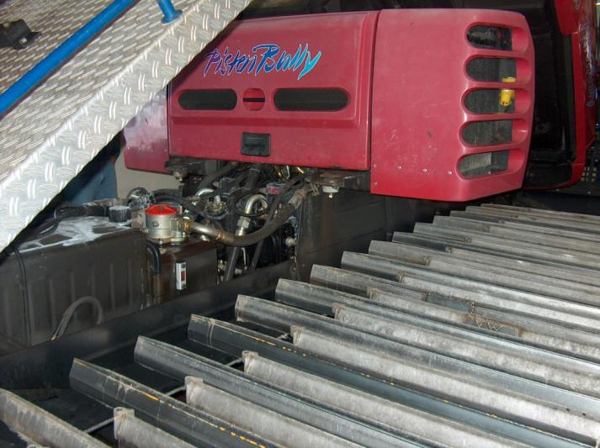
Four Elements to Preventative Maintenance
INSPECTION: much can be learned about the condition of a vehicle by carefully looking, listening, smelling, and feeling. Identify areas of common failures and closely monitor; also keep a general lookout for issues throughout the equipment.
Notes:
See page 81 of manual

Slide 4
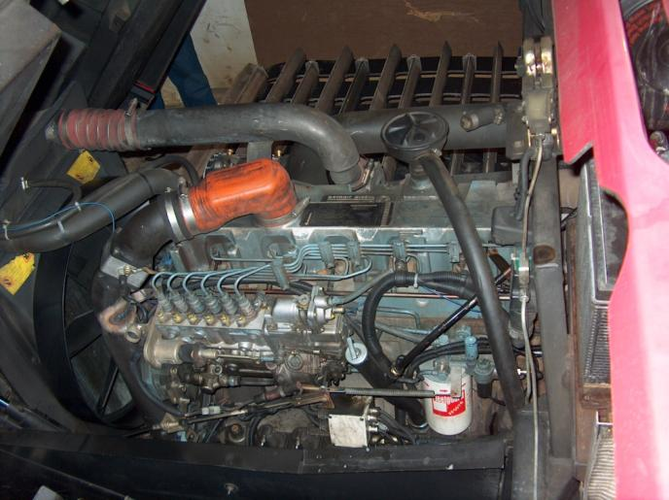
Four Elements to Preventative Maintenance
LUBRICATION: ensuring that lubricating fluids are fresh and full is extremely important. Along with lubricating important moving parts, installing fresh lubricants will displace water, dirt, and spent lubricant which has accumulated where it shouldn’t be.
Notes:
See page 81 of manual

Slide 5
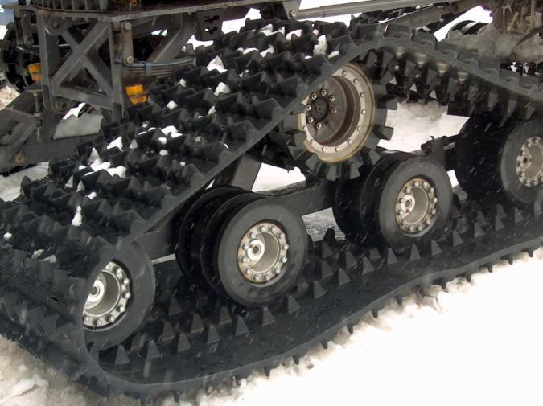
Four Elements to Preventative Maintenance
ADJUSTMENT: tracked vehicles have a number of adjustments that can compensate for wear and changes in alignment. Ensuring that adjustments are made to maintain specific characteristics is the best way to prevent nuisance failures in the field.
Notes:
See page 81 of manual

Slide 6
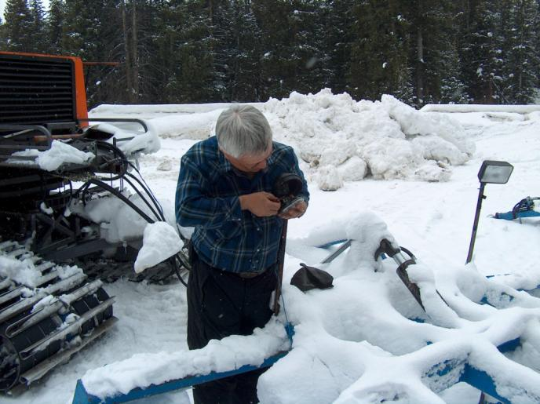
Four Elements to Preventative Maintenance
REPAIR: any part or system found to be damaged, worn out, or otherwise not doing its job should be promptly and fully repaired by a qualified individual to prevent having the machine and operator stranded out on the trail because of a preventable breakdown.
Notes:
See page 81 of manual

Slide 7
Types of Maintenance
First Time Operation of a new Unit
Pre-Season Inspection and Maintenance
Pre-Operation Inspection and Maintenance
Post-Operation Inspection and Maintenance
Routine Shop Inspection and Maintenance
Off-Season Storage Procedures
Always refer to the Owner’s Manual, as well as follow these general guidelines:
Notes:
See page 82 of manual

Slide 8
First Time Operation of a New Unit
Prior to operation, read the Owner’s Manual. Also:
Perform visual inspection of entire vehicle – inside and outside.
Check fuel and oil levels and fill as needed.
Familiarize yourself with all controls and functions, including all Owner’s Manual recommendations.
Notes:
See page 82 of manual

Slide 9
First Time Operation of a New Unit
With engine running, verify that all gauges are operating and within specified limits.
ALWAYS PROCEED VERY SLOWLY, getting the feel of the vehicle and its characteristics when operating any vehicle for the first time.
After 10 hours (or as specified by manual) check for loose bolts, nuts, fittings, etc., as well as for proper track tension.
Notes:
See page 82 of manual

Slide 10
Pre-Season Inspection and Maintenance
If off-season recommendations were followed, readying the vehicle at the start of a new season should be relatively easy:
Refer to maintenance records and be sure that all required work was performed.
Check all fluid levels and look for signs of leaks.
Install and/or adjust tracks.
Notes:
See page 82 of manual

Slide 11
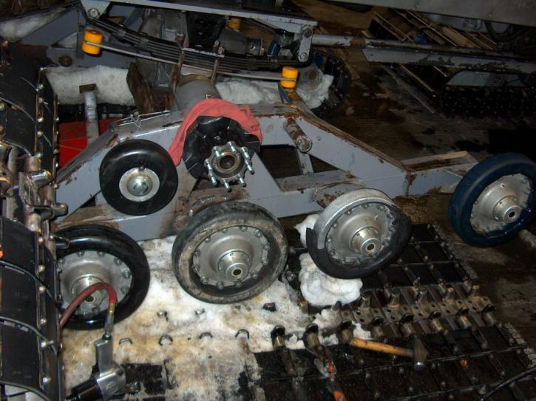
Pre-Season Inspection and Maintenance
Inspect all welded joints and stress areas for cracks.
Inspect bearings, joints, and all moving parts.
Notes:
See page 82 of manual

Slide 12
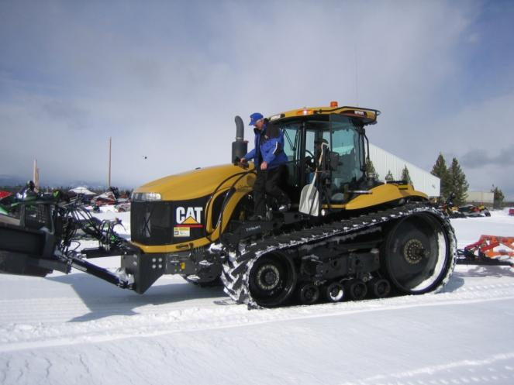
Pre-Grooming Operation
Inspection and Maintenance
Before starting operations for a new day, operators should perform a pre-operation inspection. Every piece of equipment should have a set inspection program based upon the manufacturer’s recommendations.
Warm up tractor for at least 10 minutes and use this time to complete inspection.
Notes:
See page 83 of manual and page 98 in Appendix

Slide 13
Pre-Grooming Operation Inspection and Maintenance – Sample Checklist
Fuel Tank Full
Engine Oil
Hydraulic Oil
Anti-Freeze
Wiper Fluid
Belts
Lights, Beacon & Battery
Hydraulic Hoses
Mirrors
Gauges
Wipers
Survival Gear
Radio/Phone
Fire Extinguisher
Ice Scraper & Shovel
Track Grousers & Belts
Track Wheels & Tension
Implements
Notes:
See page 98 of manual in the Appendix (Daily Grooming Log sample)

Slide 14
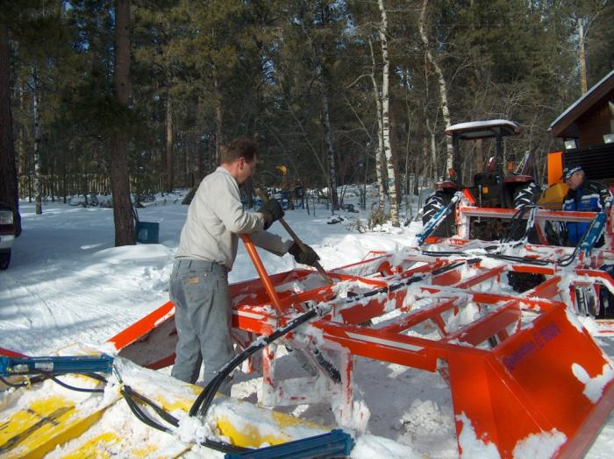
Post-Grooming Operation
Inspection and Maintenance
Develop a routine for shutting equipment down at the end of a run, based upon manufacturer’s recommendations. Use this shut-down time to perform a walk-around inspection and to refuel.
Often good to remove excess snow and ice that accumulated on equipment during shift.
Notes:
See page 83 of manual and page 98 in Appendix

Slide 15
Post-Grooming Operation Inspection and Maintenance – Sample Checklist
Fill Fuel Tank
Radio/Phone Off
Water Separator Checked
Brake On
Key Off
Plugged In
Implements in Down Position
Shoveled Off
Maintenance Needs Recorded
Daily Log Completed
Notes:
See page 98 of manual in the Appendix (Daily Grooming Log sample)

Slide 16
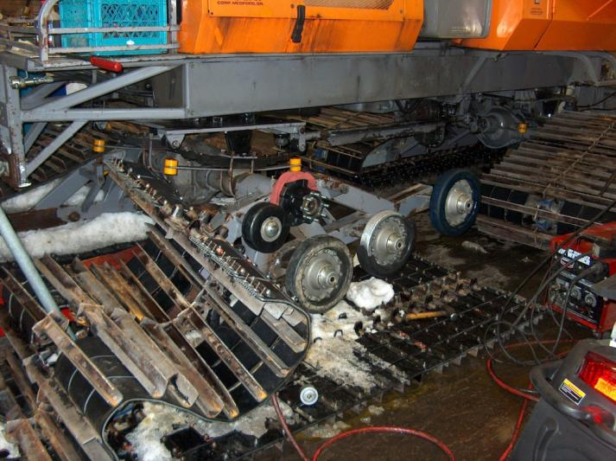
Routine Shop Inspection and Maintenance
In addition to on-going operational maintenance – tracked vehicles require regular and frequent shop inspection and maintenance (thaw out if possible).
Notes:
See page 83 of manual

Slide 17
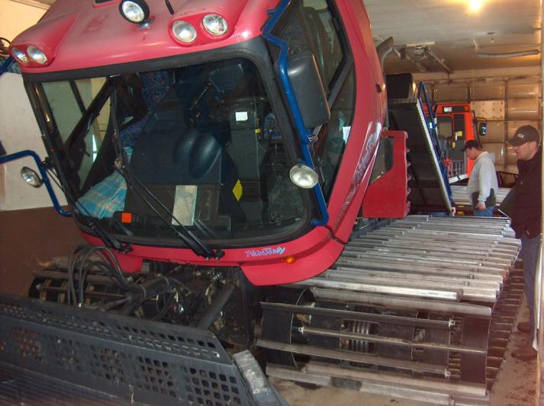
Routine Shop Inspection and Maintenance
Use a maintenance log/checklist to help identify needs within timeframes recommended by the manufacturer and to track maintenance performed.
Notes:
See page 83 of manual

Slide 18
Off-Season Storage Procedures
Grooming vehicles spend a significant part of the year sitting completely idle, so proper storage is important for protecting major investments.
An off-season maintenance program should be developed for every vehicle based upon the manufacturer’s recommendations. General guidelines should include:
Notes:
See page 84 of manual

Slide 19
Off-Season Storage Procedures
Clean and service the battery and the battery compartment.
Change the oil, transmission fluid, hydraulic fluids, and filters.
Lube all fittings to displace water and spent grease.
Check for wear points: track belts and components, wheel wear, cracks in carrier and frame, hydraulic assemblies, etc.
Notes:
See page 84 of manual

Slide 20
Off-Season Storage Procedures
Check engine compartment for belt wear, tension and alignment; throttle linkages and springs; broken or worn wiring; etc.
Clean interior and exterior.
Park in garage if possible. If exposed to weather, remove or cover tracks to prevent UV light damage to rubber. If stored with tracks on – release tension.
All engines should be started monthly.
Notes:
See page 84 of manual

Slide 21
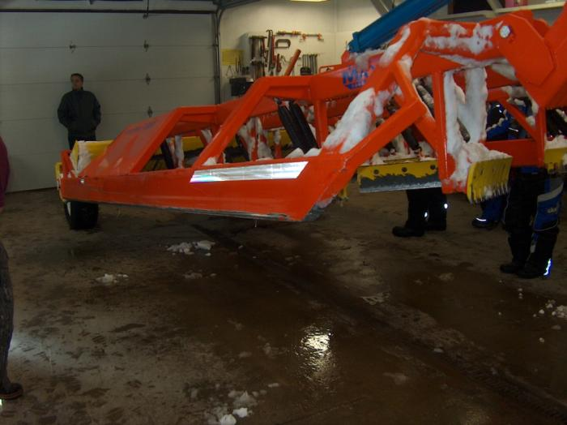
General Tractor Maintenance Tips
If at all possible – completely thaw out tractor and implements for every scheduled maintenance session regardless of mess and time involved. This is the only way to discover cracks in welds, missing small parts like nuts and screws, and will save on down-time later.
Notes:
See page 84 of manual

Slide 22
General Tractor Maintenance Tips
Always jack up each track for journal bearing lubrication, checking track tension, and track adjustment.
When greasing track journals, a very thorough greasing is required; it’s easy to under-grease but nearly impossible to over-grease them.
Notes:
See page 84 of manual

Slide 23
General Tractor Maintenance Tips
Aluminum or steel track cleats are often over-tightened when fastened to track belts, which can lead to premature belt failure. Always use a torque wrench since guidelines typically stipulate tightening nuts as low as 25 foot-pounds. (but always be certain to check manufacturer’s recommendations since this can vary) Must be set tight enough to slightly depress the rubber, or you may lose cleats.
Notes:
See page 84 of manual

Slide 24
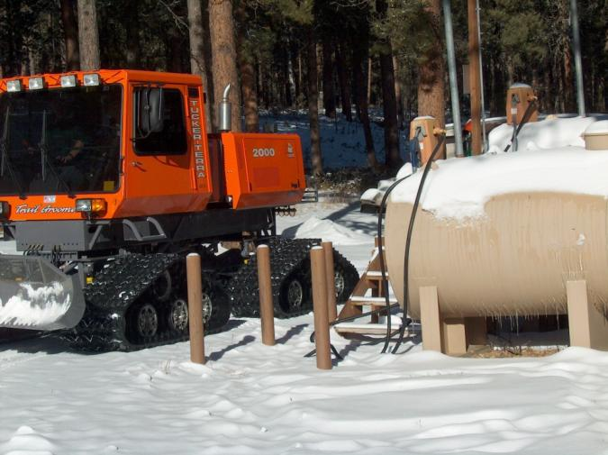
General Tractor Maintenance Tips
Always refuel the tractor at the end of a grooming run. This ensures the unit is ready to go the next time it’s needed or in event of an emergency. It also helps avoid condensation buildup in the empty fuel tank, which could lead to fuel line freeze-up or engine problems.
Notes:
See page 84 of manual

Slide 25
Chapter 5 Quiz
Preventative maintenance can help prevent downtime and keep equipment safe to operate. The four main elements of a good preventative maintenance program include:
a) measurement, fueling, tinkering, and replacement
b) monitoring, greasing, tuning, and overhauls
c) inspection, lubrication, adjustment, and repair
d) surveillance, servicing, alignment, and rebuild
Notes:
c) inspection, lubrication, adjustment and repair

Slide 26
Chapter 5 Quiz
Preventative maintenance can help prevent downtime and keep equipment safe to operate. The four main elements of a good preventative maintenance program include:
a) measurement, fueling, tinkering, and replacement
b) monitoring, greasing, tuning, and overhauls
c) inspection, lubrication, adjustment, and repair
d) surveillance, servicing, alignment, and rebuild
Notes:
c) inspection, lubrication, adjustment and repair

Slide 27
Chapter 5 Quiz
Before operating any grooming equipment, always check all fluid levels and check for leaks. True or False
If you identify a repair that needs to be made while doing a pre-operation inspection, go ahead and do the scheduled grooming run and report the condition to the Grooming Manager when you return. True or False
Notes:
2. True, 3. False

Slide 28
Chapter 5 Quiz
Before operating any grooming equipment, always check all fluid levels and check for leaks. True
If you identify a repair that needs to be made while doing a pre-operation inspection, go ahead and do the scheduled grooming run and report the condition to the Grooming Manager when you return. False
Notes:
2. True, 3. False

Slide 29
Chapter 5 Quiz
When operating a vehicle for the first time, run it as fast as it will go to see if it has enough power. True or False
A tractor should be shut off as quickly as possible after a grooming shift to conserve fuel. True or False
Notes:
4. False, 5. False

Slide 30
Chapter 5 Quiz
When operating a vehicle for the first time, run it as fast as it will go to see if it has enough power. False
A tractor should be shut off as quickly as possible after a grooming shift to conserve fuel. False
Notes:
4. False, 5. False

Slide 31
Chapter 5 Quiz
Never remove ice or snow that has built up on grooming equipment since it might damage the equipment; plus the added weight is good for trail compaction. True or False
Grooming tractors should be stored inside or have their tracks removed during the off-season to avoid UV light damage to rubber tracks and belts. True or False
Notes:
4. False, 5. True

Slide 32
Chapter 5 Quiz
Never remove ice or snow that has built up on grooming equipment since it might damage the equipment; plus the added weight is good for trail compaction. False
Grooming tractors should be stored inside or have their tracks removed during the off-season to avoid UV light damage to rubber tracks and belts. True
Notes:
4. False, 5. True

Slide 33
Chapter 5 – Training Program Photo Credits
Kim Raap – Trails Work Consulting
Wyoming State Trails Program
Project Manager
Kim Raap – Trails Work Consulting
4015 S. Brady Court – Sioux Falls, SD 57103
605) 371-9799 Trailswork@aol.com
Contact IASA at www.snowiasa.org

Slide 34
ACKNOWLEDGEMENT & DISCLAIMER
This series of Power Point training slides has been produced to accompany Chapters 1 – 6 of Guidelines for Snowmobile Trail Groomer Operator Training – A Resource Guide for Trail Grooming Managers and Equipment Operators which was produced by the International Association of Snowmobile Administrators (IASA) in 2005. This project has been produced by IASA, with financial assistance from the Recreational Trails Program administered by the U.S. Federal Highway Administration (FHWA), to aid local operator training.
This training program is disseminated under the sponsorship of the Department of Transportation in the interest of information exchange. The United States Government assumes no liability for the contents or use thereof. The contents of this program do not constitute a standard, specification, or regulation.
Special recognition is given to the many agencies, companies, and individuals whose photos have been used for demonstration purposes in this project. Sponsors of this project do not endorse products or manufacturers. Trade and manufacturer’s names appear in this training program only because they are considered essential to the object of these training slides.
Copyright © 2007 Owned by the International Association of Snowmobile Administrators.
All Rights Reserved.

