Slide 1

Group Discussion
Training Slides
“Anticipate Your Needs”
and
“Critique This”

Slide 2
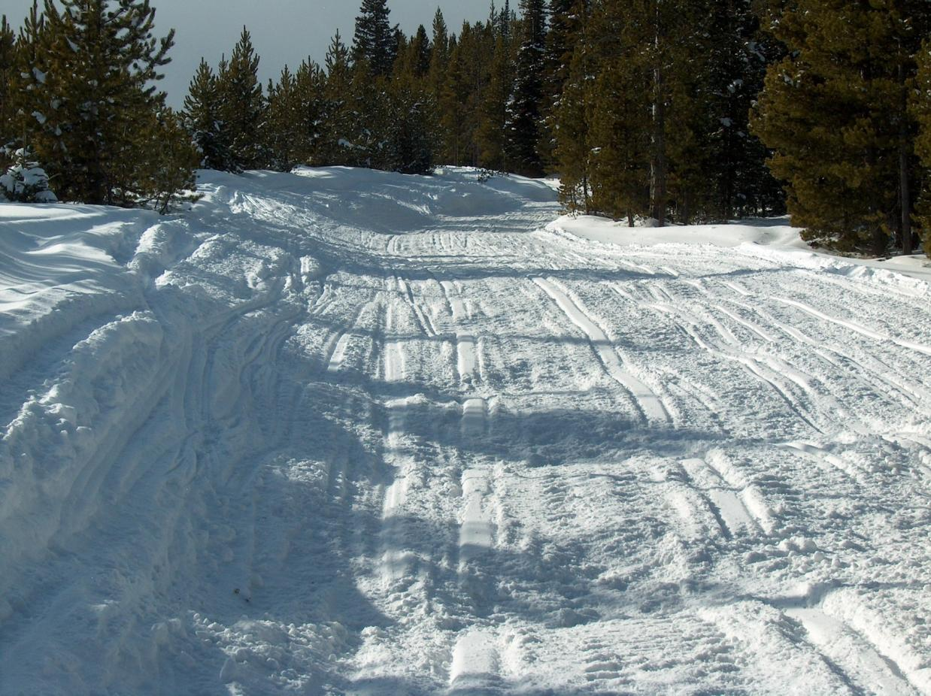
Anticipate Your Needs
Notes:
Heavy moguls; need to be aggressive with front blade and drag or tiller – likely needs double pass to bring back to good condition. While need to bring snow in from edges, need to be cautious = could be stumps in snow to the right and could likely be a cut bank on the left side of trail; also need to anticipate traffic around the curve ahead. Other?

Slide 3
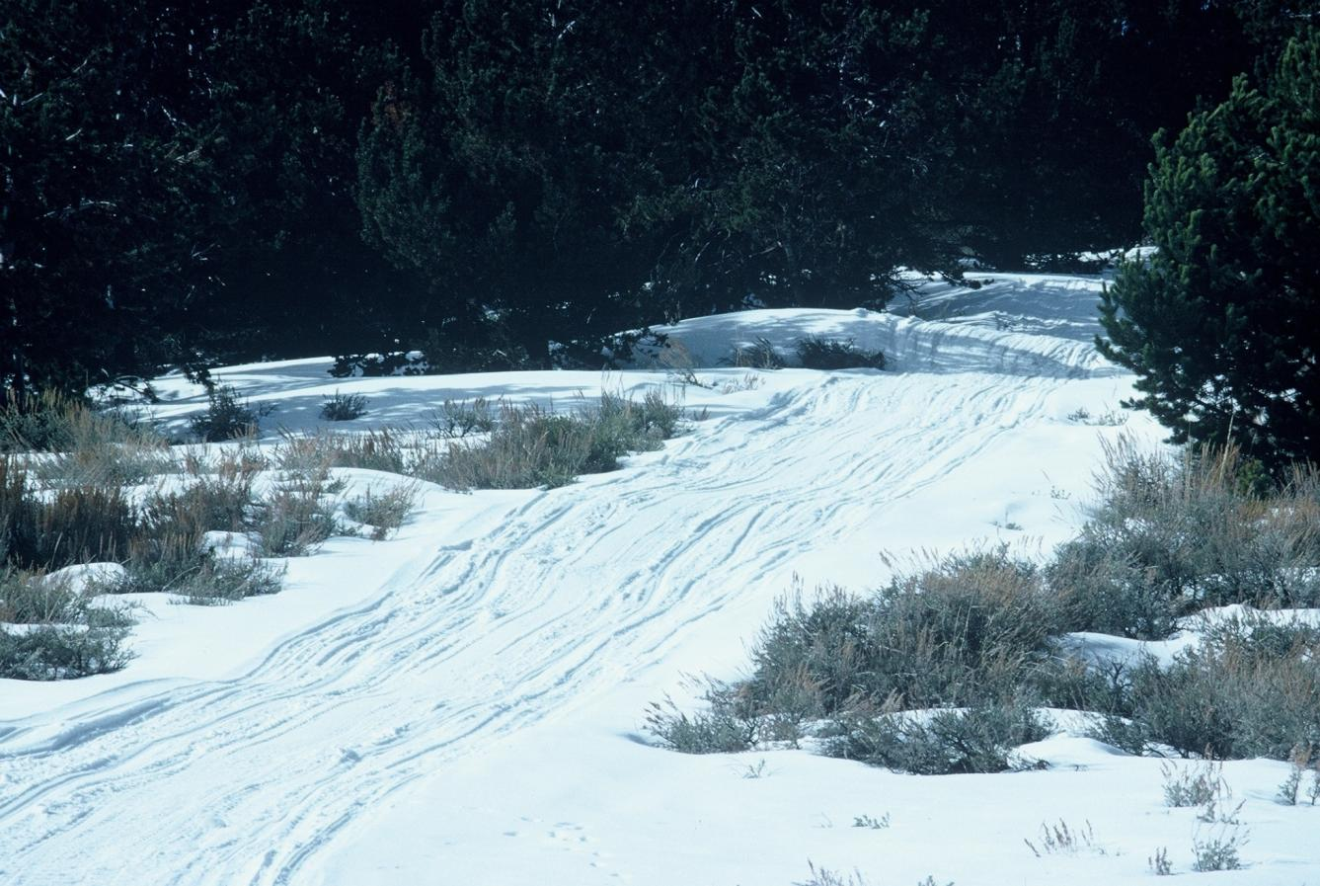
Anticipate Your Needs
Notes:
Generally low snow conditions. Need to address moguls in the foreground, but also need to carry snow to fill drainage depression near the top of photo, which could be a challenge due to the low snow. Other?

Slide 4
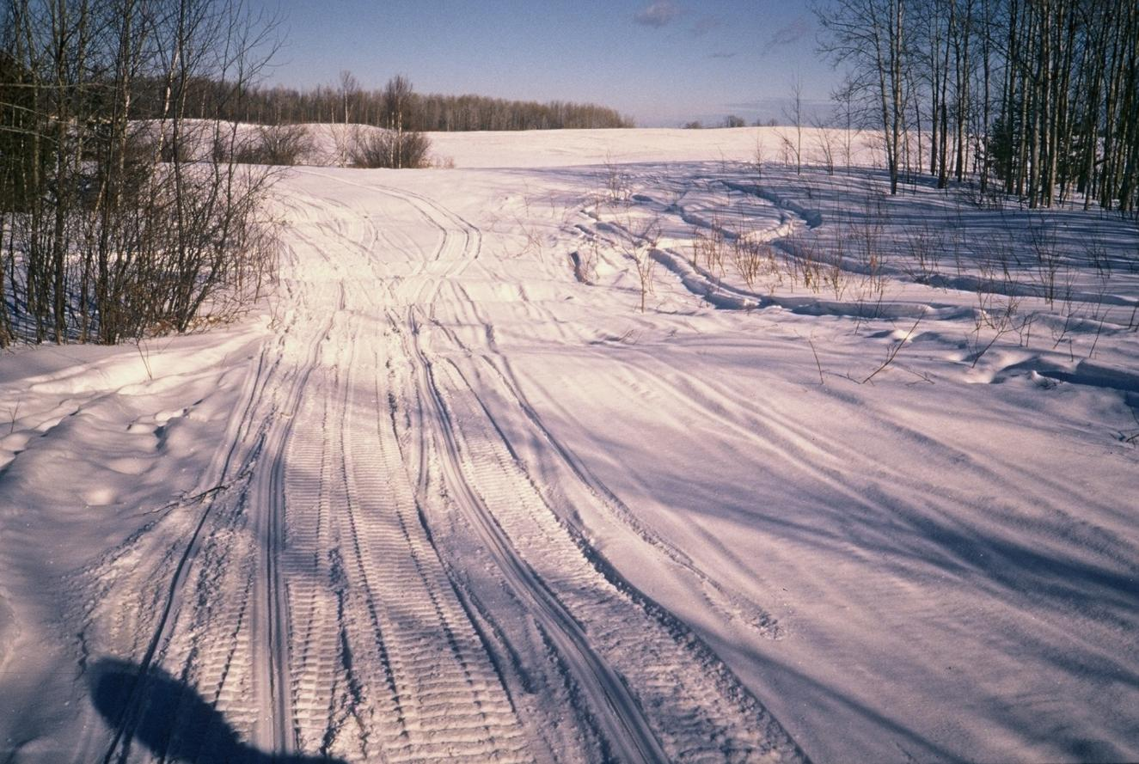
Anticipate Your Needs
Notes:
Snow conditions are deeper than they may appear since what appears to be grass at a glance is actually the top of thickets. Which way does the trail go – since there are sleds tracks both left around the corner as well as to the right into the open area? There are moguls to address ahead in the constricted point. Other?

Slide 5
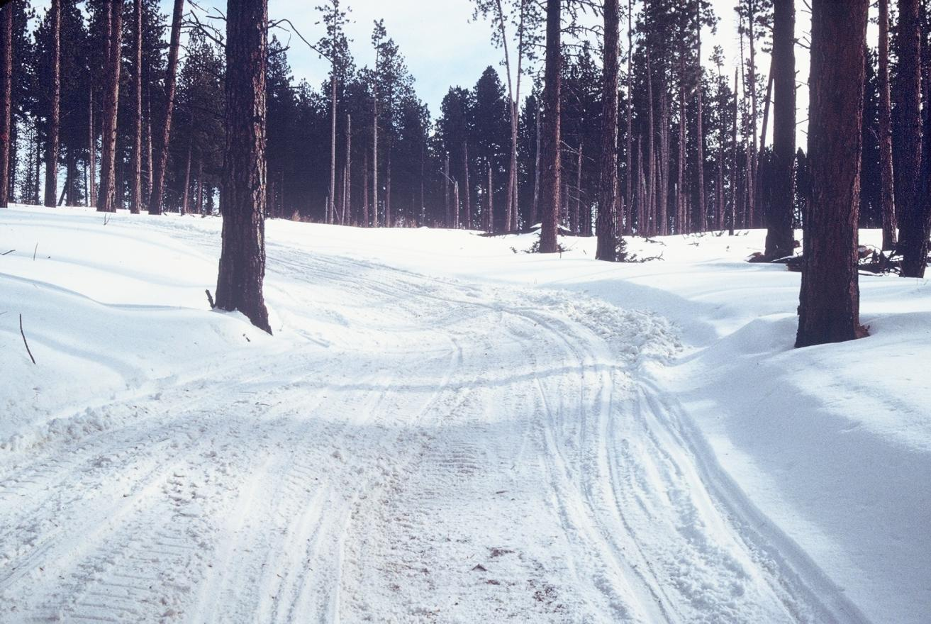
Anticipate Your Needs
Notes:
Sharp turn with little room to negotiate due to tree in the bottom of the curve = can’t cut the corner with a drag. High berm on outside edge with low snow/ holes in the bottom of the curve. Other?

Slide 6
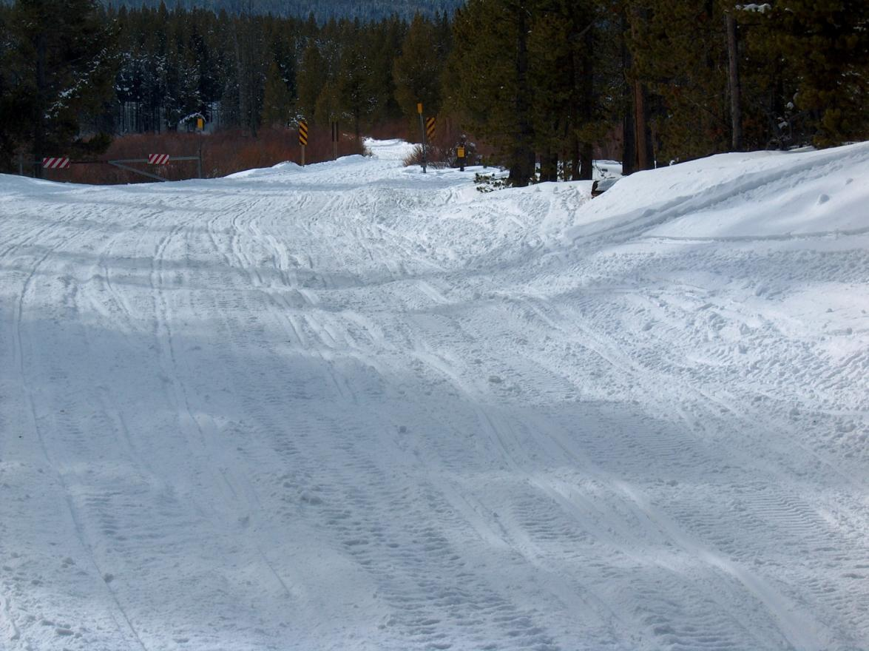
Anticipate Your Needs
Notes:
Where is the trail – left or right? Don’t try to groom too wide – so need to pick a consistent path. Heavy moguls to work – also with a bridge (= a width restriction ahead). Other?

Slide 7
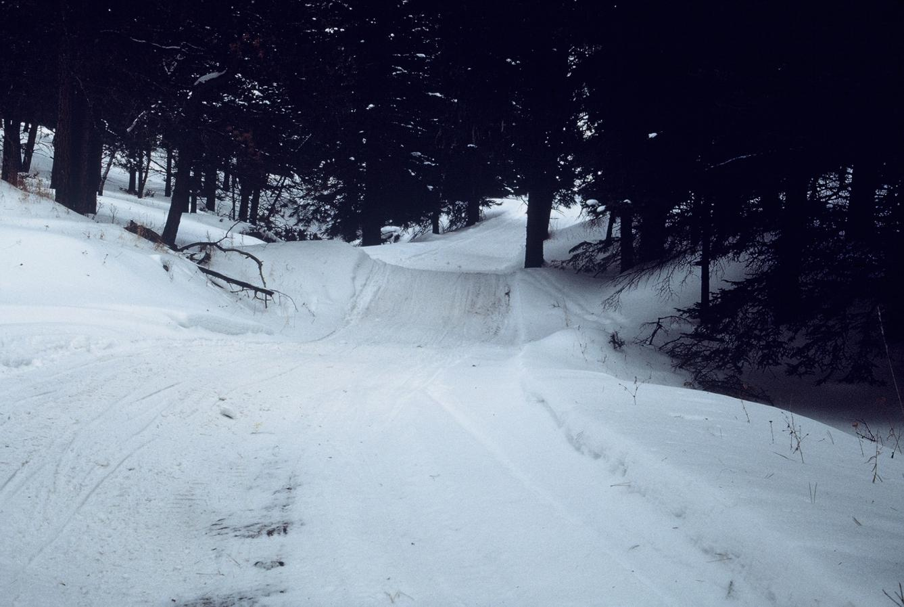
Anticipate Your Needs
Notes:
Tank trap (or Kelly Hump) ahead. Need to carry snow to try to fill depression and even out the grade – but there is low snow (bare spot in trail) as you approach this area. Also have a tight spot due to a tree on the other side of the berm. Other?

Slide 8
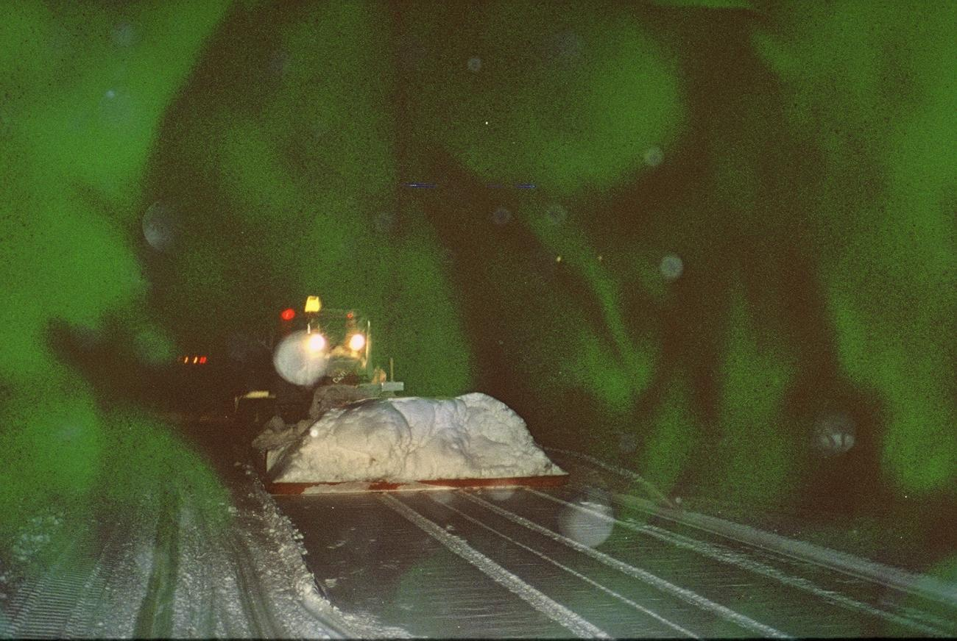
Critique This
Notes:
Night grooming; note heavy snow load on pan = should be shoveled off to reduce weight; note tire tracks behind pan = wheel kit is partially down and needs to be raised; no SMV on rear of drag but lights and beacon are very visible; other than wheel tracks, drag is laying a pretty good trail. Other?

Slide 9
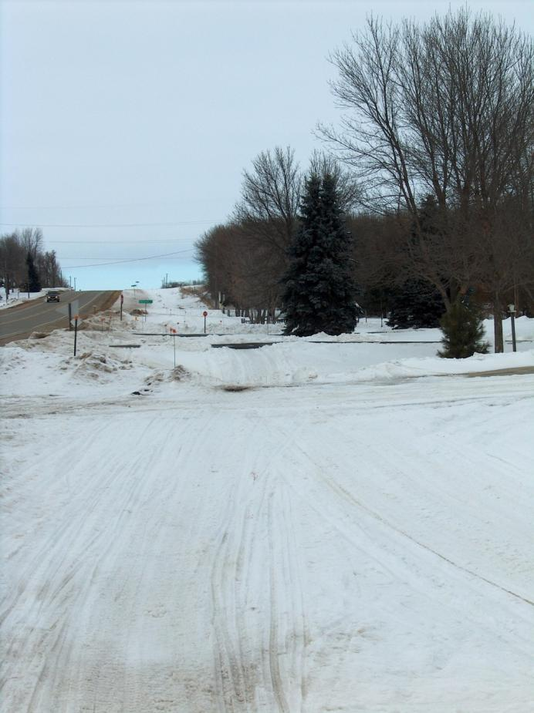
Anticipate Your Needs
Notes:
Trail located in a highway right-of-way. Lots of driveways – so use caution not to dump snow on private drives = very poor landowner relations. Other?

Slide 10
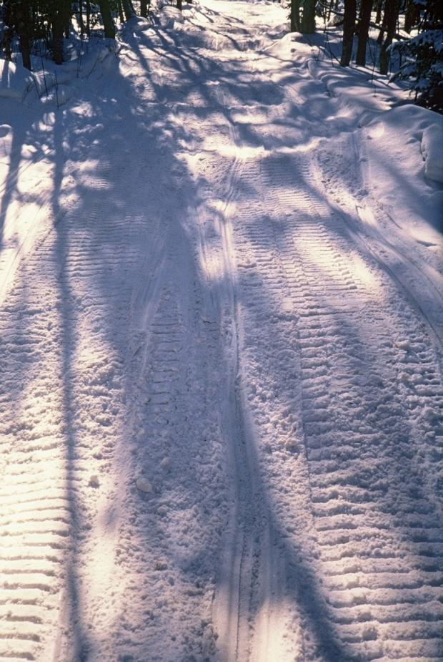
Anticipate Your Needs
Notes:
Shaded area in trees with heavy moguling due to constrained traffic. Be cautious of stumps as you search for snow on the outside edges of trail. Will need aggressive cutting to repair moguls. Other?

Slide 11
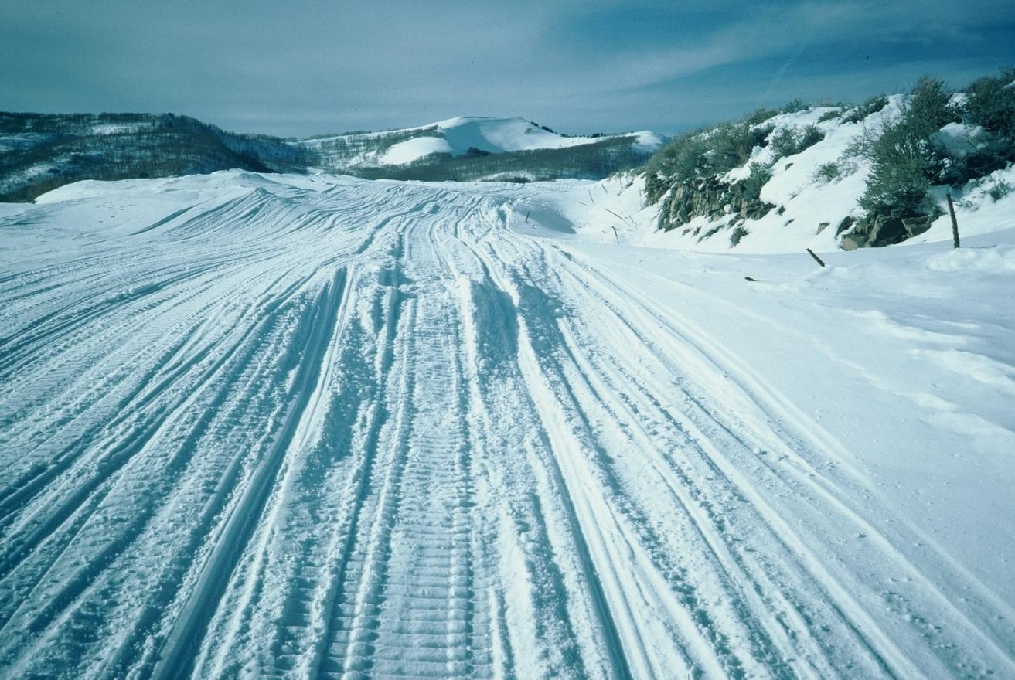
Anticipate Your Needs
Notes:
Deep snow with heavy drifting. Where is the trail route? Pick your route and keep the width within a maximum of two equipment widths. Will need to work drifts with front blade but must also be cautious about getting stuck from either getting off the compacted base and/or from cutting too deep if pulling a drag. Other?

Slide 12
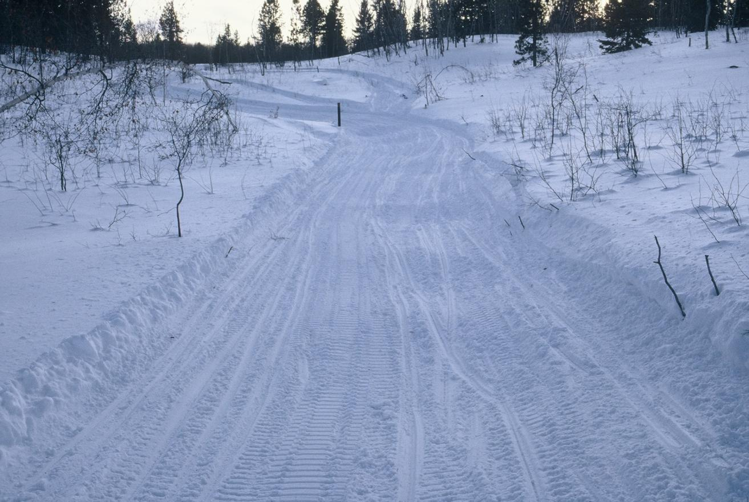
Anticipate Your Needs
Notes:
Heavy moguling through this aspen clear cut/re-growth area will need aggressive cutting. There is a high likelihood of stumps alongside the trail, so front blade work attempting to bring new snow in from the side may be dangerous. This trail segment would benefit from off-season stump removal to add width, as well as from straightening some of the curves. Other?

Slide 13
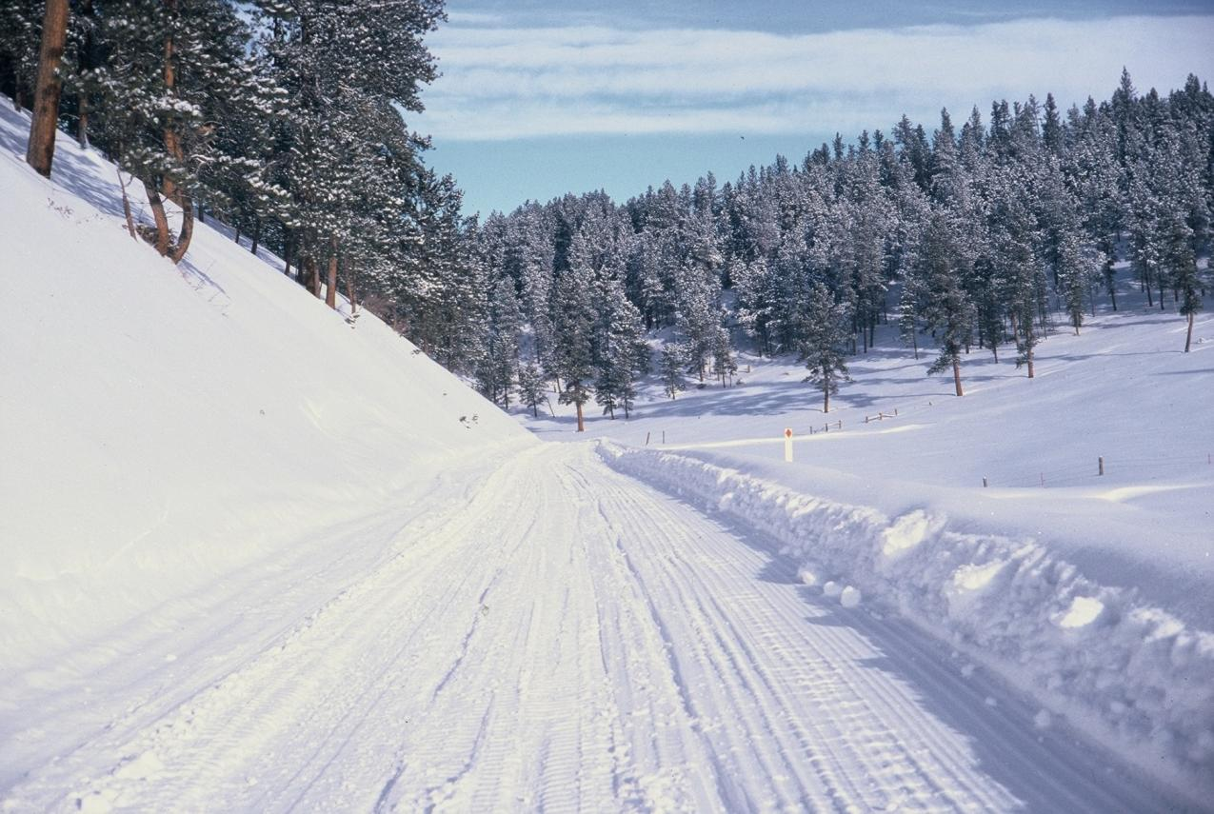
Anticipate Your Needs
Notes:
There appears to be a relatively well compacted base on this trail. However caution is always needed when grooming next to the upslope (left side of photo) cut-bank which is likely rocky and may also have stumps – so be careful when using a front blade (i.e., don’t groom where the sled tracks are at on the left side of the photo = likely a hazard area). There is also a large amount of snow “stored” on the right side of the trail – note the fairly significant windrow between the groomed surface and the white route marker. This snow could be moved onto the trail to widen it and to bring the trail away from the cut slope on the left. Other?

Slide 14
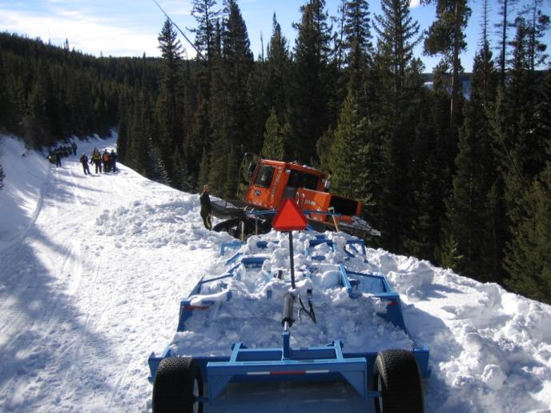
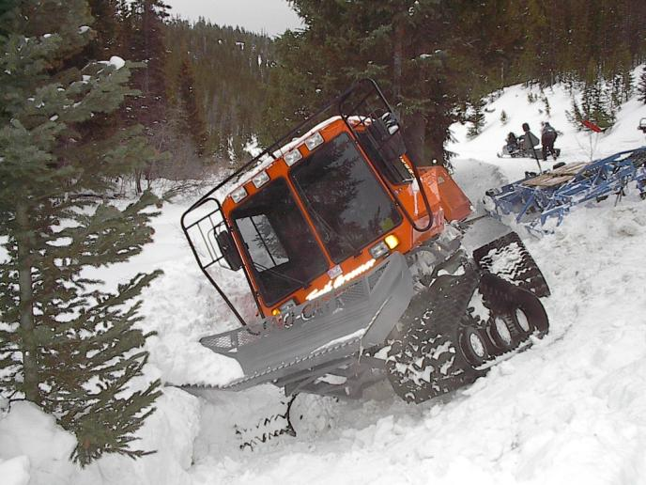
Critique This
Notes:
Left Photo: The tractor got off the compacted base and got into trouble. This occurred on a relatively straight open road – so why? Perhaps distraction? Note the large amount of snow (too much) in the drag – the operator likely got so consumed with trying to make the drag work properly that he forgot to pay attention to the trail in front of him. Other observations?
Right photo: What do you do? Shovel, unhook the drag, get the tractor level, rock it gently without spinning? Other?

Slide 15
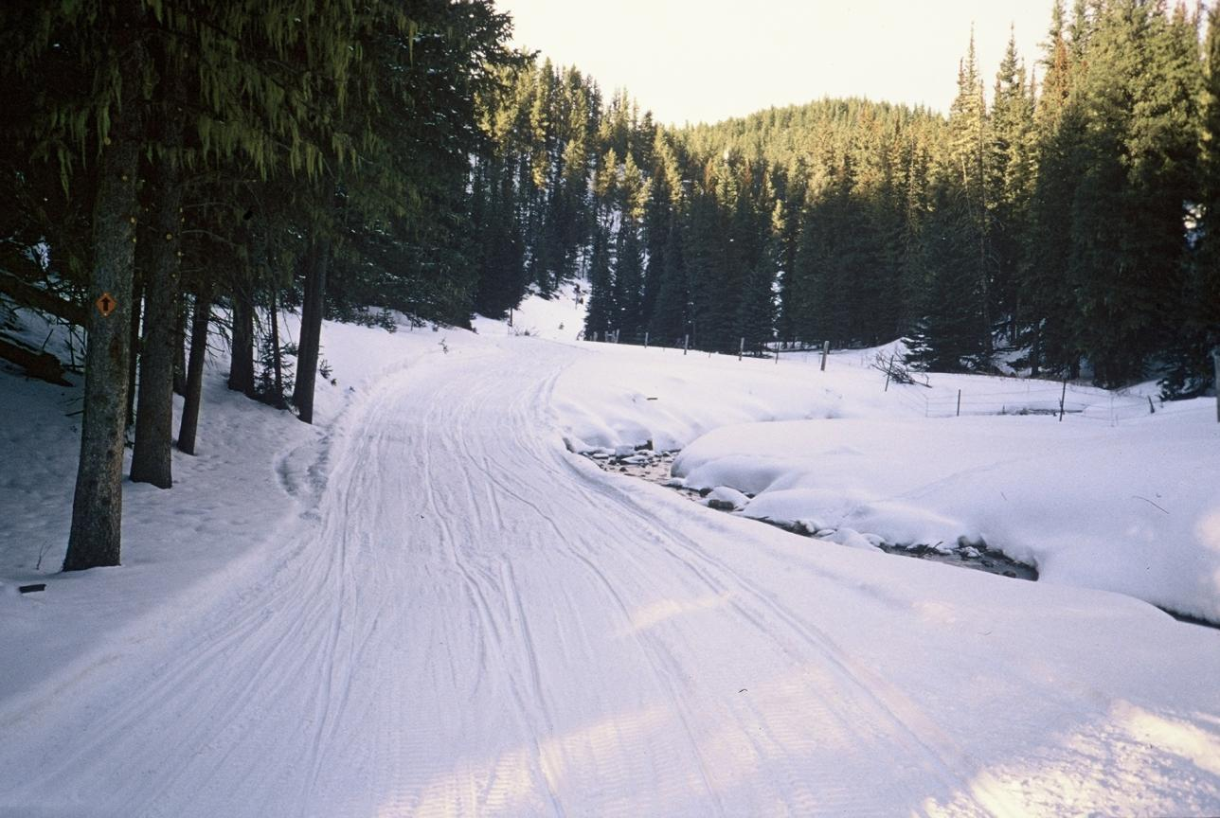
Anticipate Your Needs
Notes:
Trail next to the creek could be an issue all season long: could be a seepage area beneath the trail – so likely low snow conditions and potential for an ice flow, as well; width is restricted by the tree on one side and creek on the other – can try to widen somewhat into the creek – but the snow may or may not build an ice bridge. Try to carry snow each pass from each direction in an attempt to build a deep trail base above the creek. Other?

Slide 16
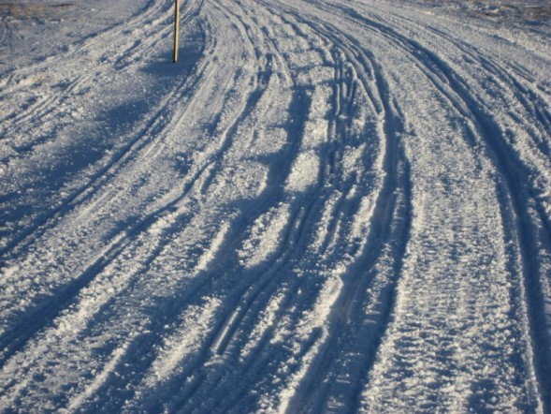
Anticipate Your Needs
Notes:
Heavy moguls on inside of curve. Not a lot of extra snow to work with, although there is a bit on the outside edge of the curve. Snow is soft and wet, so is likely very warm. Need cooler temps for proper processing and setup. Other?

Slide 17
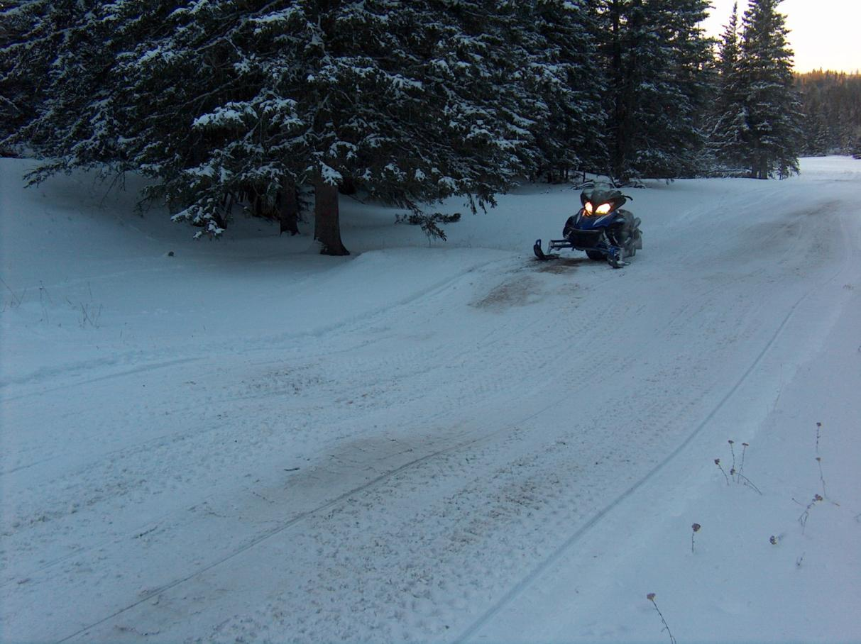
Anticipate Your Needs
Notes:
The drainage dip in front of the sled can be a pretty dramatic whoop-d-do at 40 or 50 mph – so you need to try to carry snow to help fill in the area. But since snow is thin (note all the brown snow) this may be difficult. Also need to be cautious about scalping the small mound where the snowmobile is parked. Other?

Slide 18
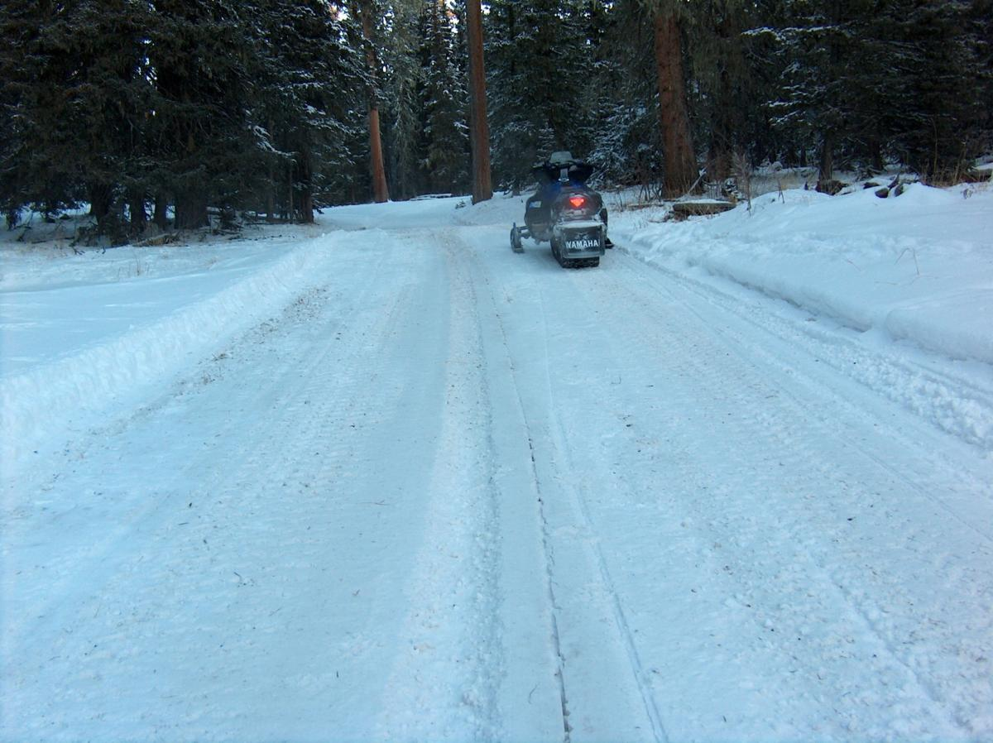
Critique This
Notes:
Note groove down the center of this trail. A rock was stuck under the drag’s blade, which created a furrow over a half-mile long before the operator noticed it. This groove can catch a snowmobile’s ski. It can also create a pocket of less dense snow in the trail unless the trail base is cut deep enough to remove its memory (It’s essentially a 4” deep longitudinal mogul that is ½ mile long). Other?

Slide 19
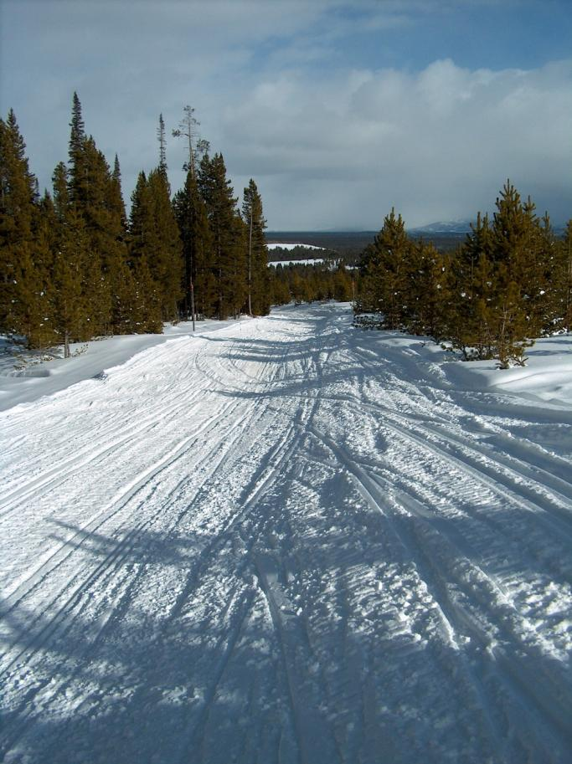
Anticipate Your Needs
Notes:
Note how the center of the trail has been dished out from high traffic in the center of the trail. Try to move snow to the middle using the front blade. Other?

Slide 20
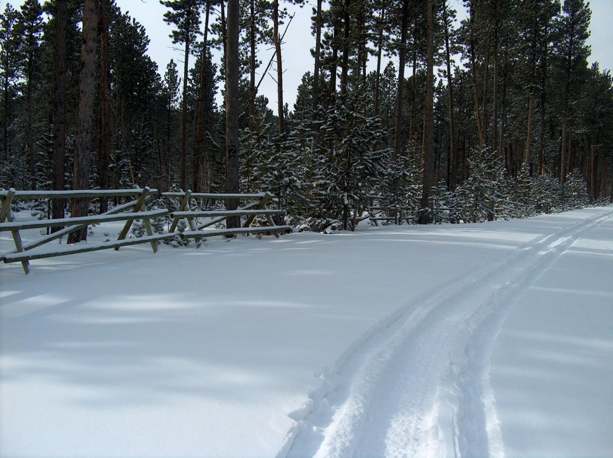
Anticipate Your Needs
Notes:
New snow to work with on a roadway: How deep is it – are there moguls underneath it – are you starting over? The roadway is wide – so you need to know where the trail’s compacted base is at – so be sure to contain your groomed width. If there aren’t moguls beneath, perhaps all you need to do is pan or should you still be working the blades to process the snow? Other?

Slide 21
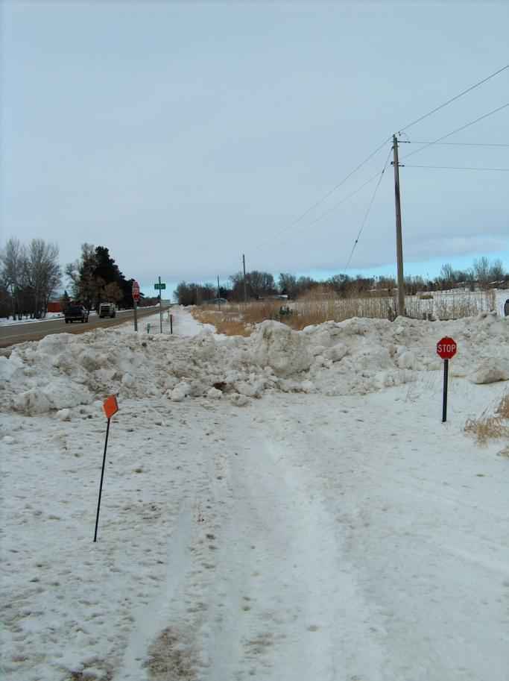
Anticipate Your Needs
Notes:
Trail is located in a highway right-of-way – the snow removal on the side road has created a large berm at the road crossing. Need to work the snow back from the road – using care not to dump snow on the roadway. Also try to keep snow banks low so there is not an issue with visibility for snowmobilers as they cross the road. Other?

Slide 22
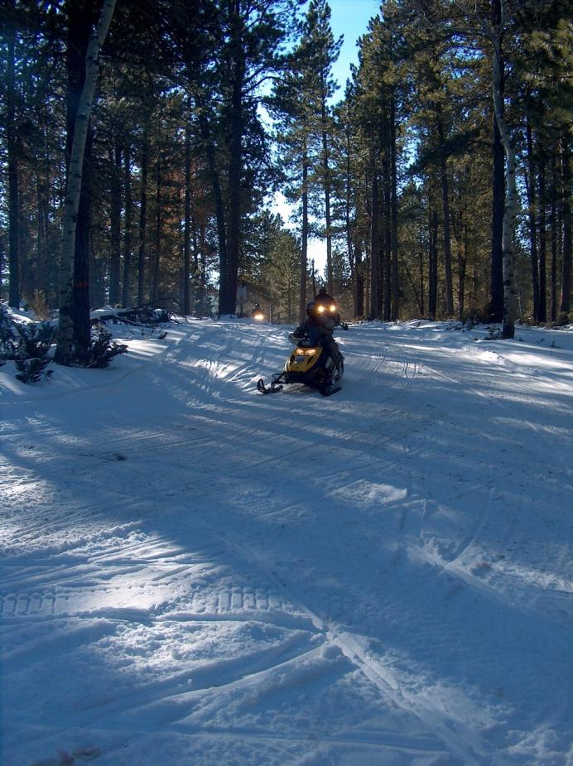
Anticipate Your Needs
Notes:
If you’re grooming during the day – need to watch for sled traffic. Snow conditions look to be low – so be cautious when working the implements. What should the groomed width be? Other?

Slide 23
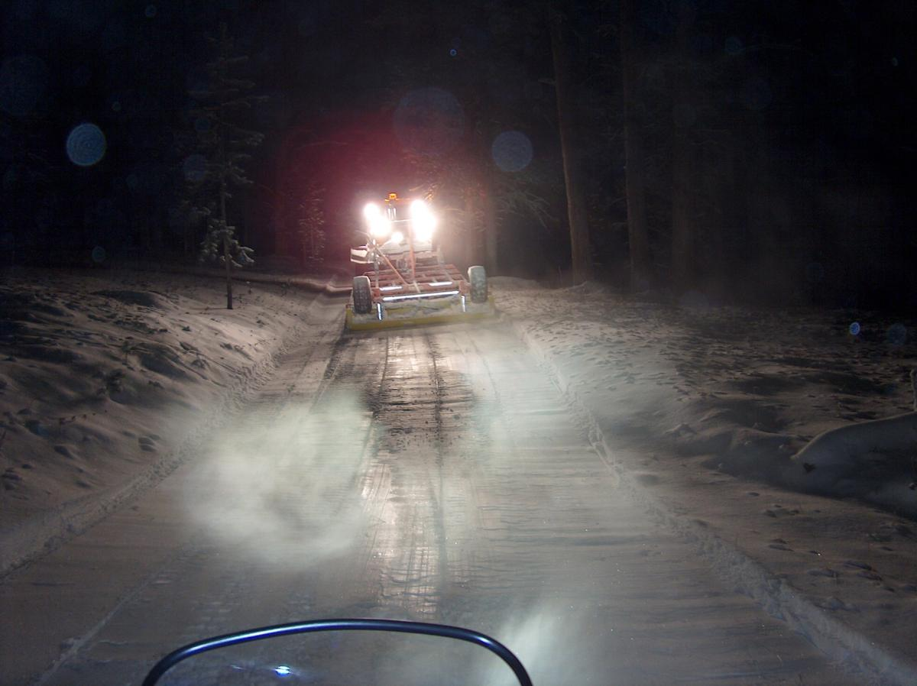
Critique This
Notes:
How is the finished product? Wide groove in middle of trail – not carrying enough snow? Ripples at right edge of freshly groomed surface = grooming too fast – drag is rocking back and forth. Night grooming with all lights and beacon on – but no SMV at rear of the drag. Other?

Slide 24
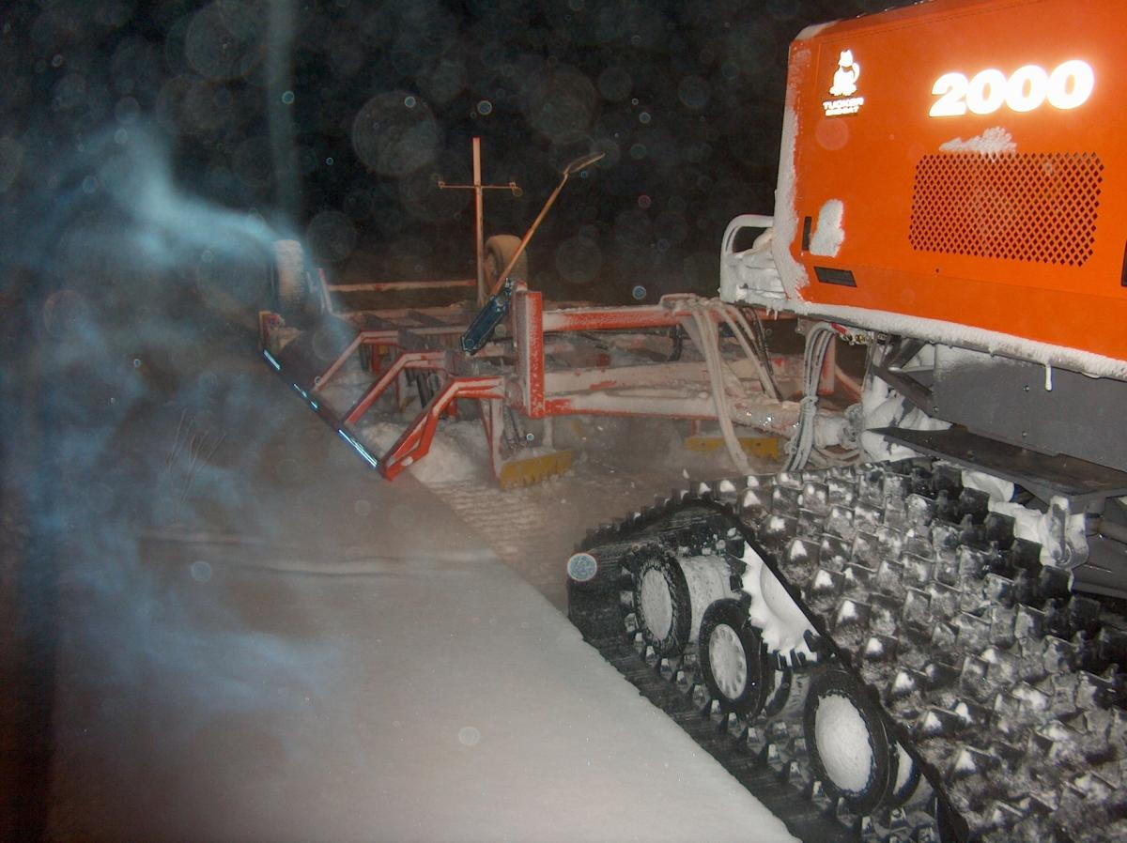
Critique This
Notes:
Can see between the tracks and the drag that the ungroomed trail is relatively smooth. So the front set of the drag blades are raised, so as to not cut too deep. The rear sets of blades seem to be working well and are processing snow, which should help increase the depth of the trail’s compacted base. Other observations?

Slide 25
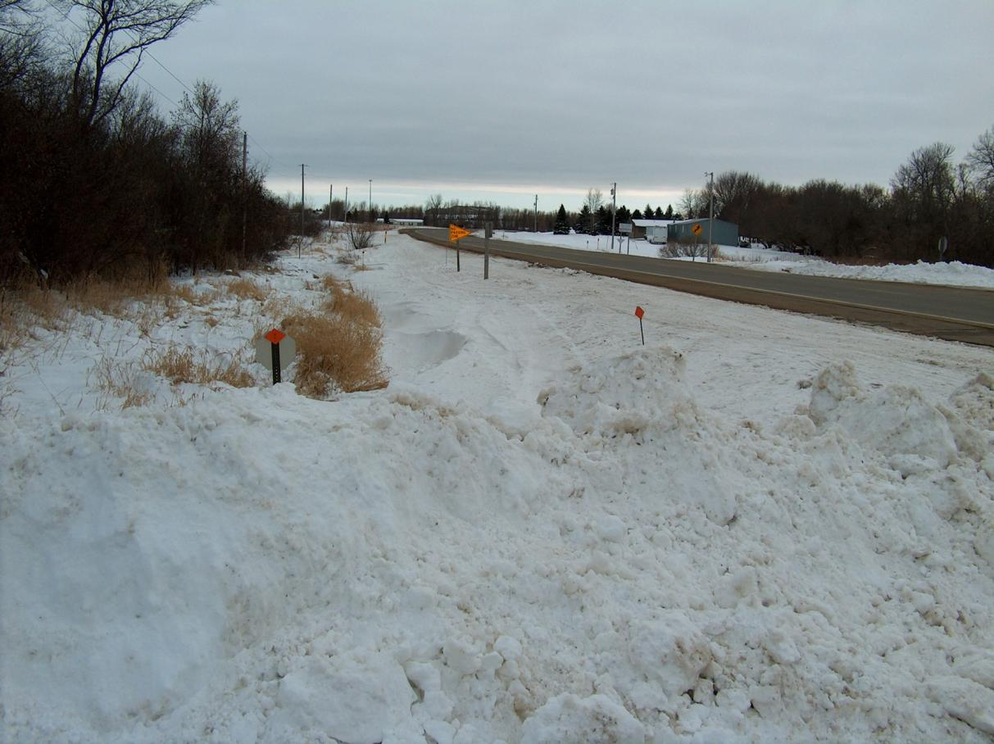
Anticipate Your Needs
Notes:
Trail located in a road right-of-way. Likely to be deep spots from drifting and snowplows. Also need to be aware of culverts and other hazards like utility boxes or buried road signs, delineator posts, etc. Other?

Slide 26
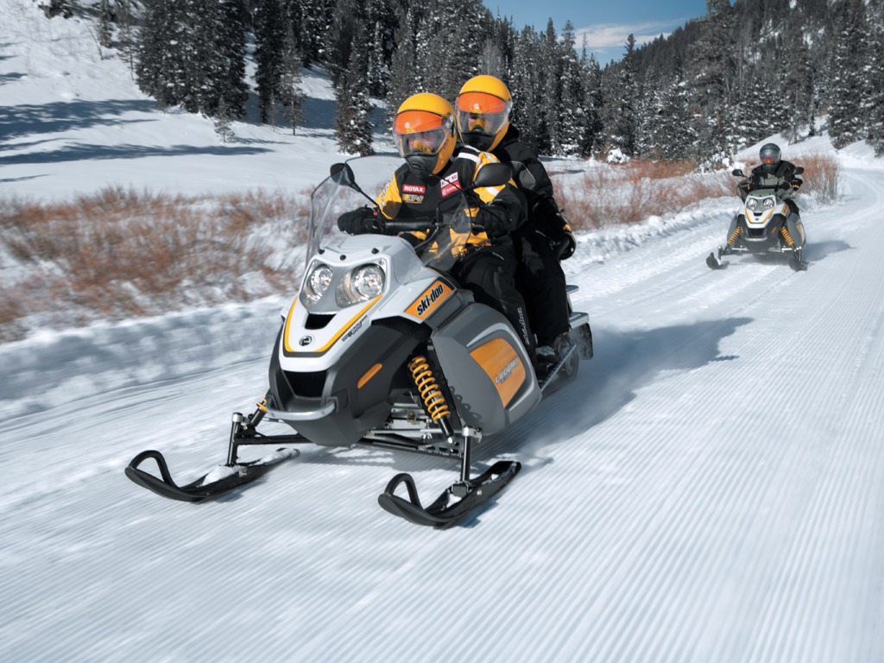
Critique This
Notes:
Very good trail setup. Ski skags and track are leaving only a very light mark on the trail’s surface. Other?

Slide 27
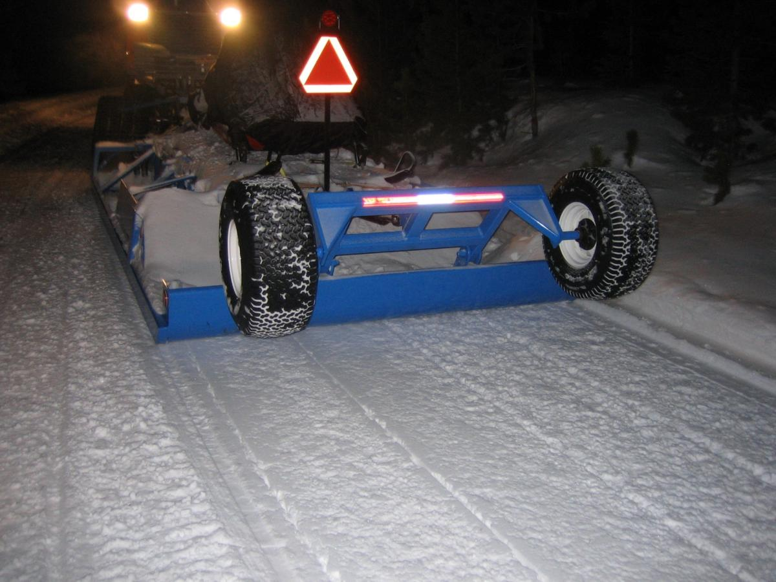
Critique This
Notes:
How is the finished product? What do you think the temperature is and how is it affecting the processing of the snow? (It’s warm and the snow is sticking.) Other?

Slide 28
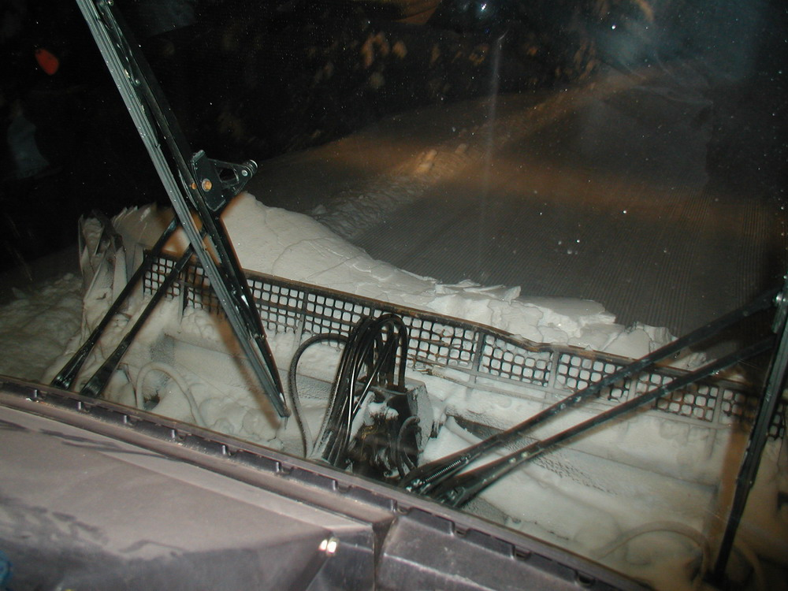
Critique This
Notes:
View from the operator’s seat inside the cab of the tractor – looking at the front blade at work. Note that the snow above the blade screen is rolling/curling over forward – which is good, particularly if tilling, since this helps to process the snow (versus having it just plowing ahead and only spilling out the sides. Other observations?

Slide 29
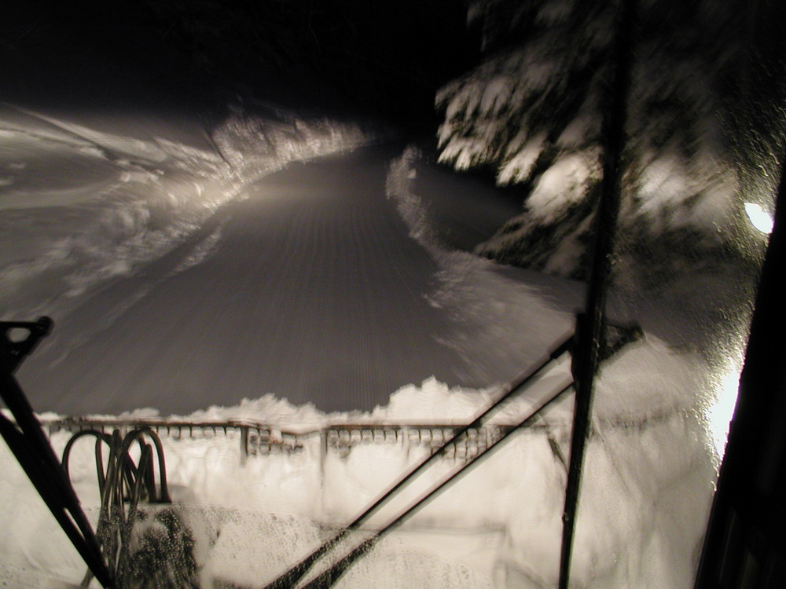
Anticipate Your Needs
Notes:
Note that the trail has been freshly groomed – so this is a return trip/second pass. You should be trying to widen the trail versus just going back in the same track. Know the trail and control the width. Which side are you going to work? (Always the right side…) Other?

Slide 30
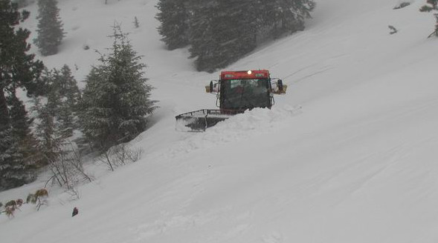
Anticipate Your Needs
Notes:
The trail has been covered by severe wind drifting. Proceed slowly – ensure you’re on the compacted sub-base. Use the blade to lay a path in front of you that will support the tractor. Always beware of avalanche potential above you. Be cautious about dropping off the low side – but also beware of hazards like rocks buried on the upslope side. Other?

Slide 31
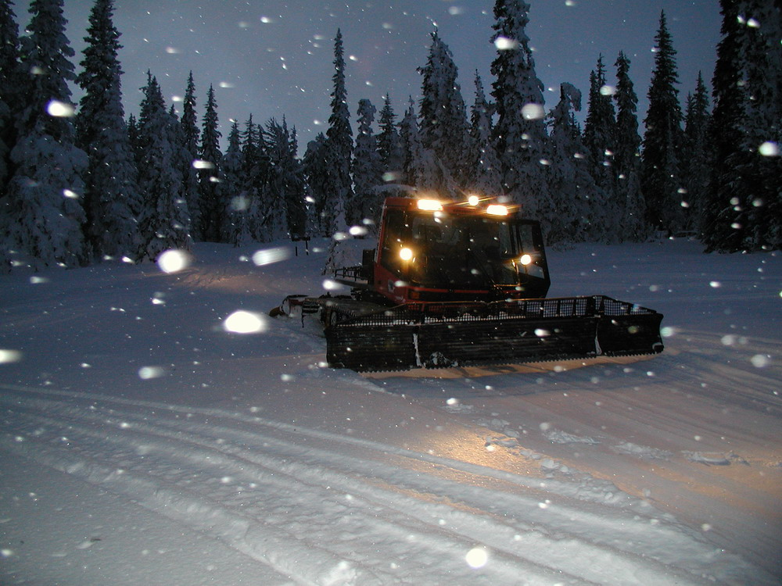
Anticipate Your Needs
Notes:
Note the finished surface in front of the tractor – so this is a return trip. Note the footprints in the groomed surface – how is the compaction from the first pass? (footprints are fairly deep – so not great) Check the equipment settings to try to improve compaction and setup. Other?

Slide 32
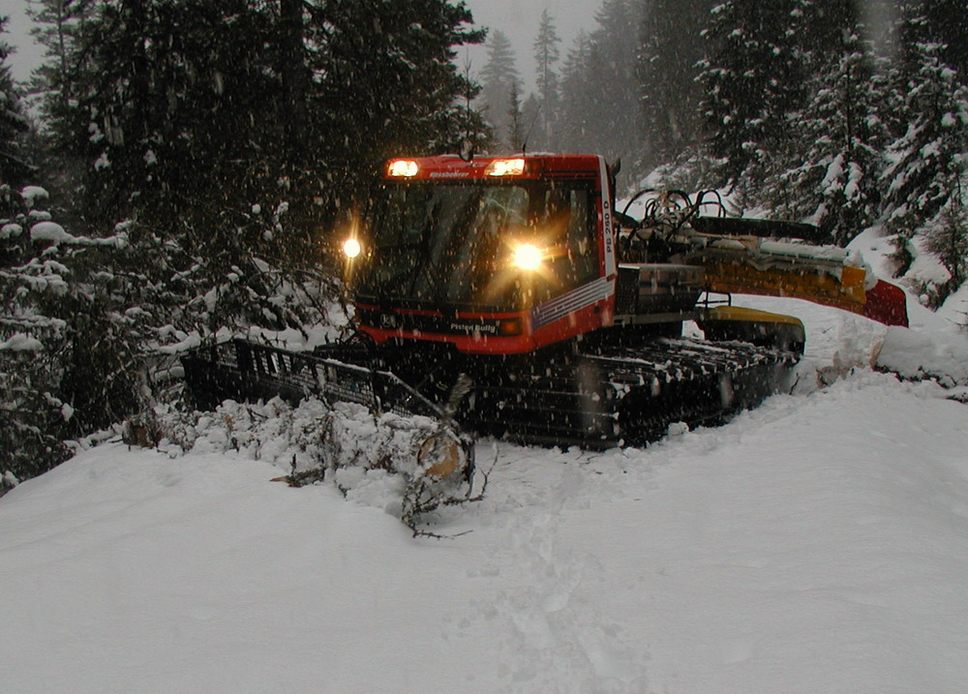
Critique This
Notes:
The front blade should never be used as a bulldozer. If you need to use the front blade to push downed trees off the trail – first cut the tree up into manageable pieces that won’t over-stress the tractor’s blade. Be sure to push the tree far enough off the trail so it is not a hazard. Also be extremely cautious while maneuvering the tractor. Other?

Slide 33
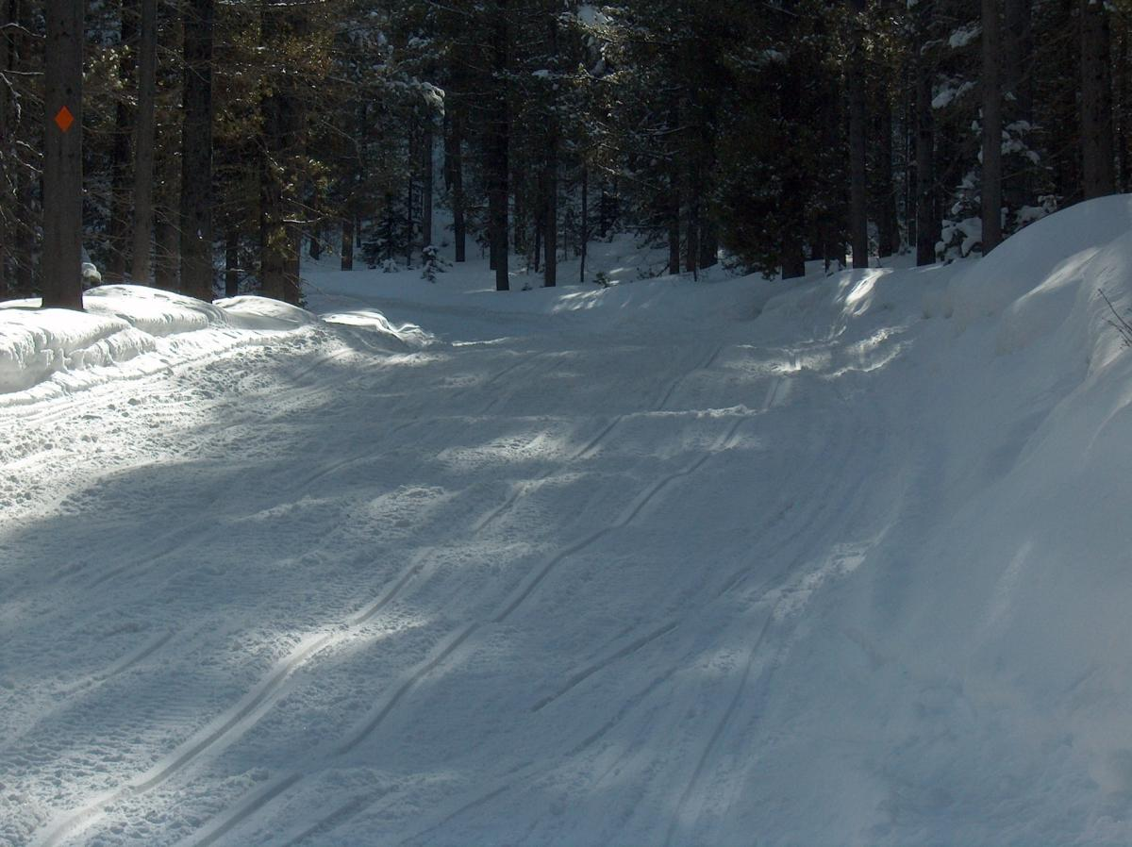
Anticipate Your Needs
Notes:
Beware of on-coming traffic around curve. Inside (left) of curve is dished out and outside (right) has been sloped up. Cut the moguls away. Move snow from outside to inside. Other?

Slide 34
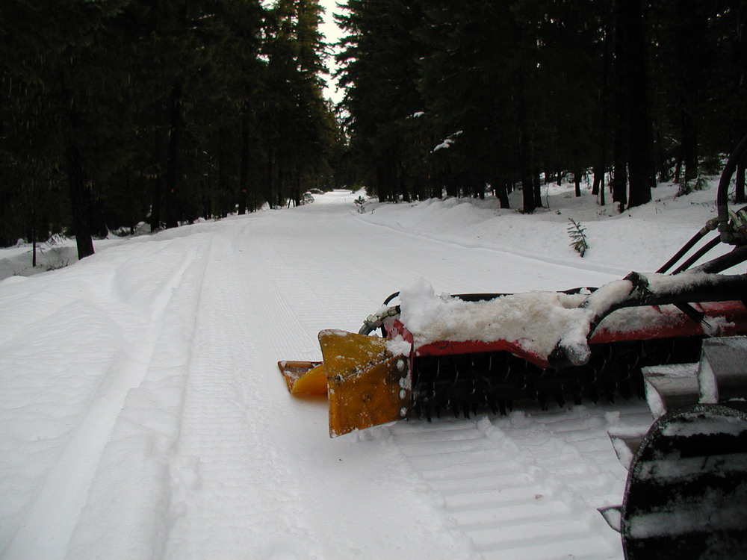
Critique This
Notes:
How is the finished product? It appears to be a return trip since the trail to the left of the tiller is also smooth. The groomer appears to be working the middle of the trail – is that the right place to be in this circumstance? Other?

Slide 35
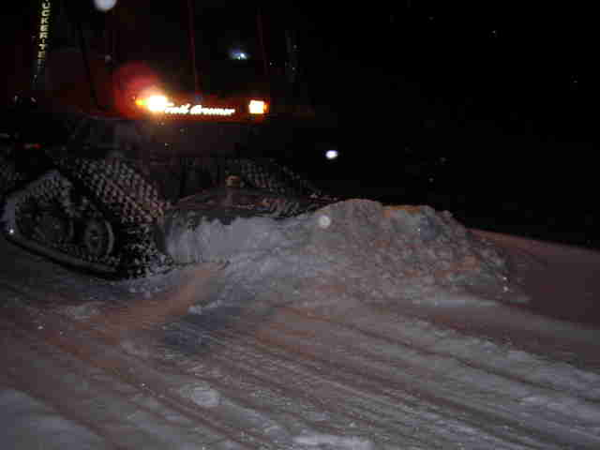
Critique This
Notes:
Is the blade being used properly (tilted downward to dig outside edge) to bring new snow into the trail? The tractor is operating on the wrong side of the trail = no. Other?

Slide 36
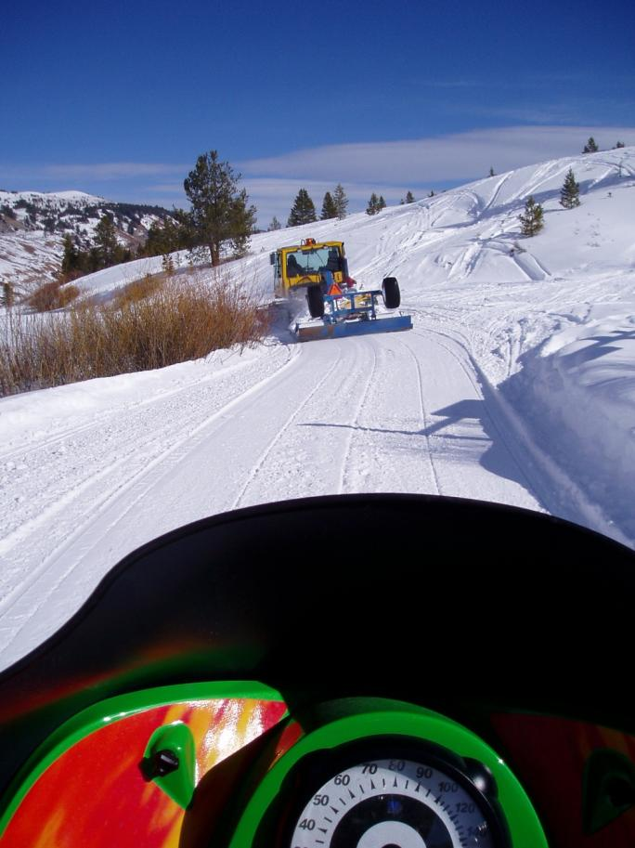
Critique This
Notes:
Daytime grooming (often not the optimum time): no lights or warning beacon on. How is the product? What about the route the groomer is taking into the curve? Appears to be grooming the middle of the trail – should they be trying to widen the trail? Other?

Slide 37
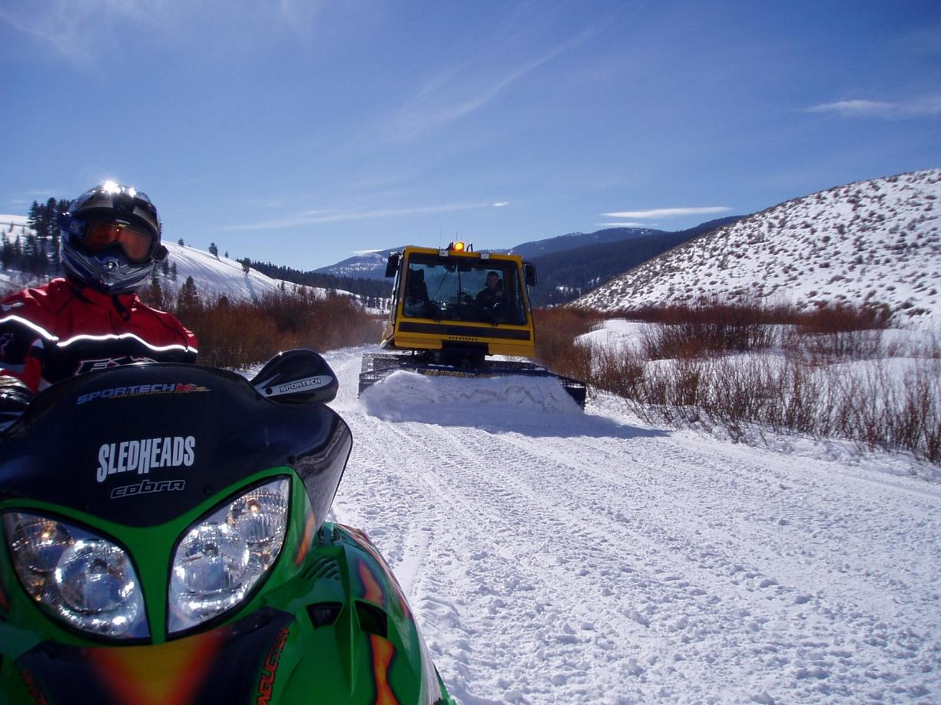
Critique This
Notes:
Daytime grooming without lights or warning beacon on. “Grooming” a smooth trail with the front blade (while also pulling a drag) = poor/over-use of a front blade – let the drag do the work. Other?

Slide 38
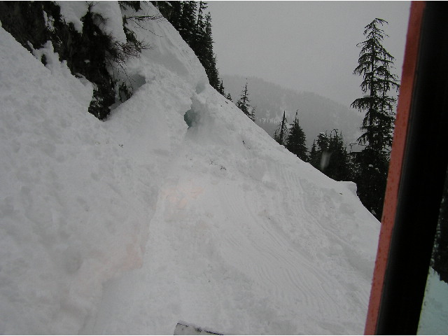
Anticipate Your Needs
Notes:
A slide area across the trail: first, be certain the snow above is stable enough for you to be working below. Proceed slowly and cautiously using the front blade to build a stable platform for the groomer. Try to widen the bench for the trail route as you proceed. Other?

Slide 39
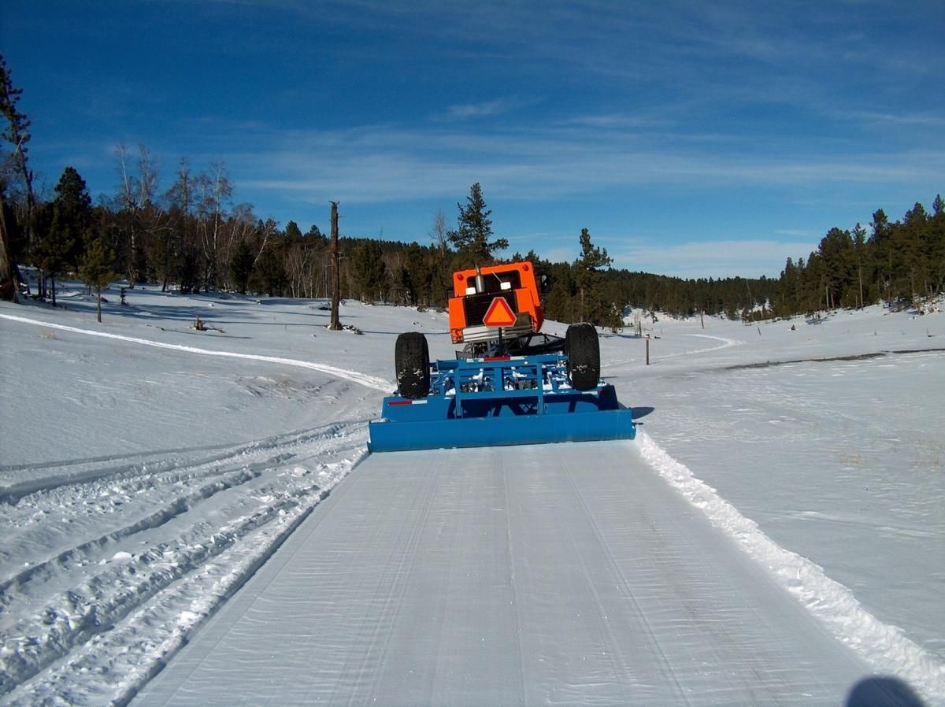
Critique This
Notes:
Good product in spite of low snow conditions = slow down so the drag has time to work the little snow there is to work with. Other?

Slide 40
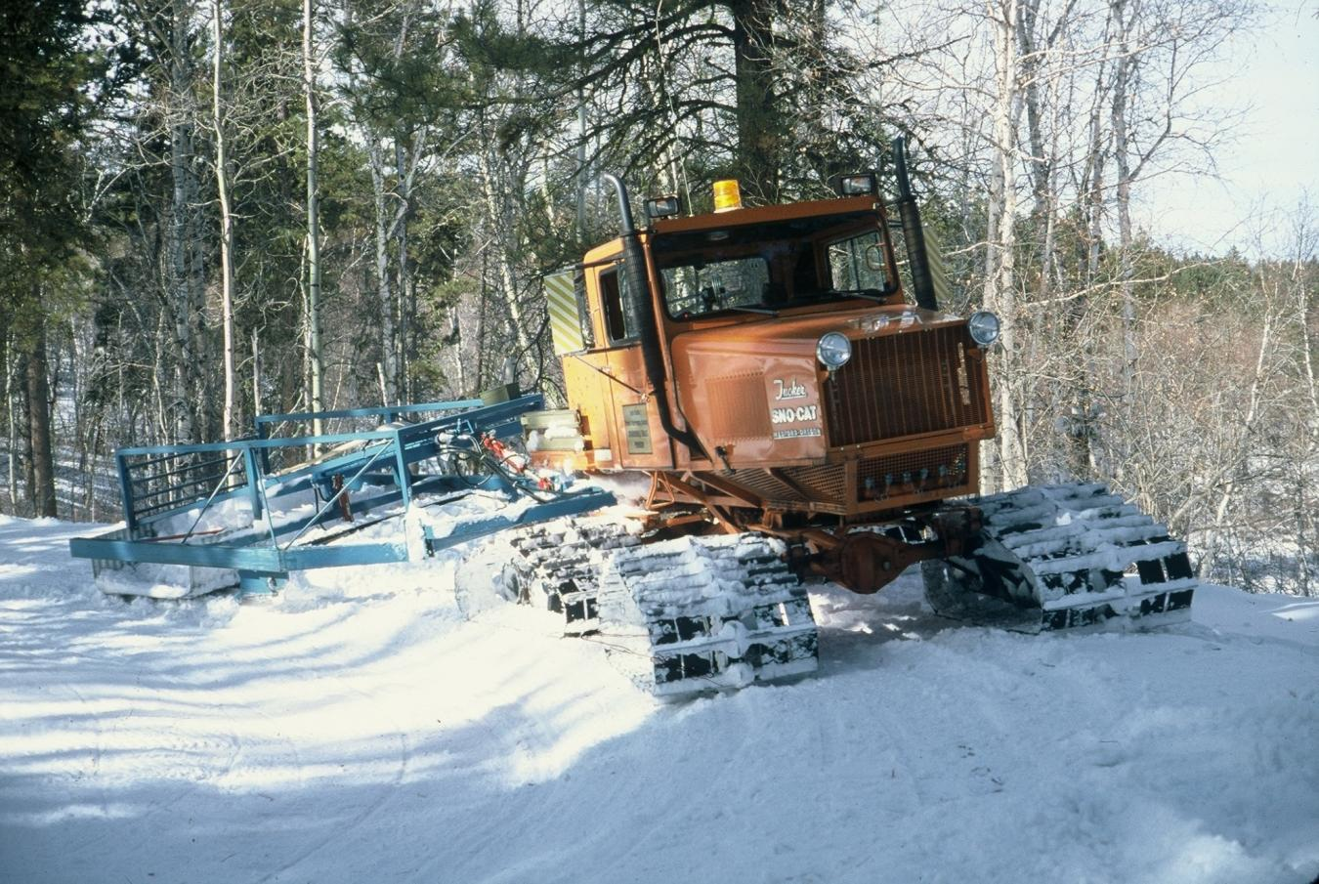
Critique This
Notes:
Working against traffic on the wrong side of the trail. Also high on the outside berm of the curve = high potential to get high-centered/stuck. A disadvantage not having a front blade on the tractor. Daytime operation – so lights and beacon should be on. Other?

Slide 41
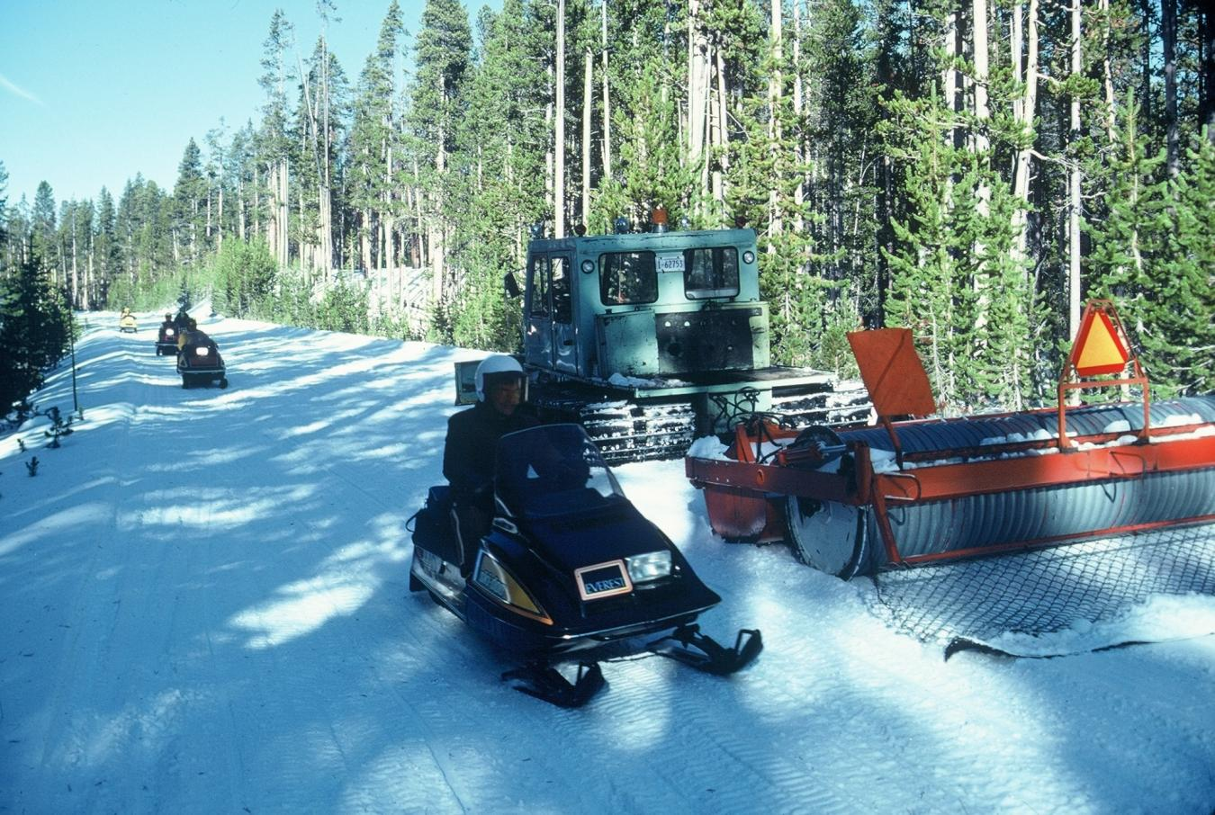
Critique This
Notes:
An oldie but goodie. Principles still very similar. Other?

Slide 42
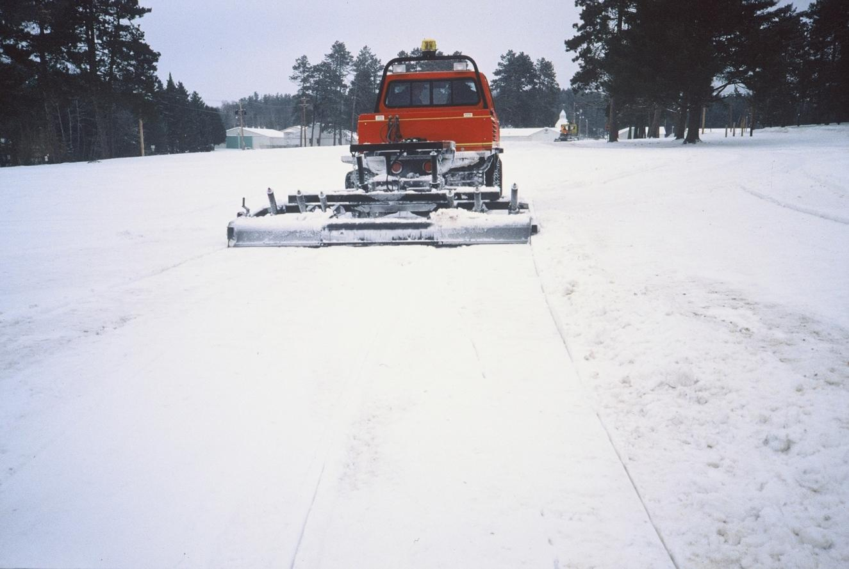
Critique This
Notes:
How is the finished product? Fold-up drag like on the Track Truck can do a good job – if you take the time to do it right. Other?

Slide 43
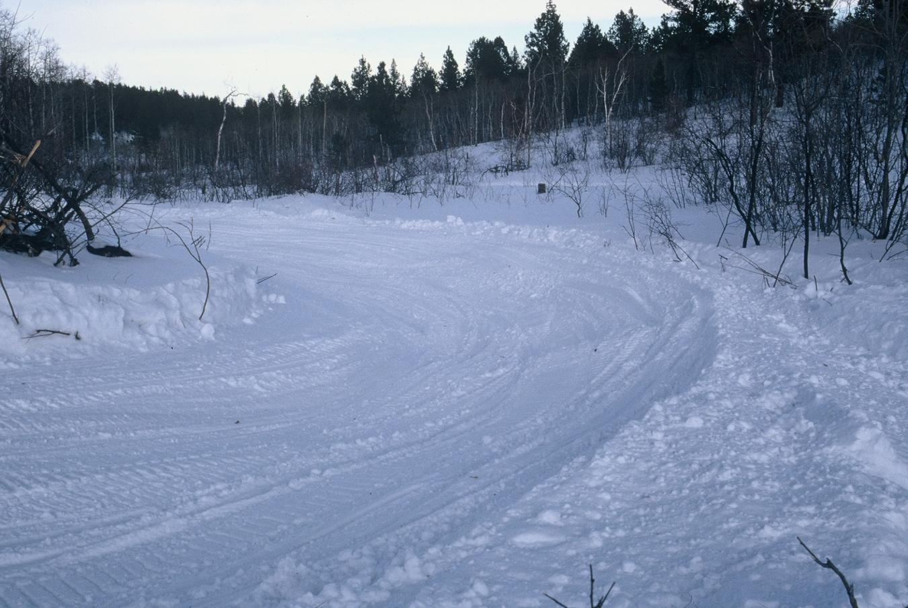
Anticipate Your Needs
Notes:
Low snow in bottom and high berm on outside: Be cautious of traffic coming around the curve; try to use front blade to work snow into bottom; don’t get too high on outside berm or may get stuck. Other?

Slide 44
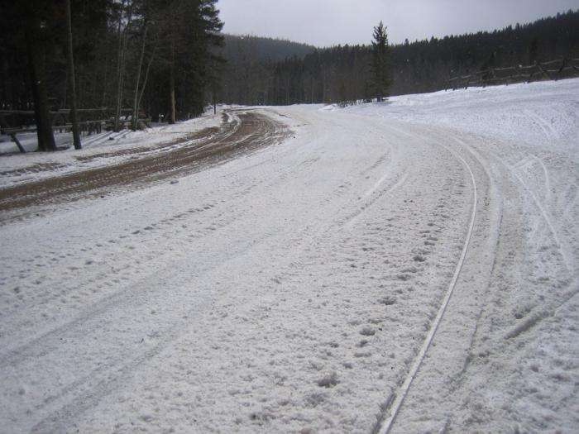
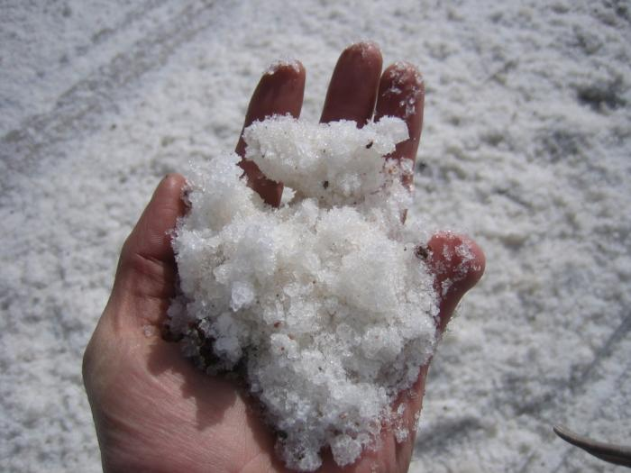
Anticipate Your Needs
Notes:
Wet snow: what do you do? Pan? Stay home? Wait for weather to change? Night Groom? Other?

Slide 45
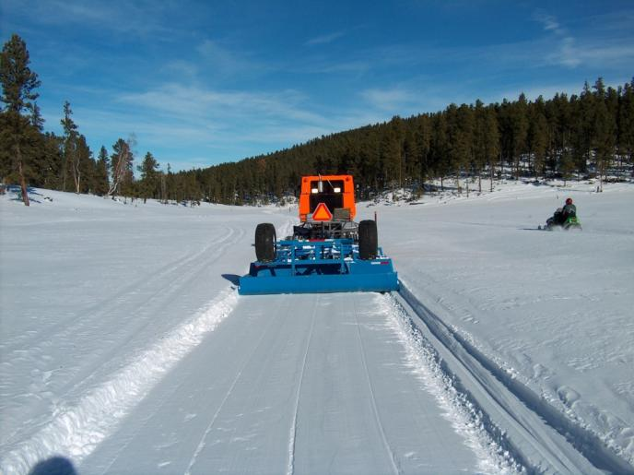
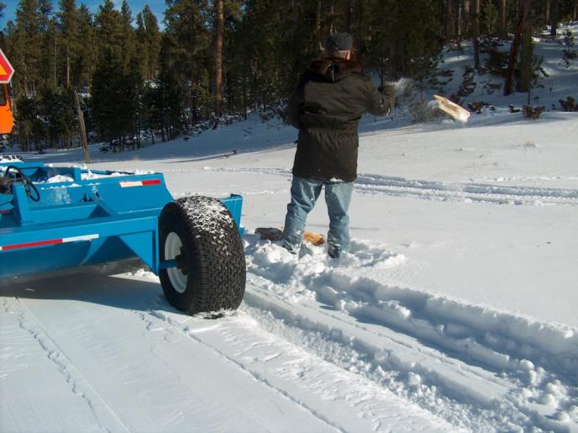
Critique This
Notes:
Rut on right side of groomed surface caused by pieces of wood being caught under the blade and pan. Operator went nearly a mile before they noticed. This rut can be a hazard for sleds and also can cause a less dense spot in the trail if it is not cut completely away the next time the trail is groomed. Otherwise, a good trail. Daytime grooming without lights and beacon on. Other observations?

Slide 46
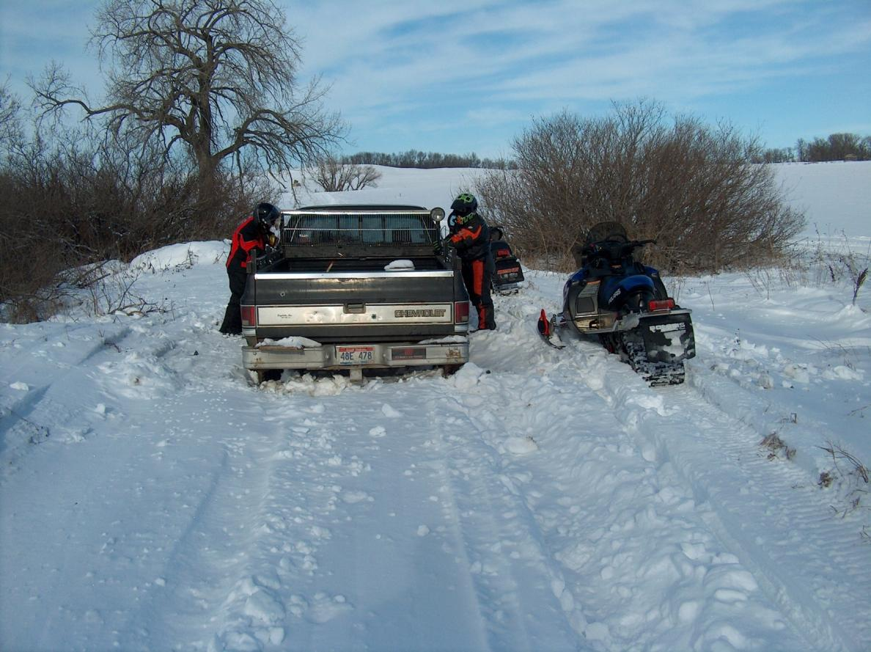
Anticipate Your Needs
Notes:
A vehicle stuck on a groomed trail – in some areas this happens too often. Need to get the vehicle removed, need to repair the tire ruts (sometimes for a very long distance, need to place barrier or signs if this is a recurring problem. Other?

Slide 47
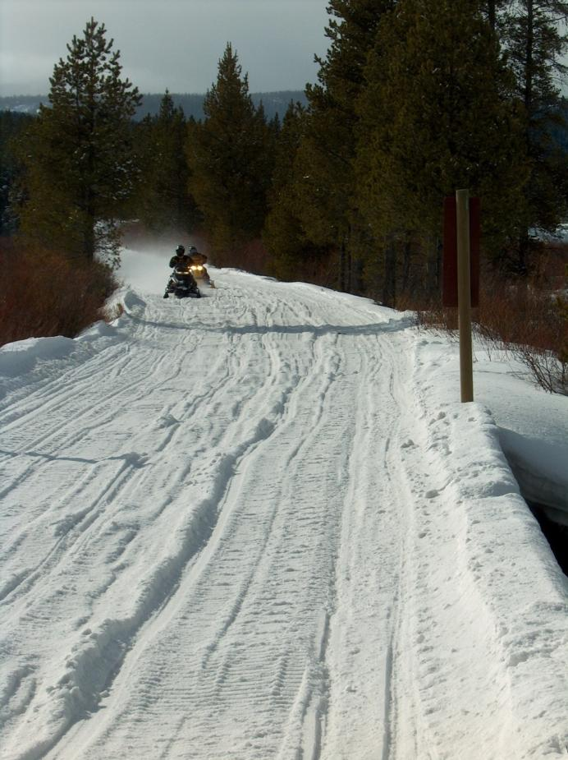
Anticipate Your Needs
Notes:
Extreme moguling. Needs aggressive processing. Bridge in foreground contributes to a width restriction. Moisture content of snow is poor and much of it is worn out from consistent high traffic. Other?

Slide 48
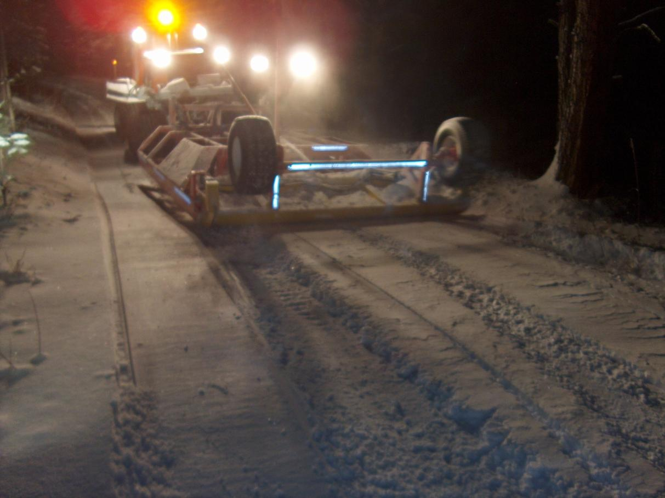
Critique This
Notes:
How is the finished product? Drag not carrying enough snow = leaving groove in the middle and wide gap on left side of drag. Drag could also be plugged with a rock or tree branch in rear blades or partially under the pan. No SMV on the rear of drag. Other observations?

Slide 49

Anticipate Your Needs
Notes:
Heavy moguling in curve. Unusual in that outside (right) of curve is dished and the inside (left) has sloped upward from the traffic – most likely because of drifting in an open area. Work to flatten the curve back out. Other?

Slide 50

Critique This
Notes:
How is the finished product? Should there be ripples/grooves or should the tiller’s depth be adjusted for a flatter finish? Other?

Slide 51

Critique This
Notes:
Note that the drag is over-full – which means it cannot operate properly. This can also result in getting the tractor stuck if the drag is not raised. Other?

Slide 52

Critique This
Notes:
Note the humps in the finished surface. The operator needs to resist making sudden changes in the tiller’s settings, as well as sudden changes in the direction of travel. Other?

Slide 53

Critique This
Notes:
How is the finished product? Are the slight grooves in the trail the desired product, or should the tiller’s depth be adjusted? Other?

Slide 54

Anticipate Your Needs
Notes:
Heavy moguls in center of trail; limited snow depth to work, but a little extra at outside edge of the trail. Appears to be warm, so the snow is soft and will likely not setup well unless the temperature drops. Other?

Slide 55

Anticipate Your Needs
Notes:
Trail in a road right-of-way immediately adjacent to the highway – and immediately in the person’s front yard = very sensitive situation: they need a place to put their snow (right side) yet there needs to be a safe passage for snowmobiles. Need to work hard at keeping snow pulled back (even though sometimes the landowner may intentionally keep trying to plug the trail…) Must stay at it to try to keep trail route safe as well as try to be sensitive to landowner’s needs. Other?

Slide 56

Critique This
Notes:
Don’t drag snow onto highway – wheels on drag should be down. Wheels also help protect drag blades and pan from being drug on the asphalt. Other?

Slide 57

Critique This
Notes:
How’s the finished product? Drag is just skimming since the surface is already relatively smooth. Other?

Slide 58

Critique This
Notes:
Relatively smooth trail (no moguls inside of drag) so the drag is in the pan position. Should the groomer be out working? Other?

Slide 59

Anticipate Your Needs
Notes:
Heavy moguls: Will require aggressive cutting with blades, possibly a double pass to help restore smooth trail base. Night grooming in this high traffic area is essential to aid setup time. Other?

Slide 60

Anticipate Your Needs
Notes:
Fresh snowfall, so lots of new snow to work with on trail and along the edge of the trail. Appears to be good moisture content in the new snow, so it should be a good situation for building/increasing trail base. Other?

Slide 61
“Anticipate Your Needs and Critique This”
Supplemental Training Program Group Discussion Slides
Photo Credits
Jerry Burr
Kim Raap – Trails Work Consulting
Mike Yonkman
Ski Doo
Steve Janes – SnoWest
Wyoming Recreation Commission
Wyoming State Trails Program
Yamaha
Project Manager
Kim Raap – Trails Work Consulting
4015 S. Brady Court – Sioux Falls, SD 57103
(605) 371-9799 Trailswork@aol.com
Contact IASA at www.snowiasa.org

